Slide 1

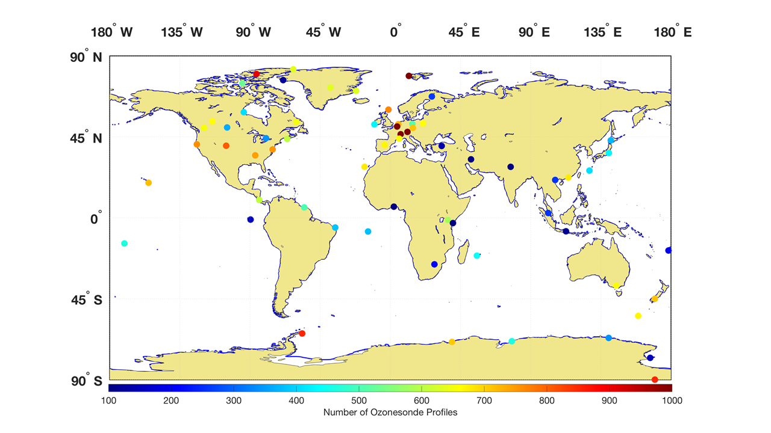









ASOPOS-Webinar Series on the Implementation of the Recommendations Made by the ASOPOS 2.0 Panel
Ozonesonde Measurement Principles and Best Operational Practices
ASOPOS 2.0 (GAW Report No. 268)
(Assessment of Standard Operating Procedures for Ozonesondes)
ASOPOS-Webinar No. 1
Introduction to ASOPOS 2.0: An Overview
Anne Thompson ⁽¹⁾, Herman Smit ⁽²⁾
(¹) anne.m.thompson@nasa.gov
(²) h.smit@fz-juelich.de
Version March 2024

Slide 2
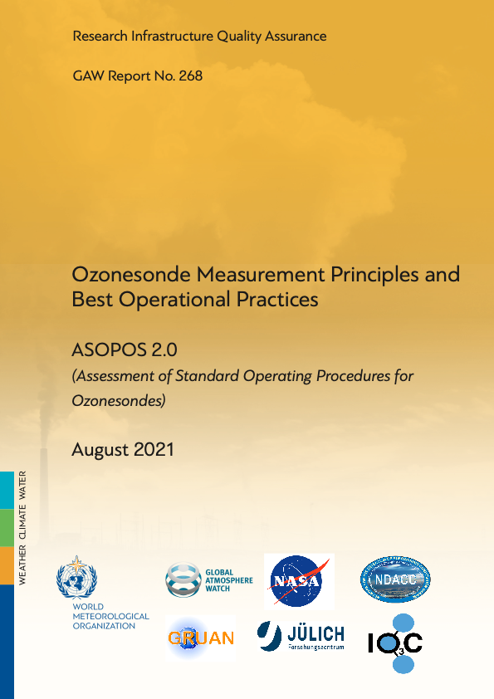
Preamble – ASOPOS 2.0 Introduction
The ASOPOS 2.0 Report builds on an earlier ASOPOS 1.0 (GAW Report No. 201, 2014). Adoption of the 2014 SOP by many global ozonesonde stations proved that uniform practices increase QA of the sounding data. From ~15% uncertainty in sonde data 20 years ago, the first ASOPOS improved that value to 5-10%. ASOPOS 2.0 aims for 5% or better uncertainty.
Thus, ASOPOS 2.0 Report (WMO/GAW Report No. 268) updates GAW 201, describing (1) the ECC-Ozonesonde instrument, (2) more detailed recommendations for sonde operation “best practices” and (3) data processing. The latter adds specification of uncertainties and traceability of the final ozone concentration to a single world reference.
Note! ASOPOS Webinars only explain the most crucial and critical aspects of the ECC SOP. Sonde operators and data providers are referred to WMO/GAW Report 268 for step by step details.
Available at https://library.wmo.int
GAW-Report No. 268
https://library.wmo.int/index.php?lvl=notice_display&id=21986#.Y2px6uTMJc8

Slide 3

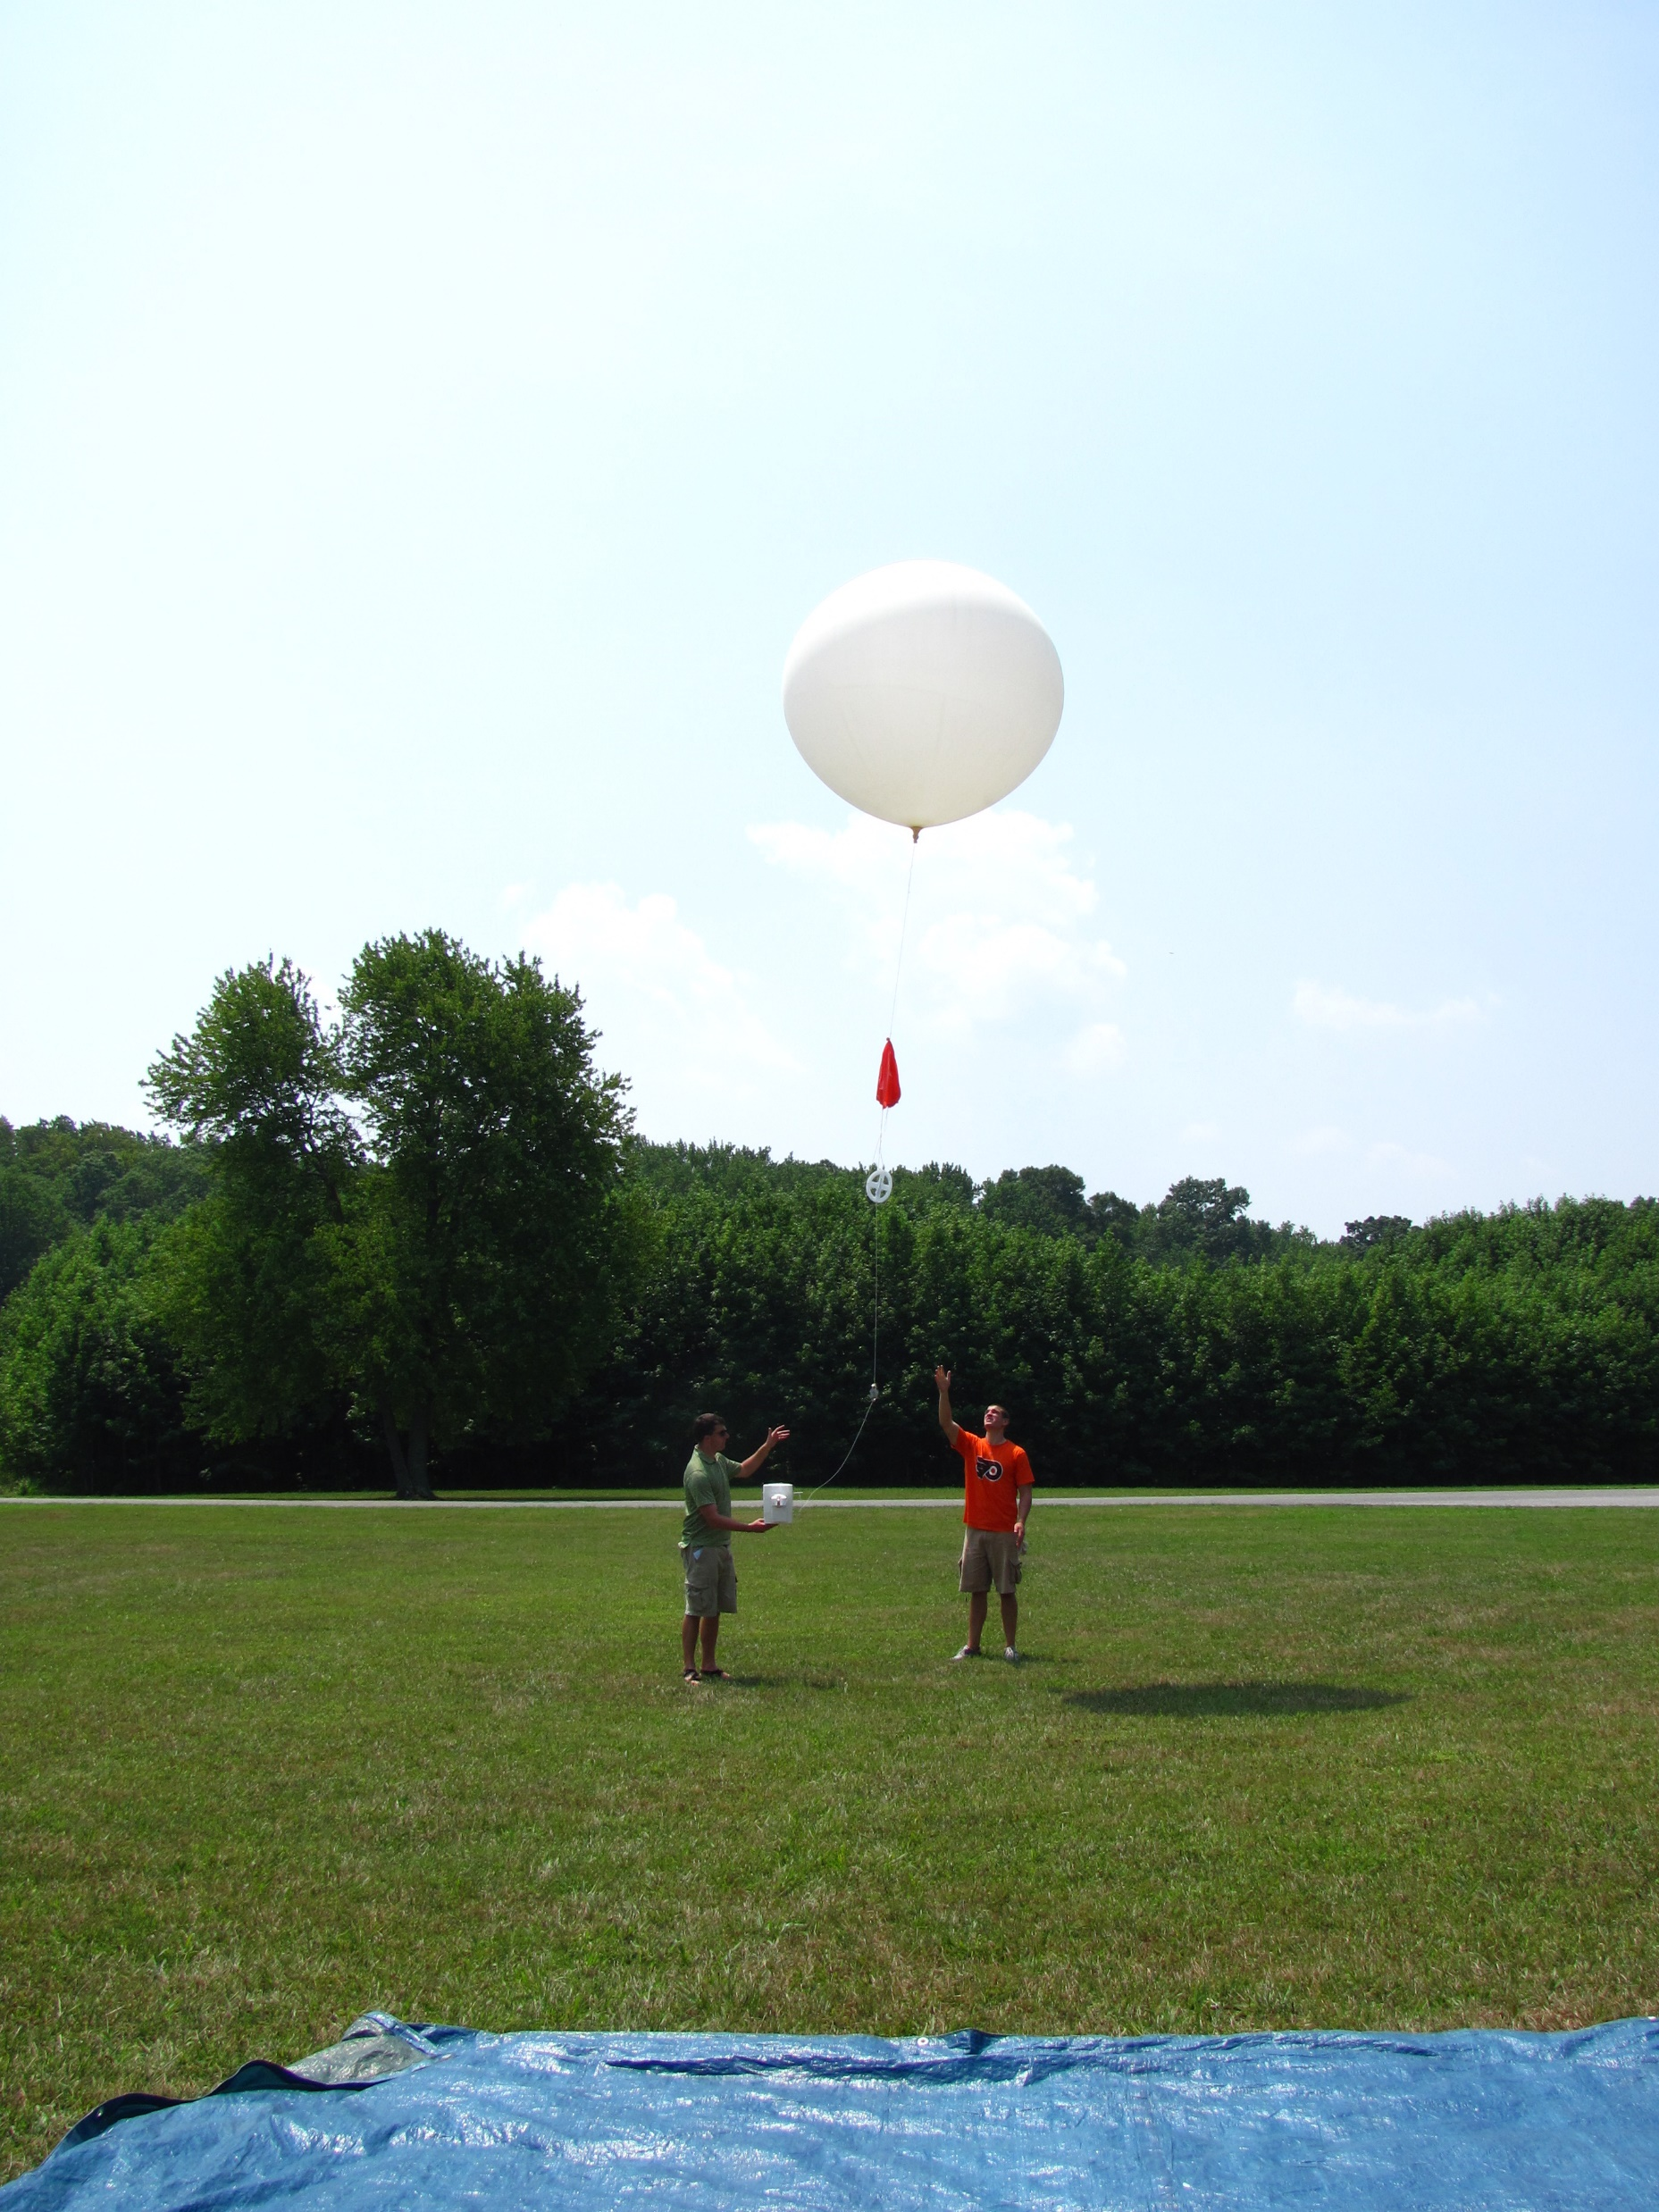
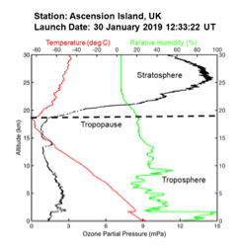
Webinar #1 Outline
Ozonesonde Instrument, Quality Assurance (QA)
Ozonesonde Data Uses, ASOPOS Background
- QA Elements: WCCOS, JOSIE, ASOPOS
- Success of Prior ASOPOS & Homogenization
- ASOPOS 2.0 Foundation & Related Studies
WMO/GAW Report No. 268, August 2021
Recommended Operations & Data Archiving
Implementing Recommendations Globally

Slide 4
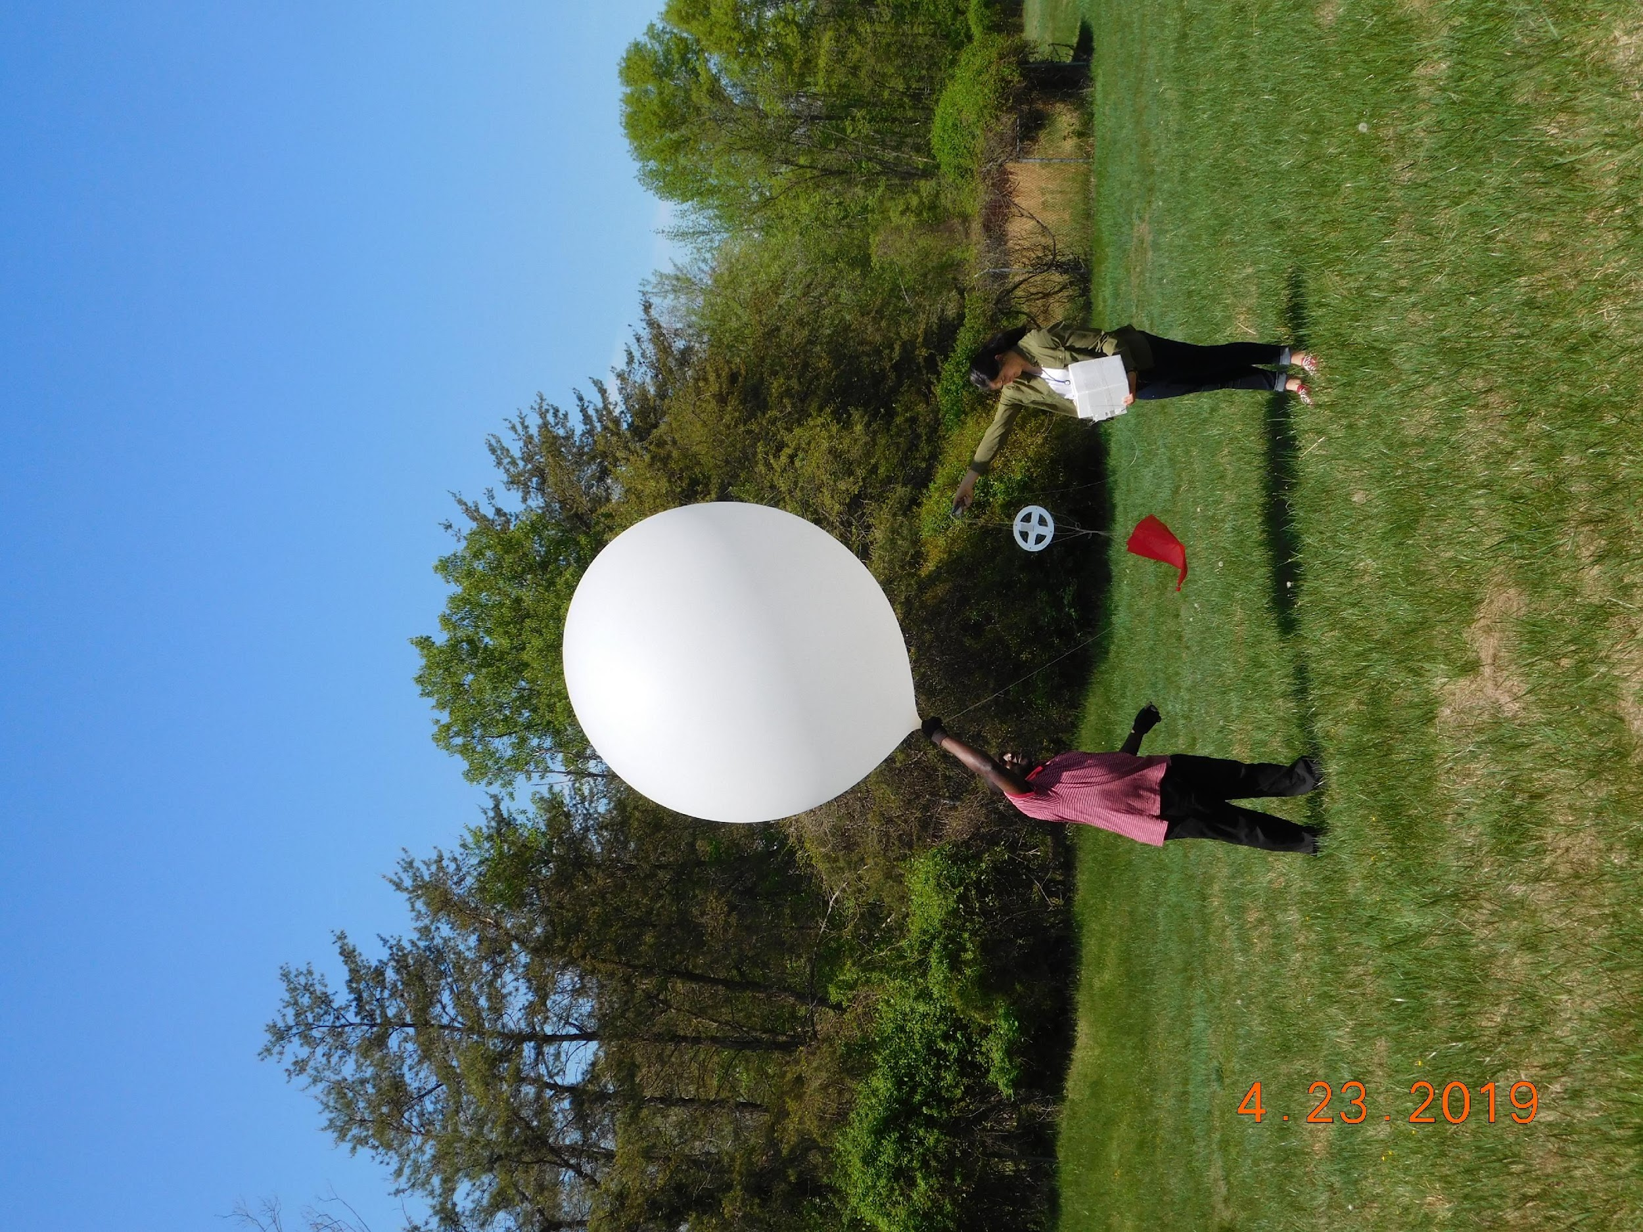
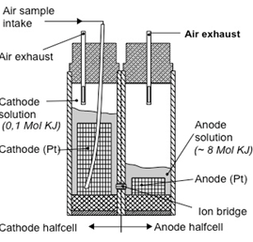
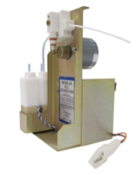
Ozonesonde Instrument (More details in Webinar No. 2 on Hardware)
Ozonesonde:
Small instrument (1 kg) attached to a radiosonde & flown on a weather balloon to measure O₃ concentration from surface to 35 km with ~100-m height resolution, weather independent (e.g. rain, clouds)
Electrochemical Concentration Cell (ECC) sonde:
Titrates ozone (O₃) in a KI sensing solution:
2 KI + O₃ + H₂O ➔I₂ +O₂ + 2 KOH
In the ECC, the I₂ produced is converted back into 2 I⁻ by uptake of 2 electrons, creating a current proportional to the O₃
Ozonesonde QA Challenges:
Unique Instrument, launched & lost. Need standard preparation
Two manufacturers (SPC & En-Sci) & three different sensing solutions types (SST’s)
Different sonde-SST pairings may not measure the same O₃ amount
Principle of Operation:
A small pump forces ambient air through the dilute KI-solution in the cathode chamber
The O₃ is related to the amount of sampled air
A small pump forces ambient air through the low concentrated aquous KI-solution in the cathode chamber
Ozone is converted into iodine by the reaction:
At a platinium cathode the Iodine is converted to Iodide by the uptake of 2 electrons by one Iodine molecule:
In external electrical circuit a current is generated directly related to the uptake rate of ozone in the sensing cathode solution.

Slide 5
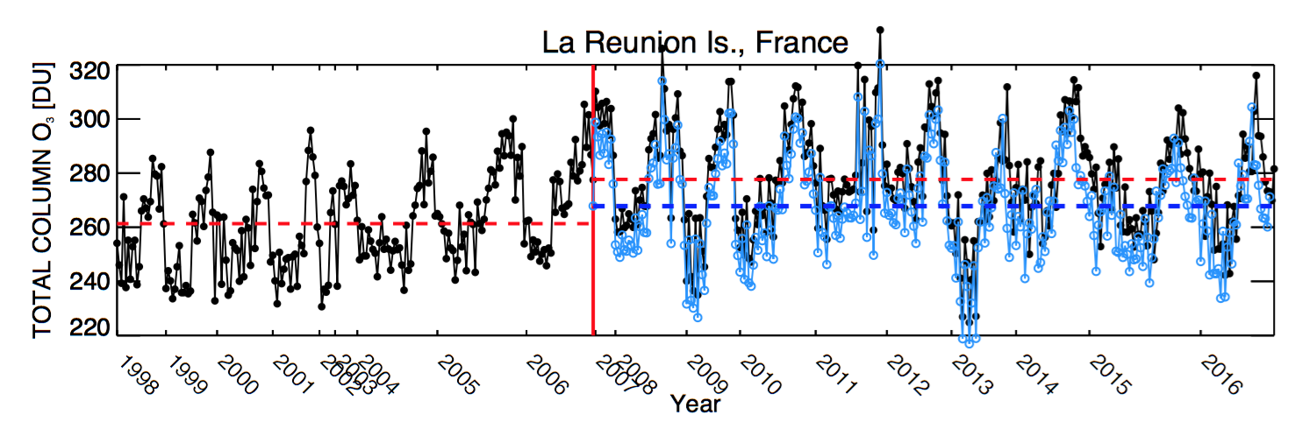
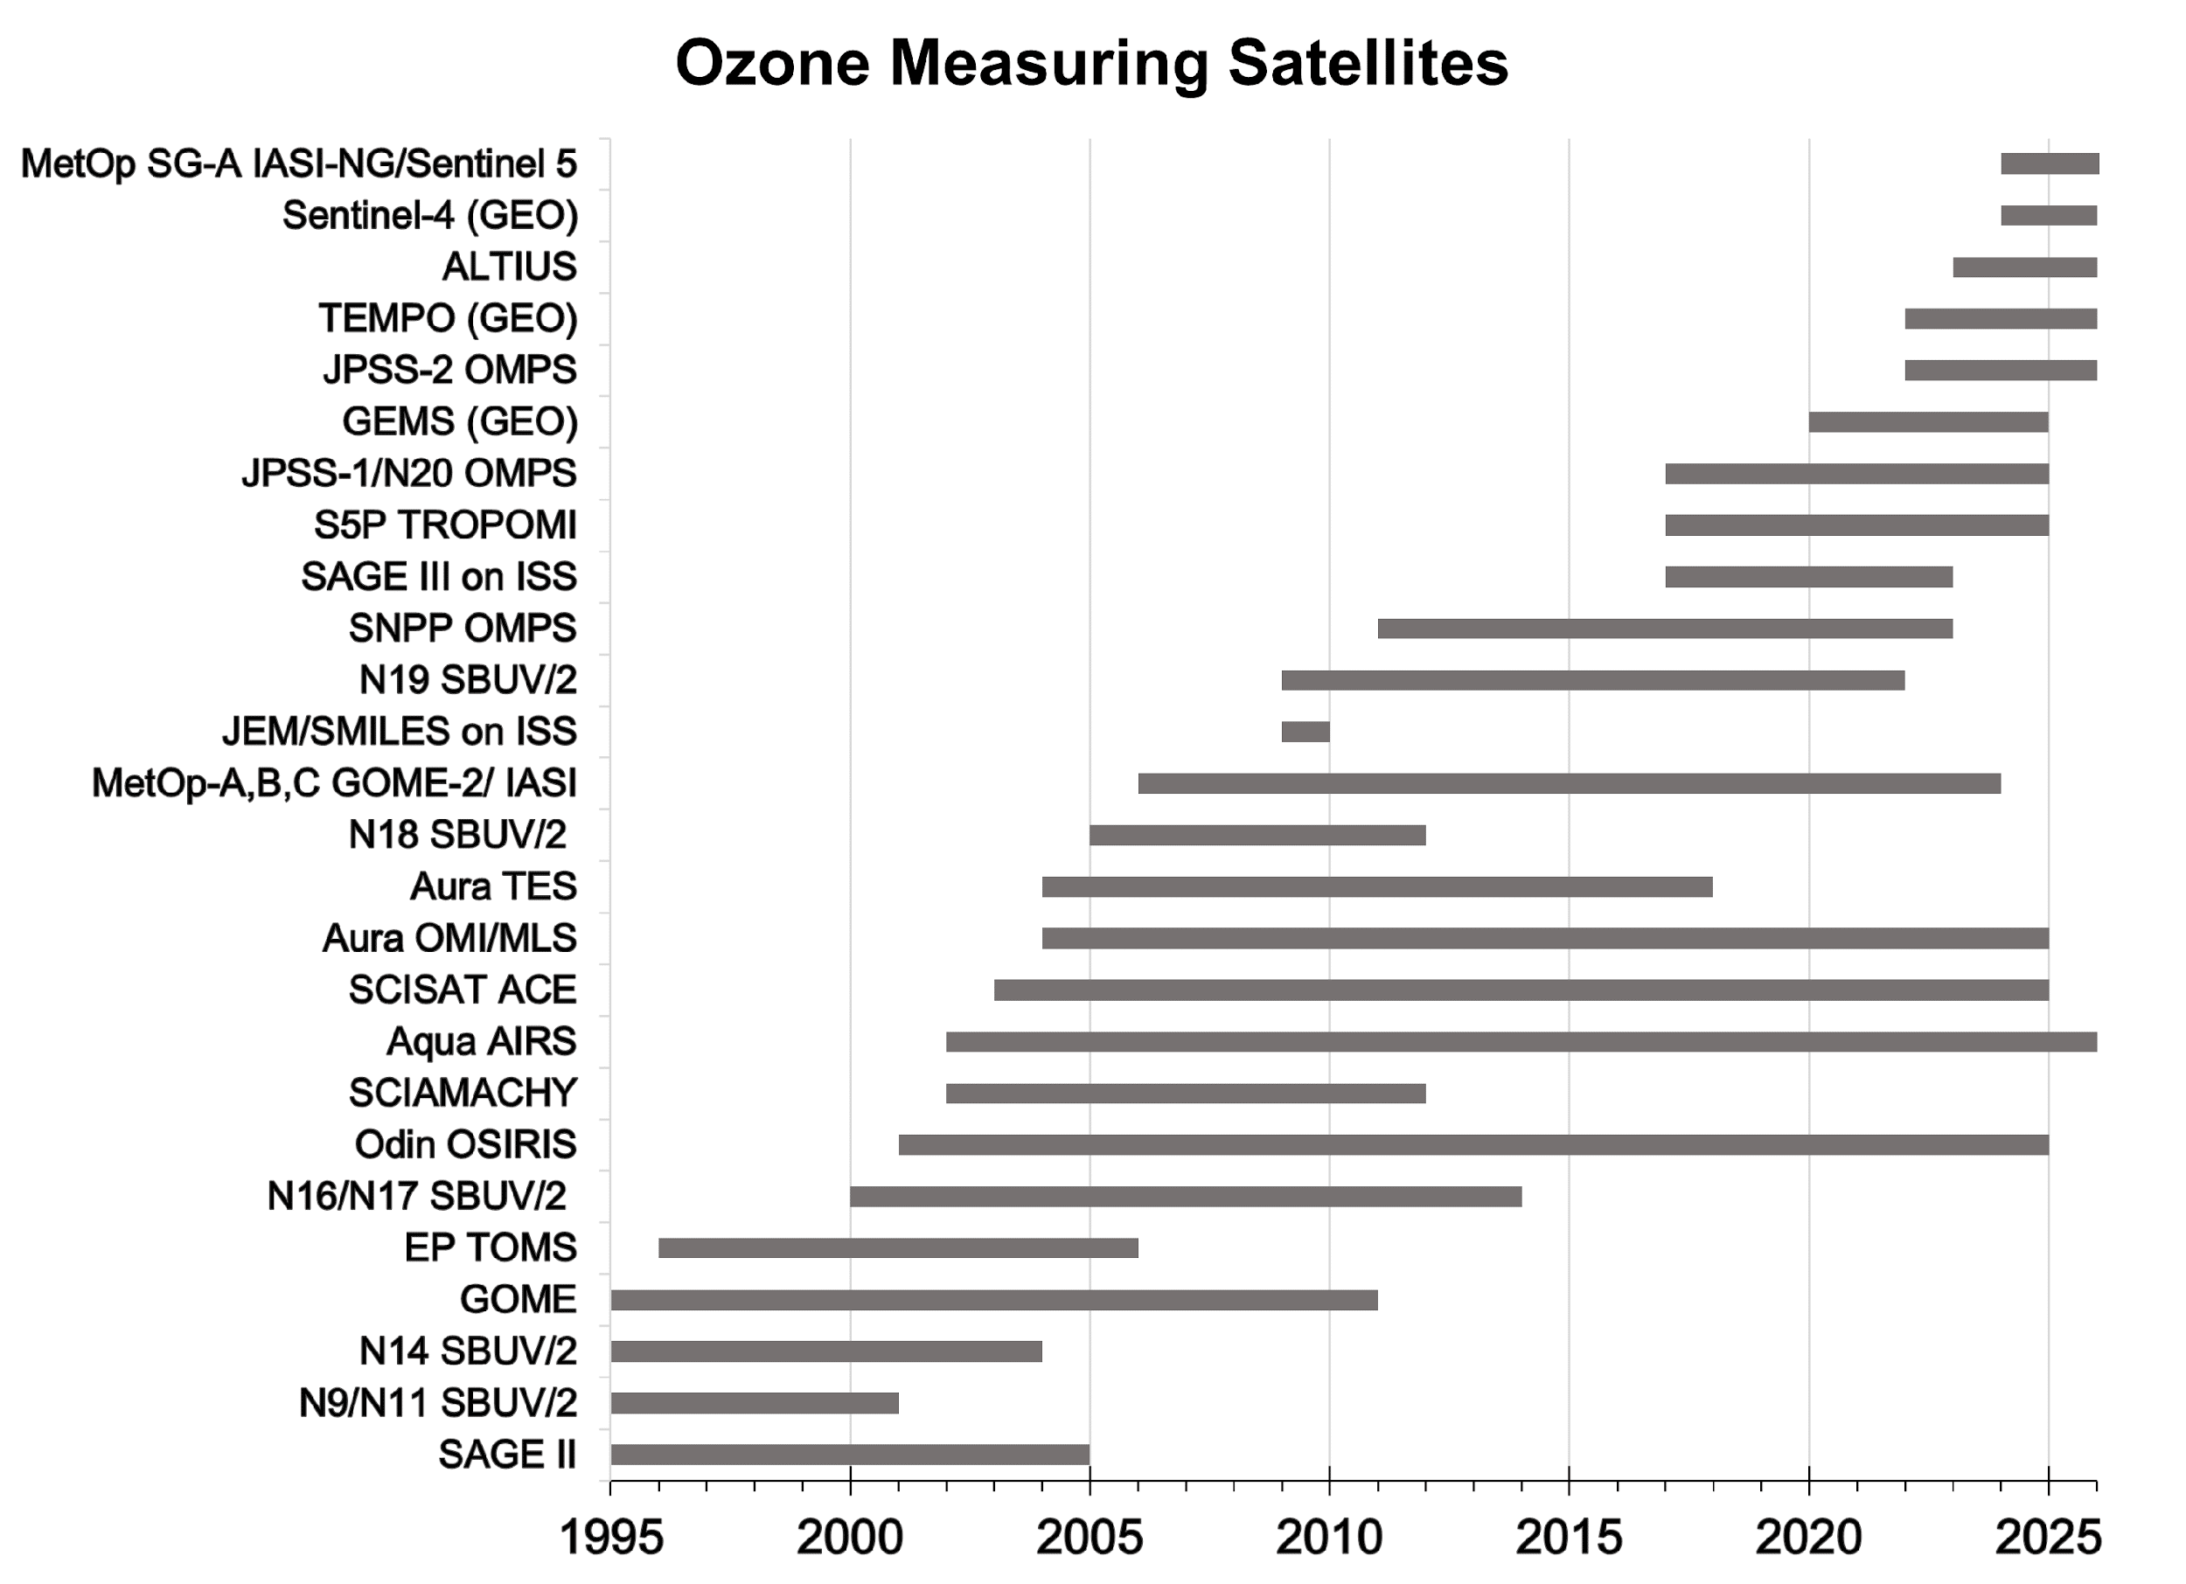
Ozonesonde QA Requirements. Why SOPs Matter.
Data Needs, continued:
Sondes evaluate models, air quality forecasts
Sondes required for UNEP/WMO quadrennial Ozone Assessments that support Montreal Protocol). Users now demand 5% uncertainty!!
QA challenge! What happens when a station changes instrument or SST? How are data compared across stations using different methods?
Sonde community needs (a) to evaluate each sonde type and SST against absolute reference; (b) prescribe SOP for sonde preparation; (c) methods to correct „homogenize“ archived data time-series
Global Ozonesonde Network. Data Uses
ECC sondes are launched 2-5 x/month or more often at ~60 sites globally
Sondes support validation of Satellites, Lidars, Aircraft profiles (e.g. IAGOS)

Slide 6
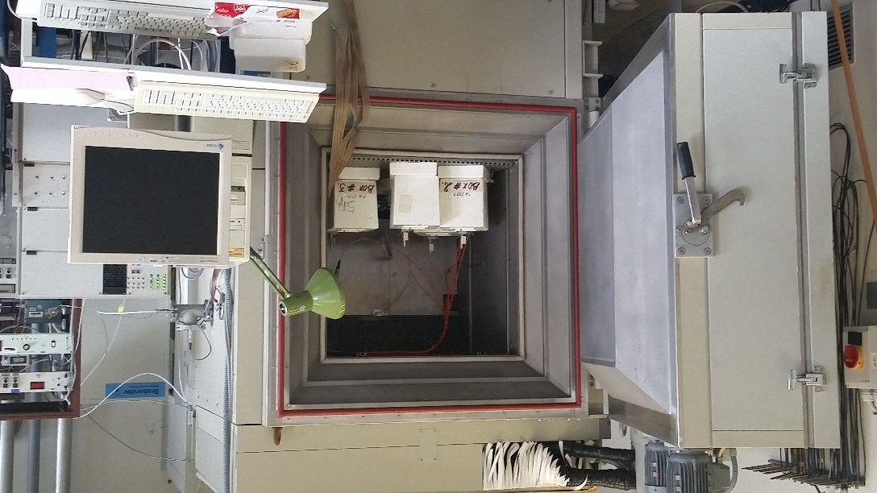
Three Elements of Ozonesonde QA: WCCOS - JOSIE - ASOPOS
1994 WMO/UNEP Assessment of Ozone Depletion: Must improve sonde data QA!!!
(1) In 1995 the Research Centre Jülich established the World Calibration Centre for Ozone Sondes (WCCOS) to support the WMO/GAW plan for ozonesonde QA. Core of WCCOS is the ESF (right) that has tested all instrument types used across the global ozonesonde network.
(2) Six international Jülich Ozone Sonde Intercomparison Experiments (JOSIE’s) conducted at WCCOS/ESF since 1996
(3) JOSIE results evaluated by Assessment of Standard Operating Procedures of Ozone Sondes (ASOPOS) expert panel develops recommended SOP by consensus
The Environmental Simulation Facility (ESF):
Enables control of pressure (P), temperature (T) and ozone (O₃) concentration
Simulates quasi realistic flight conditions of ozone soundings from surface to Z=35 km
Dual beam UV-photometer (OPM) serves as a reference (uncertainty better than 3-5%)
JOSIE: Four ozonesondes are “flown” simultaneously at different vertical profiles of O₃, P & T (polar, mid-latitude, sub-tropical and tropical conditions)

Slide 7
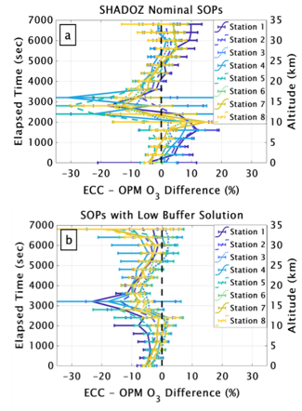
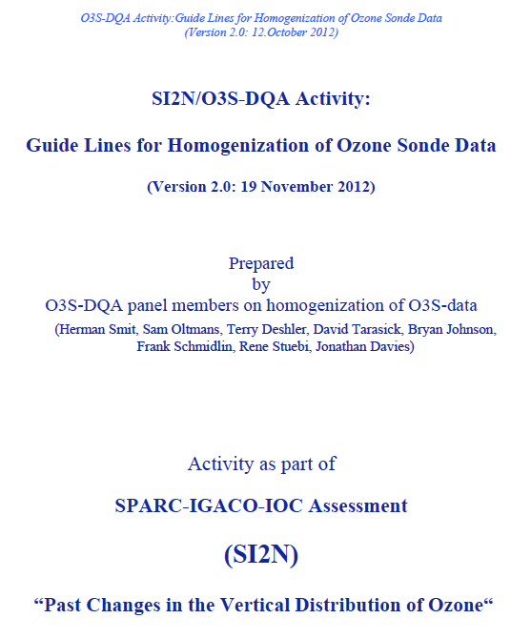
ASOPOS Success: JOSIEs and O3S-DQA (Homogenisation)
ASOPOS-Aim: Provide QA evaluated sonde data for trends, satellite and model validation that are consistent across the global network, following SOPs for operations and data handling.
ASOPOS-Process: A Team of ozonesonde experts (i) analyzes and evaluates the results of intercomparisons (e.g. JOSIE) and time-series homogenisations (O3S-DQA); (ii) develops sonde preparation SOPs; (iii) provides detailed SOP on data handling and re-processing
JOSIE 2009/2010
Testing ASOPOS 1.0 Recommendations
O3S-DQA (2012):
Homogenisation of Long Term O3S Time Series
JOSIE 2017 – SHADOZ
Thompson et al. (BAMS, 2019)
SPC-6A & SST1.0
ENSCI-Z & SST0.5
t-resp.
t-resp.
t-resp.
t-resp.
t-resp.
t-resp.

Slide 8
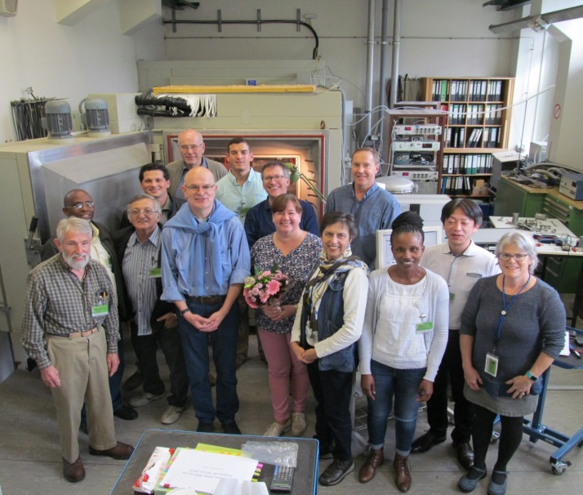
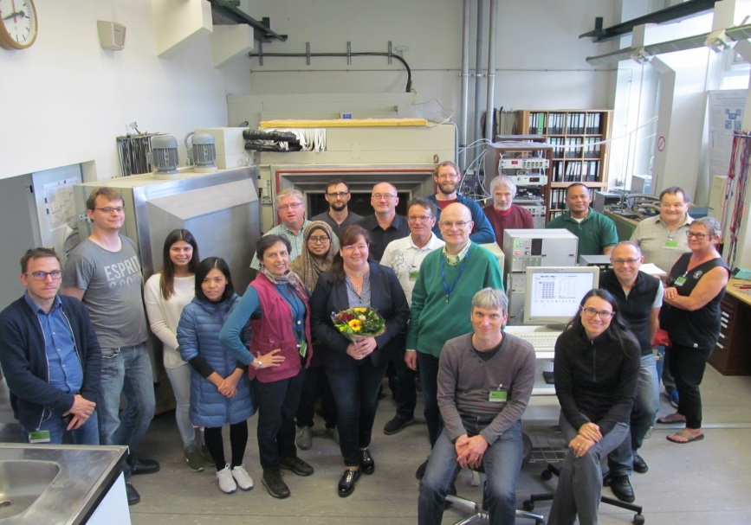
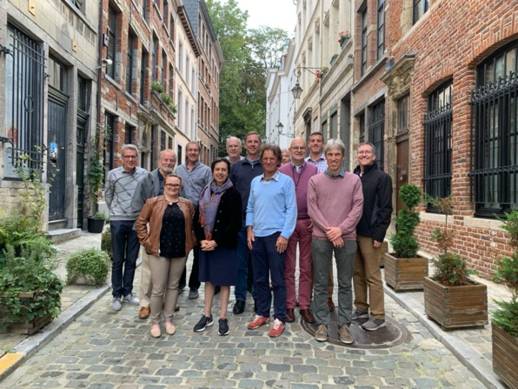
ASOPOS 2.0 Foundation and Related Studies
Basis of ASOPOS 2.0 (2016-2021):
JOSIE 2009/2010, new & re-used sondes
Analysis of Homogenised Data (O3S-DQA):
more work needed for 5% uncertainty
Results from JOSIE 2017-SHADOZ
Peer-reviewed Papers in Parallel with ASOPOS 2.0
Homogenisation:
  Tarasick et al., AMT, 2016
  Van Malderen et al., AMT, 2016
  Witte et al., JGR 2017; JGR, 2018; JGR, 2019
  Thompson et al., JGR, 2017
  Deshler et al., AMT, 2017
  Sterling et al., AMT, 2018
  Ancellet et al., AMT, 2022
  ………and still ongoing……….
JOSIE-SHADOZ-2017 at WCCOS (Oct./Nov. 2017)
O3S Performance:
  JOSIE 2017-SHADOZ: Thompson et al., BAMS, 2019
  Uncertainty Budget: Tarasick et al., ESS, 2021
  Resolving fast & slow time response: Vömel et al., AMT, 2020
  TCO Stability/Drop: Stauffer et al., GRL, 2020; ESS, 2022
  Pump Flow Measurements, Nakano & Morofuji, AMT, 2023
ASOPOS Panel at Brussels, Belgium (Sept. 2018)

Slide 9

ASOPOS 2.0: GAW Report No. 268 (2021)
Editors:
H.G.J. Smit (FZJ,Germany) & A.M. Thompson (NASA, USA)
Lead Authors:
H.G.J. Smit, A.M. Thompson, B.J. Johnson (NOAA, US), D.E. Kollonige (NASA), G.A. Morris (St.Edwards Univ., US), R.M. Stauffer (NASA), D.W. Tarasick (ECCC, Canada), P. von der Gathen (AWI, Germany), R. Van Malderen (RMI, Belgium), H. Voemel (NCAR, US), J.C. Witte (NCAR, R. Querel (NIWA, New Zealand), J. Davies (ECCC), P. Cullis (NOAA)
Reviewers: M. del Carmen Cazorla (Univ. SFQ, Ecuador), G.J.R. Coetzee (SAWS, So. Africa), M. Fujiwara (Hokkaido Univ., Japan), S.J. Oltmans (NOAA, US), W. Steinbrecht (DWD, Germany), M. Tully, BOM, Australia)
Inclusivity & Capacity Building: ASOPOS 2.0 includes UNEP “Article 5 country” participants & incorporates lab and field tests from the entire ozone community
Acknowledgements:
FZ-Jülich, NASA, NOAA. UNEP-Vienna Convention Trust Fund sponsorship of SHADOZ participants at JOSIE-SHADOZ-2017. Many organizations with long-term commitments to the ASOPOS Team. WMO/GAW, IO3C, GRUAN and NDACC
Available at https://library.wmo.int
GAW-Report No. 268
Notes:
Time 1-2 min
Thanks Anne for the doing this first part of the webinar and giving an overview of the ASOPOS evaluation process with the different QA aspects of ECC ozonesondes in the global network.
In this second part of the webinar I will highlight some of the outcome of the ASOPOS 2.0 and the recommendations made by the ASOPOS panel of ozonesonde experts.
A team of lead authors, listed here, had compiled their 2 years of assessment work into the ASOPOS 2.0 report, which then was peer reviewed by six atmospheric ozone scientists from five different continents who all are involved in international programmes like GAW, NDACC, SPARC or GRUAN.
After having included the reviewers suggestions and comments the report has been finalized and is now published as the WMO-GAW Report No.268 in August 2021.
The report is since then on-line available at the WMO library server.
The report gives an comprehensive overview about what are the ozonesonde measurement principles and what are the best operational practices.
At this point we also like to acknowledge explicitely the different organizations and agencies for their support and long term commitments.
Without their outstanding support we would not have been able to produce this ASOPOS 2.0 Report. And last but not least this is also true for the six reviewers for their excellen and critical reviews which has helped the ASOPOS 2.0 a lot!!

Slide 10
“Ozonesonde Measurement Principles and Best Operational Practices”
(WMO/GAW-Report No. 268)
Table of Content
Preface (WMO-GAW (Global Atmospheric Watch).
    Chapter 1 Introduction
    Chapter 2 Technical description of instrument
    Chapter 3 Data Quality Objectives & Uncertainties
    Chapter 4 SOPs: Sonde Preparation, Operation, Data Archiving
    Chapter 5 Data Quality Indicators (DQI’s)
    Annex-A Measurement Guidelines (MG’s)
    Annex-B Meta-Data
    Annex-C Practical Guidelines for Determining Uncertainties
    Annex-D Guidelines for Data Homogenization
    Annex-E Acronyms
    Annex-F ASOPOS Panel & Reviewers
Available at https://library.wmo.int
GAW-Report No. 268
Notes:
Time: 2 min
The report covers all aspects of doing ozone soundings as shown here in the table of content.
It starts from the scientific base including data quality objectives-measurements uncertainties towards standard operating procedures, the so called SOP’s, then continues with data quality indicators towards the annexes giving the practical guidelines for preparation, meta data, data processing with the uncertainties and finally also the guidelines for data homogenisation of historical long term ozonesonde data records.
Compared to the previous ASOPOS 1.0 published in GAW No.201 Report new important topics have been included.
To mention here are for example the uncertainty budget, the metadata, the data quality indicators which is supported by the practical guidelines to put it into practice.
In preparing the report we as ASOPOS panel always has our target in mind on to achieve the 5% overall uncertainty of the ozonesonde measurement.

Slide 11
ASOPOS 2.0: Achievements & Recommendations (1)
More strict and unified Standard Operating Procedures (SOPs)
Recommendations on sensing solution type and ECC sonde type stay the same as in ASOPOS 1.0
Recommendations to upgrade and regular maintenance of the zero ozone and purifying air filters and the Preparation Check Unit
Stations are requested in general only to change operations when necessary (e.g. equipment becomes obsolete)
Uncertainty budget analysis with overall uncertainty to store in the data archives
Extensive list of metadata such that data can be reprocessed
Notes:
Time 2 min
However, to aim for this target the ASOPOS panel came to several achievements and recommendations which the most important ones are listed in the next two slide:
Mention the different bullits

Slide 12
ASOPOS 2.0: Achievements & Recommendations (2)
Practical guidelines for SOPs, Meta data, Data Processing incl. Uncertainties and Homogenisation of historical long term ozonesonde records.
Base for improved data processing (resolving fast and slow time responses).
Quality assessment “monitoring” with frequent comparison to satellite and ground-based total column (TCO) ozone amounts
Final data in the data archives should be traceable to a single reference standard: JOSIE-OPM at WCCOS
NOTE! OZONESONDE QA HAVE TO BE AN ONGOING PROCESS:
Instrumentation will change, intentional or not!
WCCOS is essential for ozonesonde community to monitor changes and to provide World Standard OPM as one unique reference for every profile
Notes:
Further achievements and recommendations made in the ASOPOS report to mention here are:
Mention the first four bullits
The report contains detailed guidelines for SOPs, Meta Data, Data Processing including Uncertainties and Homogenisation of historical long term ozonesonde records
The report constitutes the base for improved data processing which includes the resolving of the fast and slow time responses in the ozonesonde profile
The report recommends the quality assessment with frequent comparison to satellite and groundbased observations of total column ozone.
Further it is important the final sonde data stored in the data archives should be traceable to a single reference standard, namely the JOSIE-OPM at the World Calibration Center of OzonesSondes.
Then a break:
Now ASOPOS also recognizes that Ozonesonde QA have to be an on-going process,
Because it has shown that instrumentation can change over time, intentional or unexpected (examples from the past such as the change of materials or components used for the sonde, or the change of type of batteries or the change of the electrical pump motor and so on….). All examples of changes that have shown to be small but had a significant impact on the performace of the sonde and thus on its data quality.
Therefore the existence of the World Calibration Center for OzoneSondes is essential for the ozonesonde community to monitor these chenges and in addition to provide the world standard ozone photometer as one unique reference for every ozonesounding.

Slide 13
ASOPOS 2.0: Implementation into the global network
The outcome of ASOPOS 2.0 with their important recommendations will now be implemented into the global ozonesonde network by:
On-line webinars as video clips: Key outcome and recommendations of ASOPOS 2.0 has been compiled into a series of six webinars
Regional on-line ASOPOS workshops dedicated to the operators of the ozonesounding stations to present ASOPOS 2.0 into practice: What and How to do in practical terms? (February/March 2023)
Coaching the ozonesonde stations individually to implement ASOPOS 2.0 into practice (2023-2024)
Future capacity building by on-line and/or on-site coaching/training
Notes:
Time 1 Min.
After given some highlights of the new ASOPOS report, the next step to do is that the ASOPOS achievements and recommendations get be implemented into the sounding practice at the field site.
Therefore the ASOPOS panel has prepared an implementation plan that looks as follows:
Mention the bullits

Slide 14
Closing Remarks
This webinar no.1 is part of a series of ASOPOS Webinars:
  Introduction to ASOPOS 2.0: An Overview (Anne Thompson & Herman Smit)
  Hardware (Herman Smit & Roeland Van Malderen)
  SOP: Standard Operating Procedures (Roeland Van Malderen & Peter von der Gathen & Gary Morris & Bryan Johnson)
  Data Processing (Herman Smit & David Tarasick)
  Data Quality Indicators (DQI) (Ryan Stauffer & Holger Voemel)
  Meta Data and Software (Ryan Staufer & Roeland Van Malderen)
The webinars do not replace the report or associated video clips, but only highlights the most important topics and eventual changes with respect to the previous ASOPOS 1.0 report (WMO/GAW Report No. 201).
When any of you have any questions or need advice you can of course consult the ASOPOS Team in general !!!
Thank you for your attention and let‘s go for good collaborations in the future !!!
Notes:
Time: 0.5 min.
But, now we are coming to the end of this webinar No. 1 as part of a series of six ASOPOS webinars for the implementation of the recommendations made by the ASOPOS panel in the GAW Report No.268.
As was said at the beginning: these series of webinars do not replace the ASOPOS 2.0 Report, but it only highlights it.
When you have any questions or need advice please don’t hesistate to consult the ASOPOS Team
But for now: On behalf of my ASOPOS co-chair: Anne Thompson, myself and the whole ASOPOS Team: Thank you for your attention and let us go for good collaborations in the future !!!
Wish you good health and Bye Bye for now................... (wait a 10 seconds and then first stop)

