Slide 1

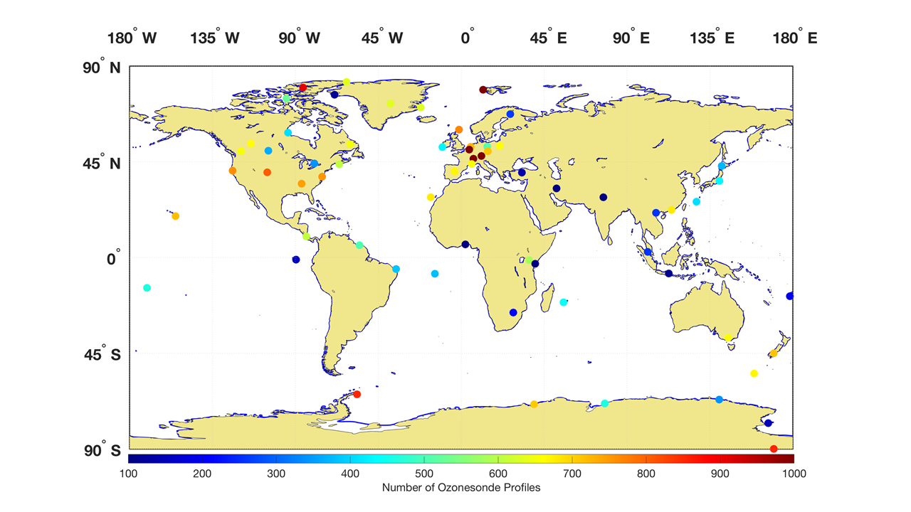









Webinar-Series on the Implementation of the Recommendations Made by the ASOPOS 2.0 Panel
Ozonesonde Measurement Principles and Best Operational Practices
ASOPOS 2.0 (GAW Report No. 268)
(Assessment of Standard Operating Procedures for Ozonesondes)
Webinar No. 2:
Hardware
Herman Smit ⁽¹⁾ and Roeland Van Malderen ⁽²⁾
⁽¹⁾ H.Smit@fz-juelich.de
⁽²⁾ Roeland.VanMalderen@meteo.be
Version March 2024
Notes:
Time 1 min:
Welcome to this webinar No. 2 in a series of 6 webinars dedicated to the implementation of the recommendations made by the ASOPOS 2.0 panel in the GAW report No.268 with the title “Ozonesonde Measurement principles and Best Operational Practices”.
ASOPOS stands for Assessment of Standard Operating Procedures for Ozone Sondes
My name is Herman Smit and I am from the Research Centre Jülich in Germany and together with my collegue Roeland Van Malderen of the Royal Meteeorology Institute in Belgium we will guide you through this webinar.

Slide 2

Preamble
This ASOPOS 2.0 Report builds on the earlier ASOPOS 1.0 (GAW Report No. 201, 2014)
In general, the hardware used for ozonesoundings has been described in Chapter 2 in general and in more detail in Annex A of the ASOPOS 2.0 Report (WMO/GAW Report No. 268).
In this Webinar only most crucial and critical aspects of the hardware and their limitations will be highlighted and explained
Because they have shown in practice to have a significant impact on the performance of the ozonesonde and the quality of the measured sounding data.
Available at https://library.wmo.int
GAW-Report No. 268
Notes:
Time: 1.0 min
But before we start with this webinar first a few remarks to avoid any misunderstandings.
This new ASOPOS report builds on the earlier ASOPOS-GAW Report No. 201 from 2014.
In this webinar we only highlight the most crucial aspects of the hardware and their limitations
Because these have shown that in practice they can have a significant impact on the performance of the ozonesonde
In general the hardware is described in detail in the GAW No. 268 Report .

Slide 3

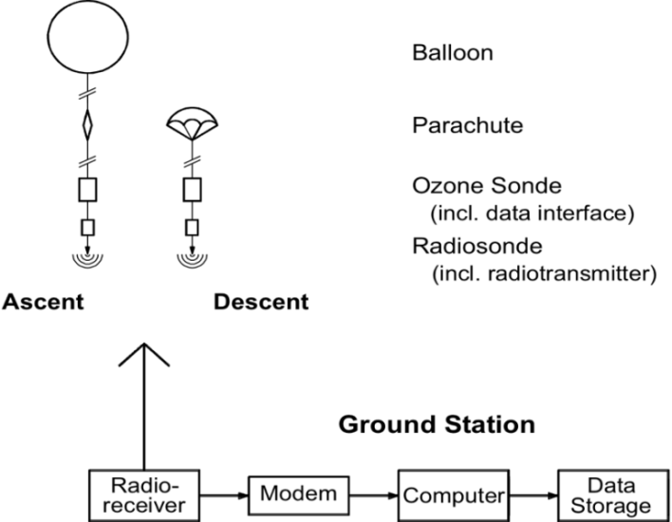
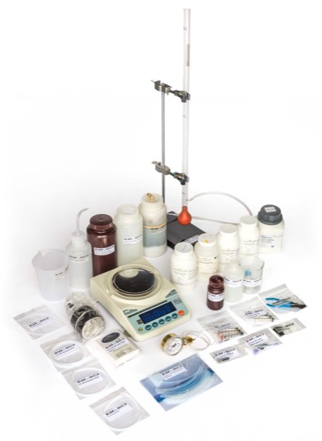
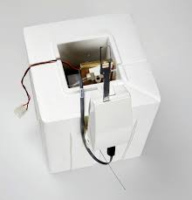
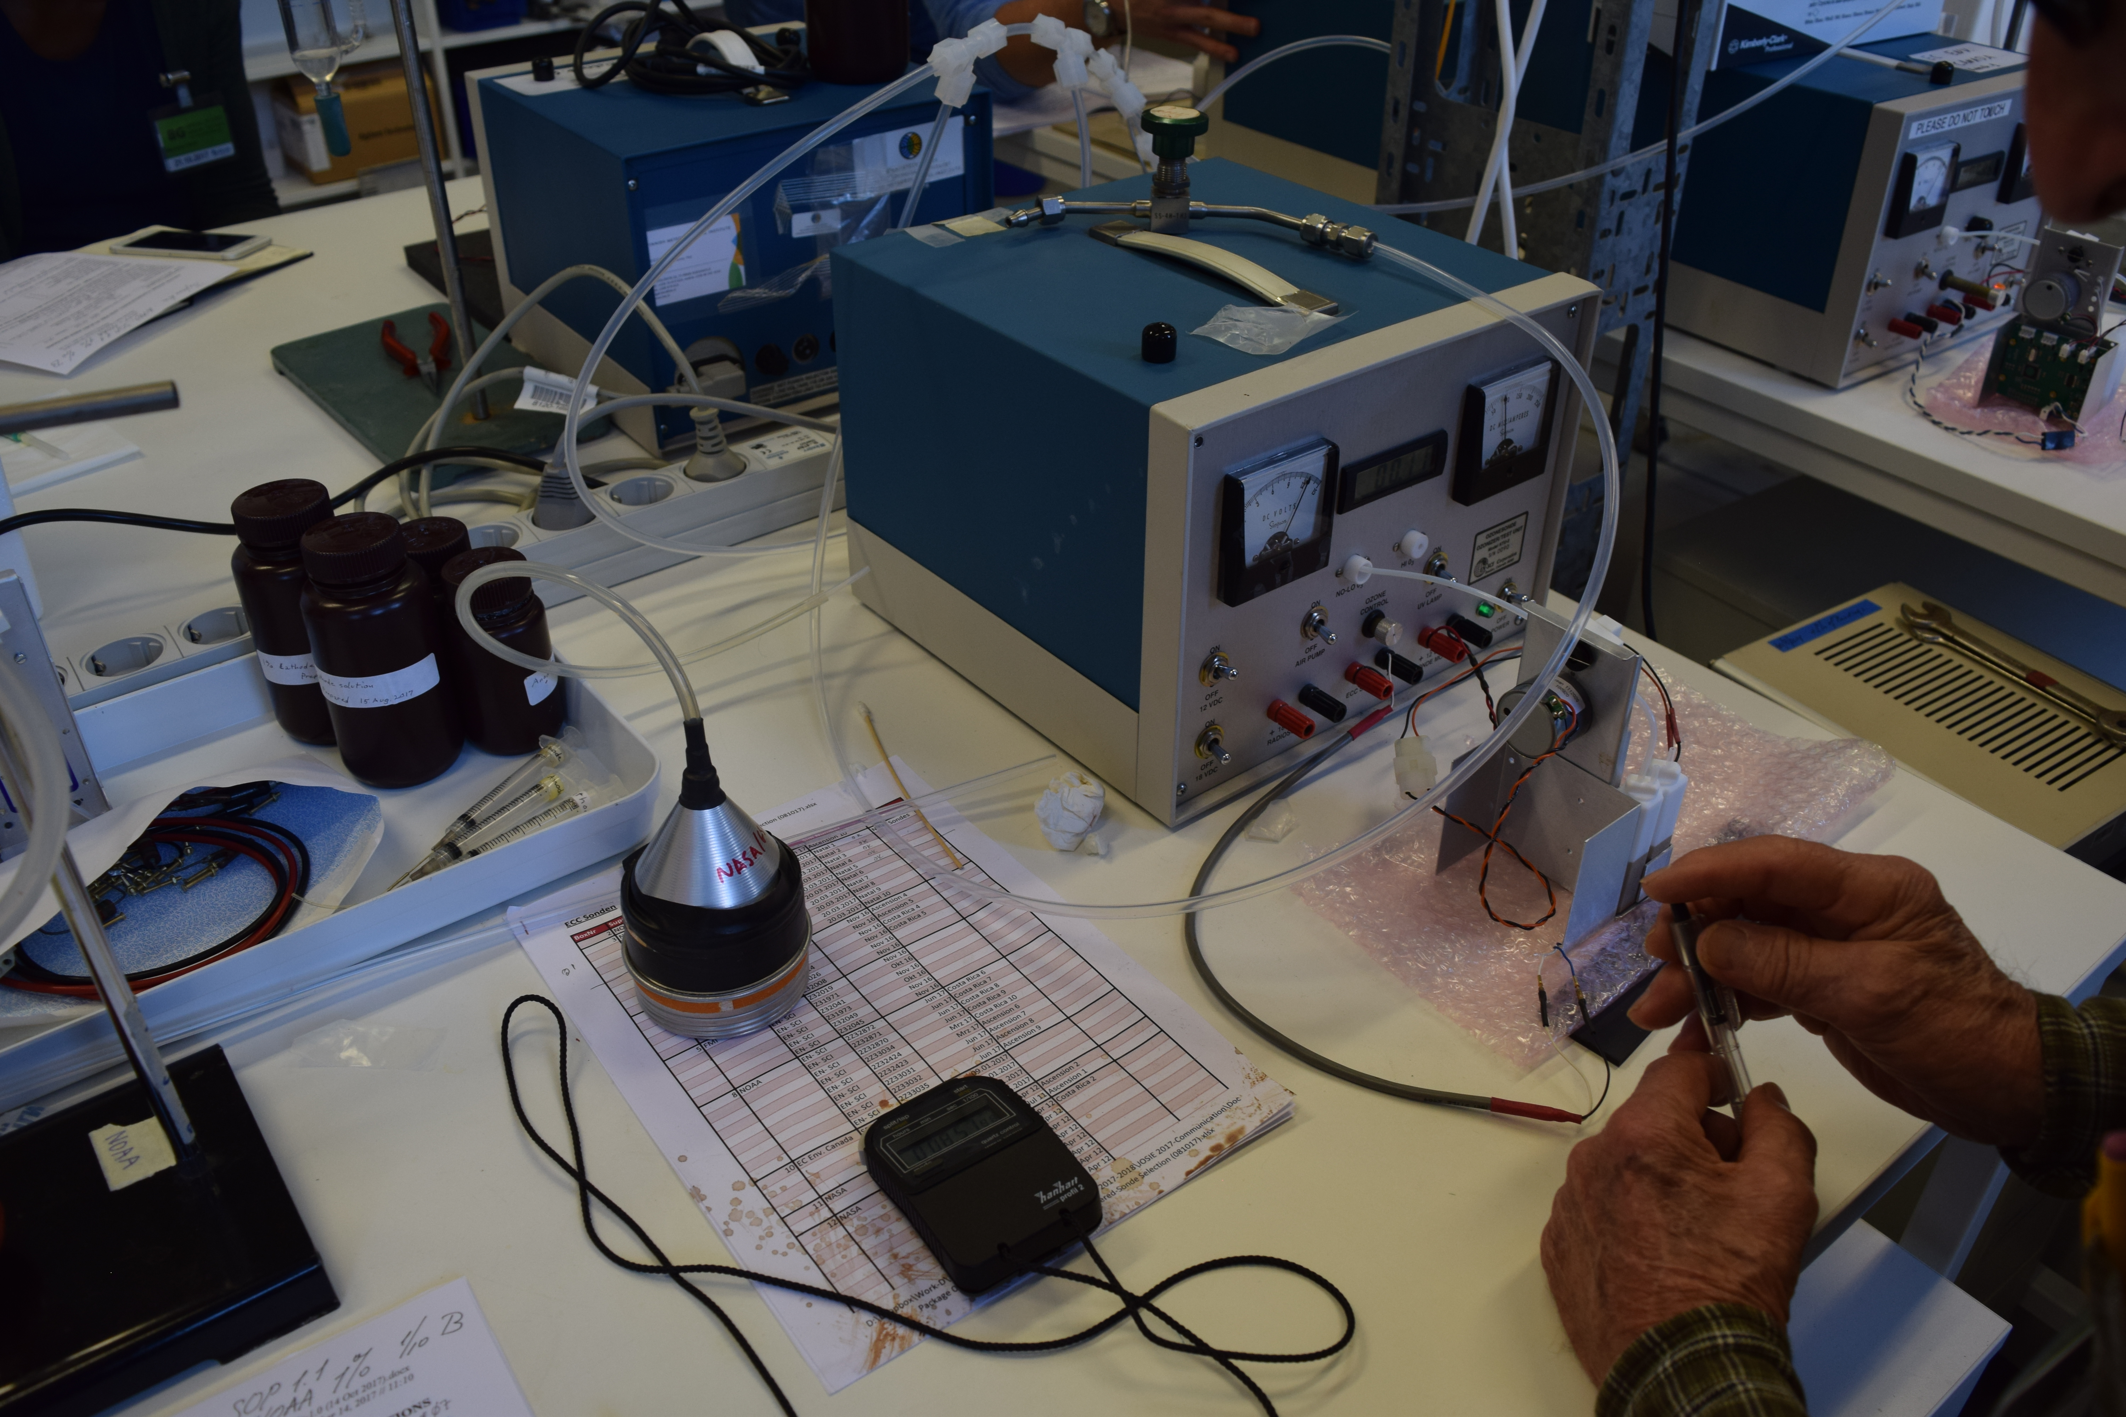
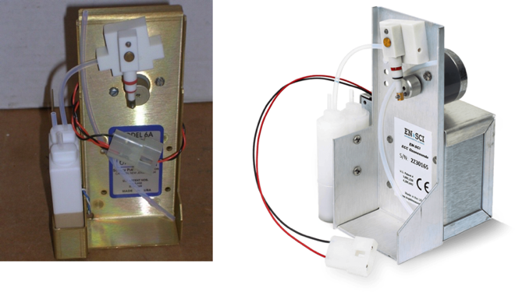
Outline
Introduction
Ozonesonde-Radiosonde-Interface
Preparation: Working space and Hardware
Proper Gas Filters
Sensing Solutions & Laboratory Tools
Regular Maintenance
Key Notes
Notes:
Time:1.0 min
But before we go into any details first a short outline
We will start with a short introduction on what is obviously to be the Achilles Heel of the performance of ozone soundings
Then also a few words on the ECC-ozonesonde, radiosonde and the data interface board linking the ozonesonde with the radiosonde.
Following to mention the laboratory and the hardware for the preparation of the ozonesonde
Important aspect on the use of proper gas filters to provide ozone free and purified air
The preparation of the chemical sensing solutions and the laboratory tools to be used
And not to forget the importance of regular maintenance of the different components of the ground equipment
Finally some key notes as take away messages

Slide 4
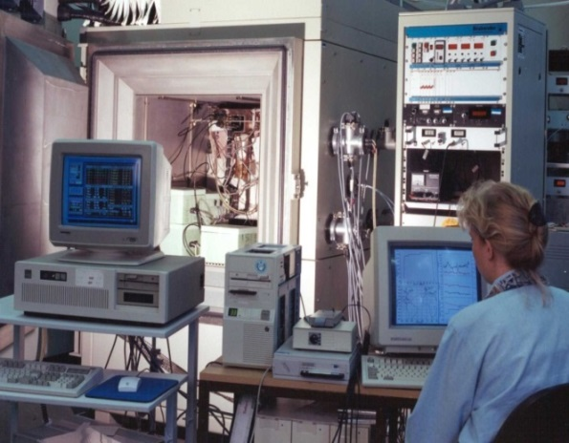
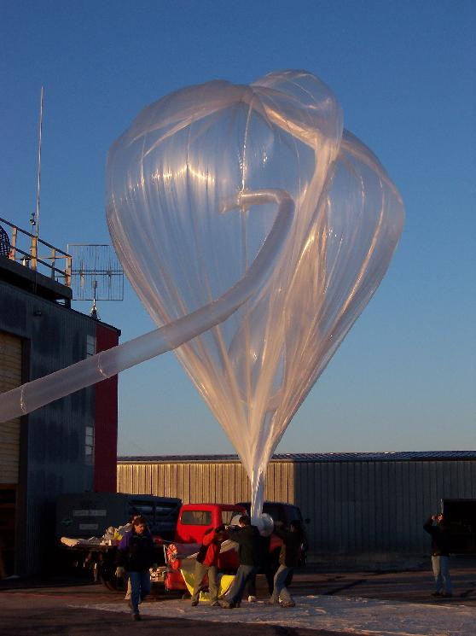
Introduction: 25 years of QA have learned us (Chapter 1 of GAW No. 268)
25 years of quality assurance work (WCCOS) in the laboratory (e.g. JOSIE) and in the field (e.g. BESOS) have clearly demonstrated (See also Webinar No.1, Part 1) that:
  Small changes of the ECC-instrument by the manufacturers or operating procedures at the sounding station can easily introduce artefacts of 5-15 % or even higher
  Well prepared ECC sondes can achieve 3 % precision
  Target of ASOPOS 2.0: 5 % overal uncertainty in the global ozonesonde network.
  But this is only achievable:
    By following strict and unified SOPs
    Using well maintained hardware for the preparation of the ECC-sonde
    All handlings have to be done under cleanliness conditions (See also Webinar No. 3 on SOPs).
WCCOS
JOSIE
BESOS
Notes:
Time: 1 min
In Webinar No. 1 an overview of 25 years of Quality Assessment of Ozonesondes have been given, which has been based on the evaluation of the results of regular laboratory and field intercomparsions. There are some general lessons we have learned from that, not only on SOP’s but also on the hardware.
Mention the bullits briefly

Slide 5
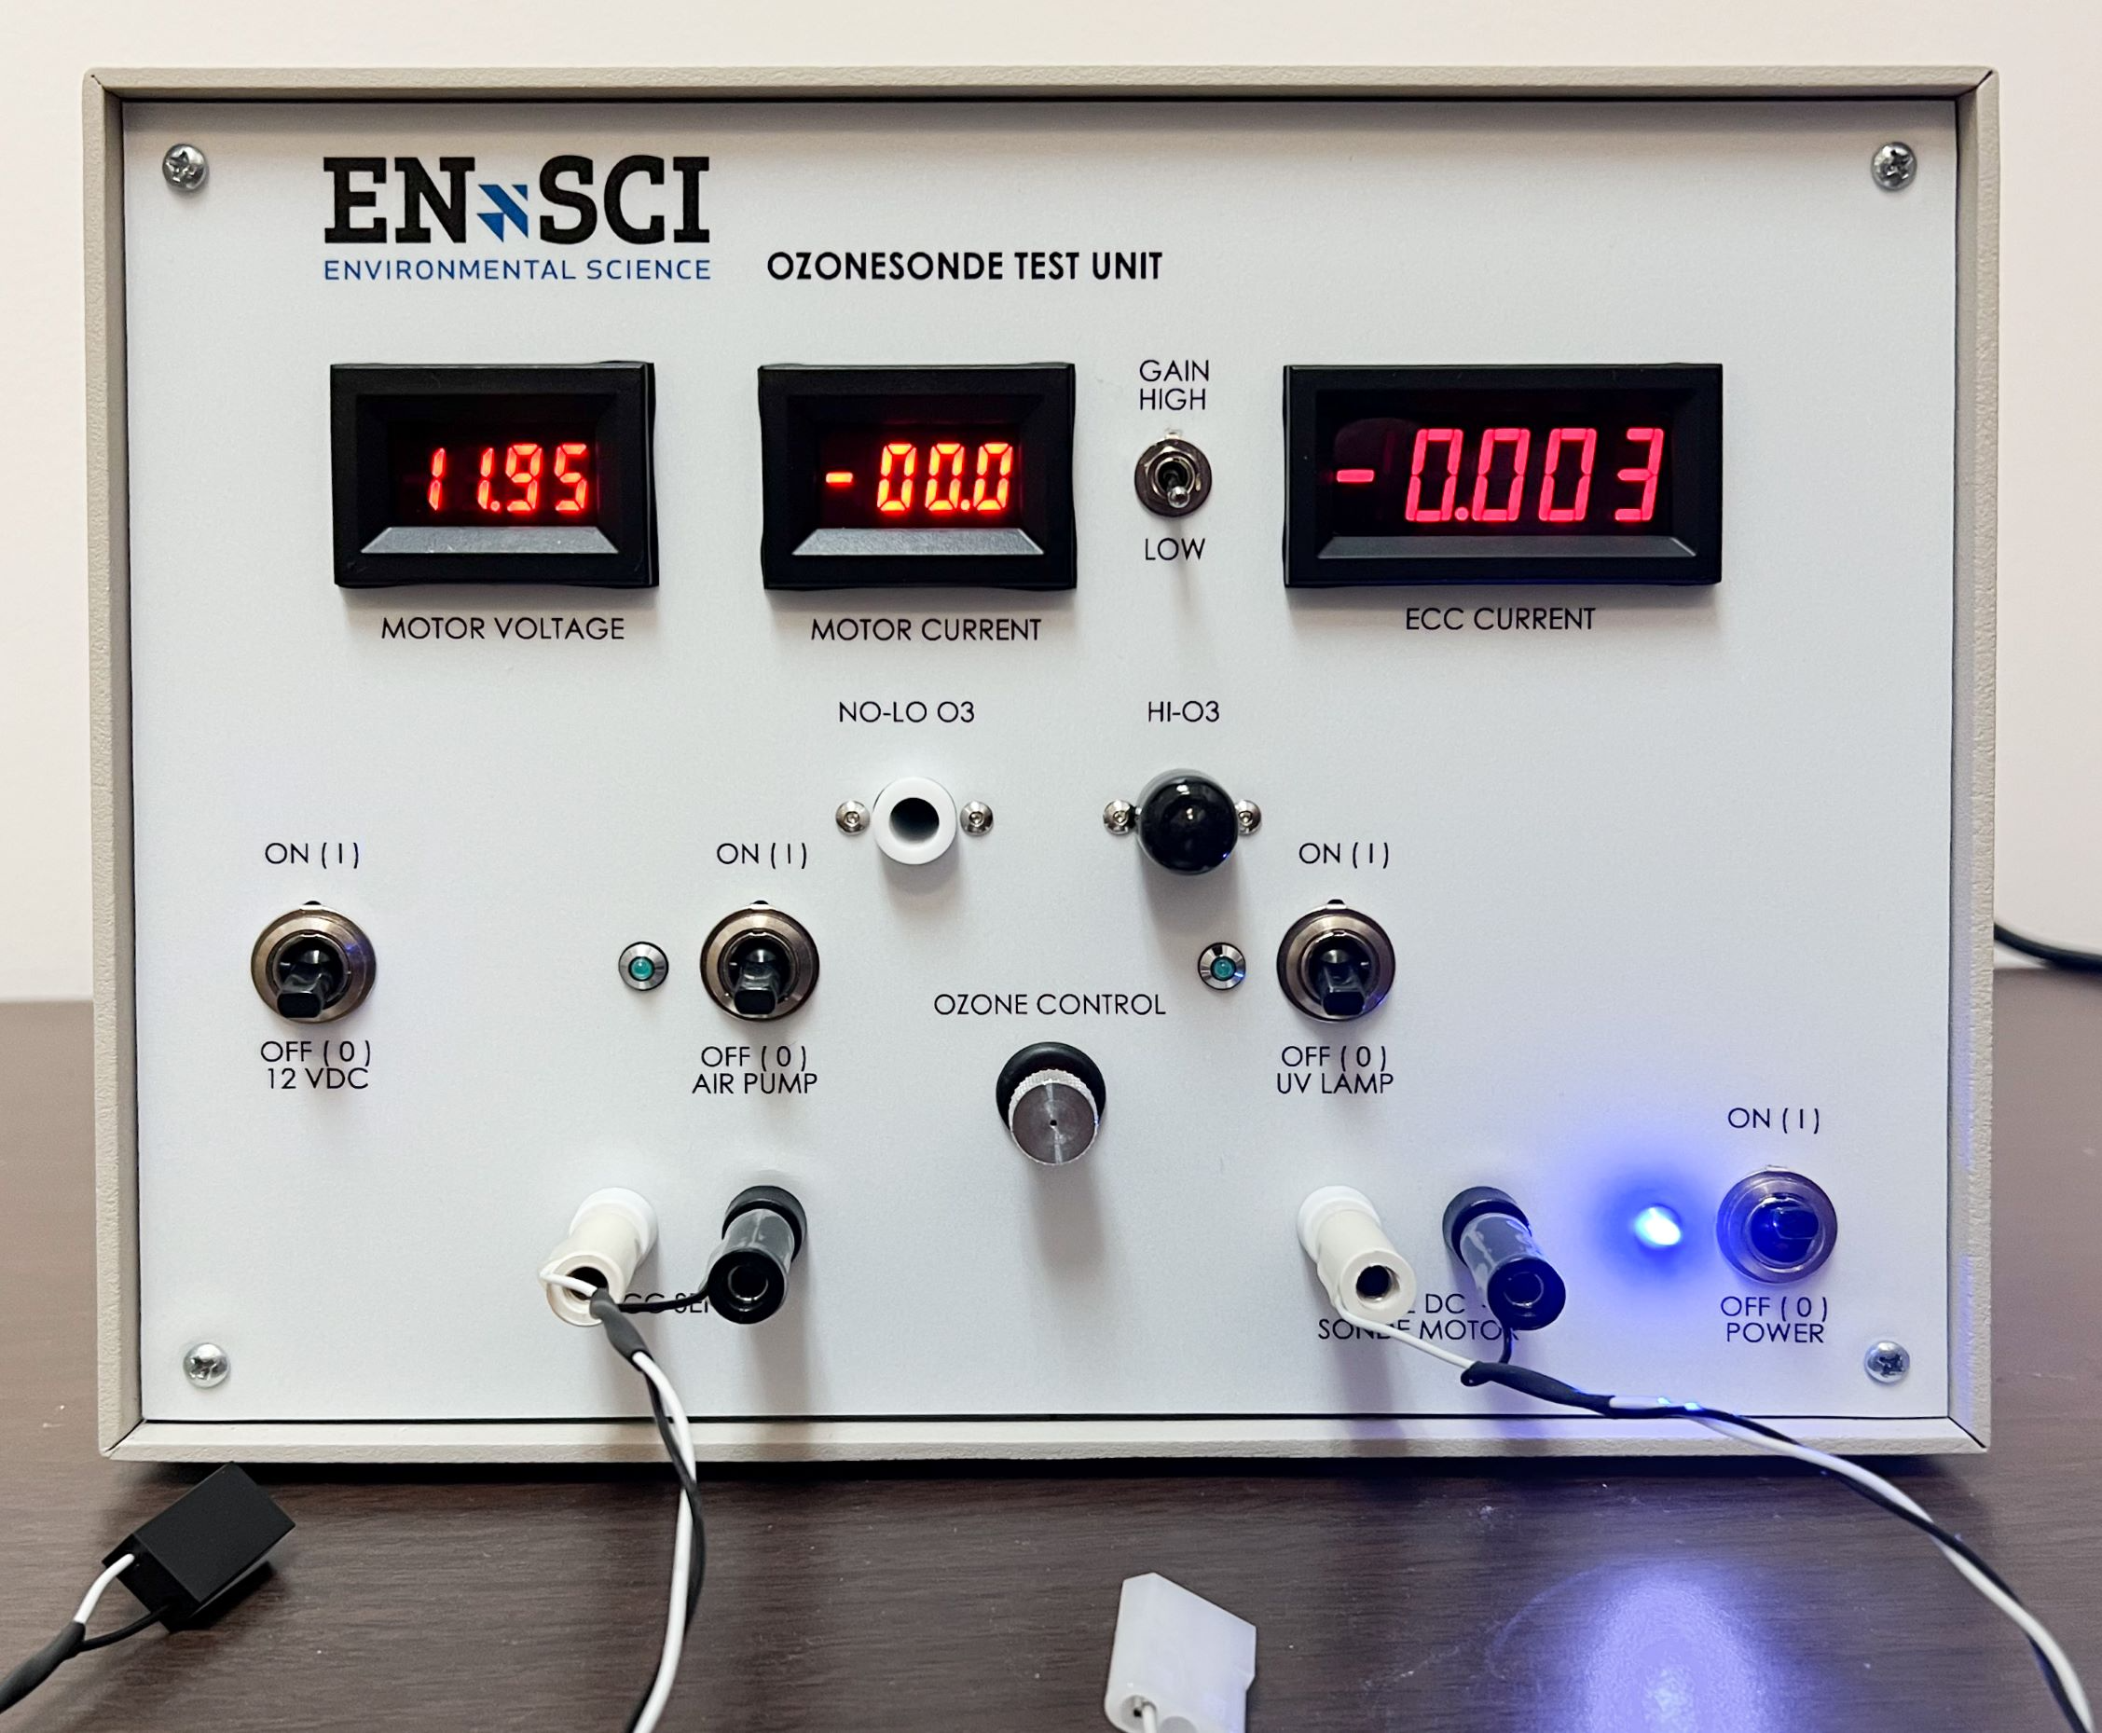
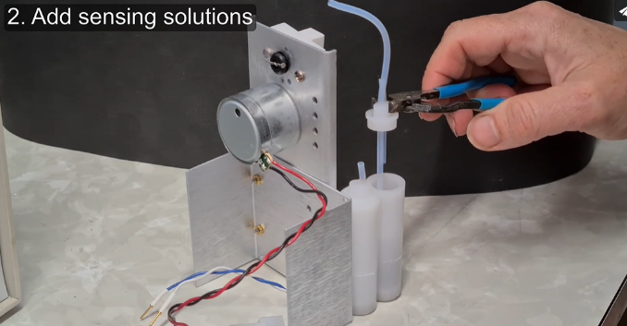
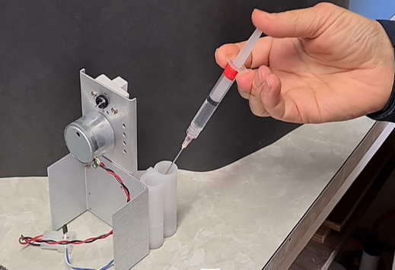
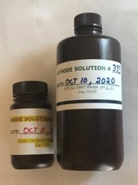
Introduction: The Achilles Heel of the ECC-Ozonesonde
One of the most critical factors in ozonesonde preparation is the composition of chemical solutions in the electrochemical cells. The handling of the instrument and the cells during the preparation steps strongly affect the sonde performance once the sonde is launched. The best way to ensure accurate measurements is by having:
  Well-maintained, up-to-date hardware
  Proper handlings of chemicals and sensing solutions
  Clean working space
Notes:
Time: 0.5 min
But what we also have learned is that the Achilles Heel of the ozonesonde is actually its electrochemical ozone sensor and particularly the chemical handlings during the preparation which easily can affect performance of the sonde and thus the sounding data quality. This can be caused either through:
Mention the 3 bullits

Slide 6
Introduction: Overview of the Hardware (Annex-A of GAW No. 268)
Balloon-Gondola:
OzoneSonde
  ECC ozone sensor
  Interface Board
  Radiosonde (incl. 403 MHz-Transmitter)
Styrofoam box
Balloon,
Unwinder,
Radar Reflector & Parachute
Pre-Flight Preparation :
Clean Laboratory to prepare the Sonde
Preparation Check Unit (e.g. KTU-3)
Zero ozone and purified air: Proper filter
Bubble Flowmeter
P,T and RH Laboratory Detectors
High graded chemicals (KI, KBr & Buffer)
High graded liquid water
Maintenance:
Preparation Check Unit (PCU):
  Zero-Purified Air Filter
  UV-Lamp & UV-Quartz glass-cuvette producing ozone
Automatic flow meter:
  Compare with bubble flow meter regularly
Data Receiving Unit (DRU):
Antenna-Receiver-Modem-Computer
Flight Data Processing Software
Data Storage
Data Submission in Data Archive(s)
Notes:
Time: 1 Min
But before going into further details of some of the hardware, here a brief overview about the hardware involved in ozonesoundings. Details of the different components shown here are described in detail in Annex-A of the new GAW No. 268 Report. Here we only want to mention:
Balloone and its gondela with the ozonesonde, radiosonde and its data interfacing board.
The data receiving unit at the ground to receive, process and archive the sounding data
The pre-flight preparation, where proper hardware and handlings are essential.
And finally the regular maintenance of the hardware.

Slide 7
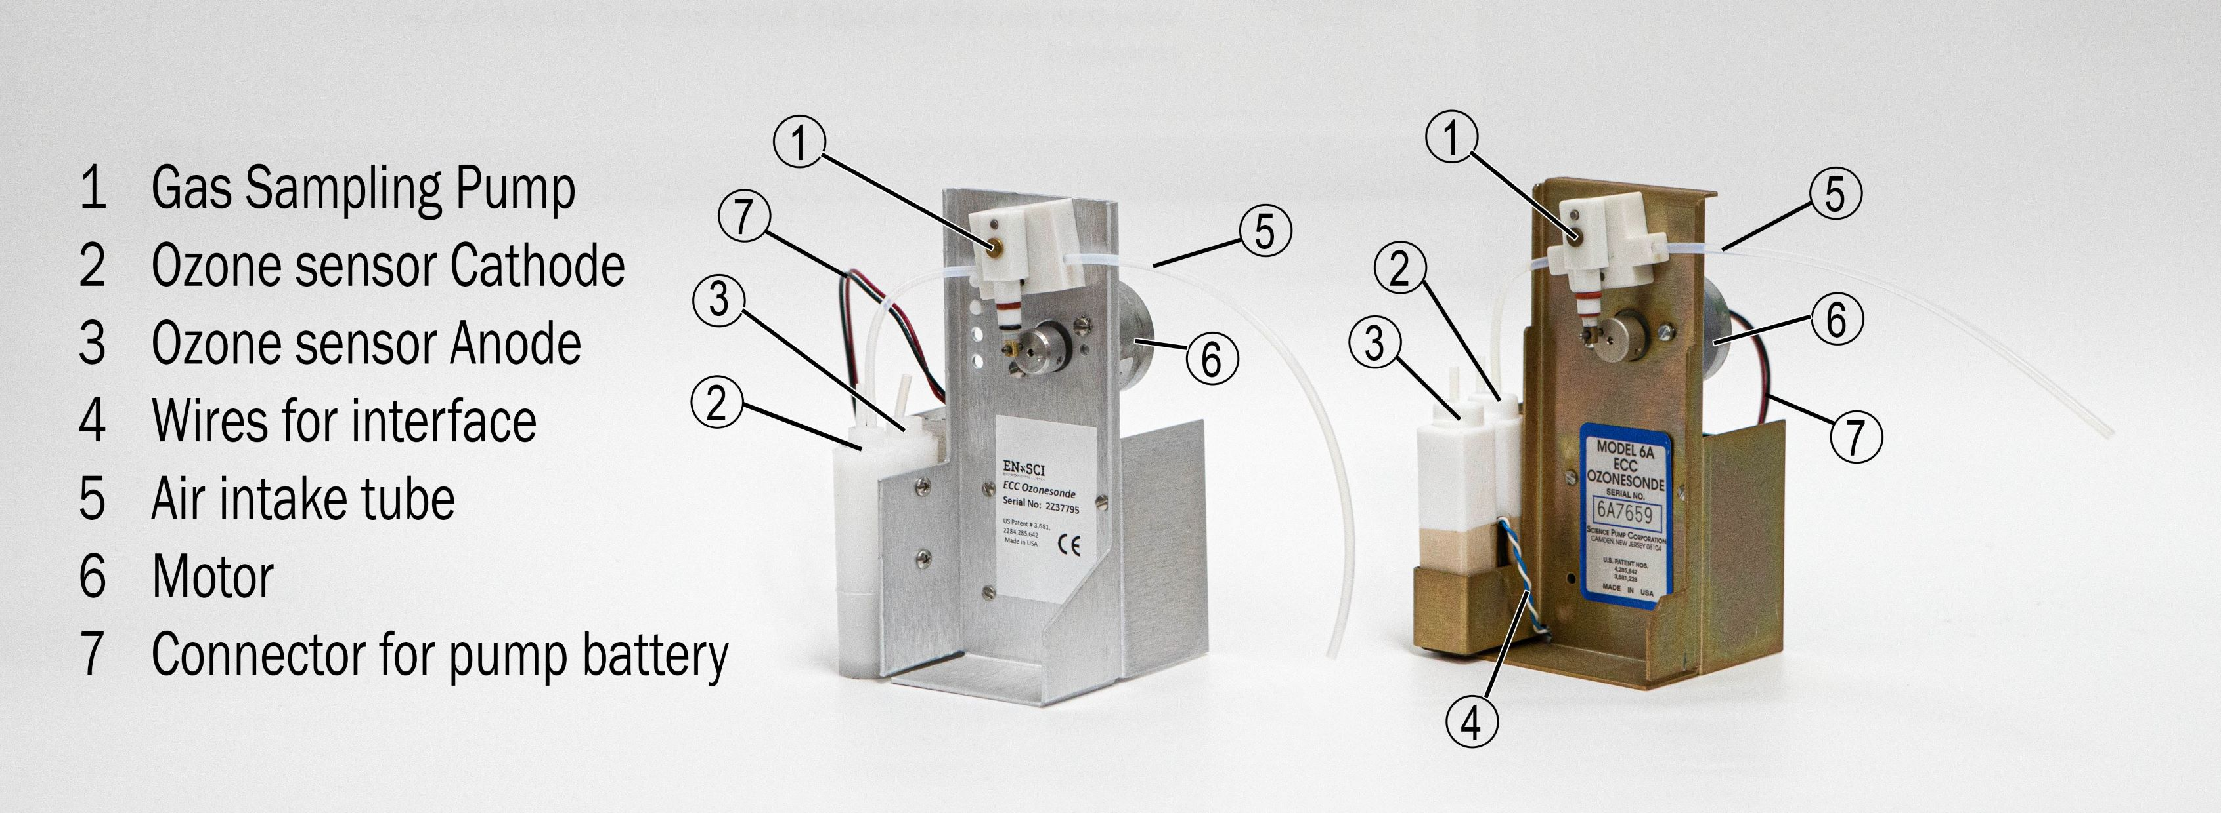
ECC-Ozonesonde: Principle of Operation (Section 2.2 & 2.3 of GAW No.268)
A small pump forces ambient air through the low concentrated aqueous KI-sensing solution in the cathode chamber of an Electrochemical Concentration Cell (Komhyr 1969)
Ozone is converted into iodine by the reaction:
At a platinium cathode the Iodine is converted to Iodide by the uptake of 2 electrons by one Iodine molecule:
In external electrical circuit a current is generated directly related to the uptake rate of ozone in the sensing cathode solution.
Two manufacturers of ECC-ozonesondes (SPC and En-Sci)
Three different KI-sensing solution types are used in the global sonde network
Notes:
Time: 1 Min
First a few words on the electrochemical ozone sensor of the ECC-ozonesonde itself.
The principle of operation of the ECC-sonde is shown here that ambient air containg ozone is flushed through a PotassiumIodide solution in an electrochemical concentration cell. Hereby the ozone is chemically capted by the KI and then electrochemically converted into an electrical current.
Now we deal with 2 manufacturers and 3 sensing solutions which makes the QA for ECC-sondes a real challenge to achieve the 5 % uncertainty targeted in ASOPOS 2.0.

Slide 8
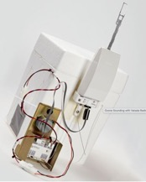
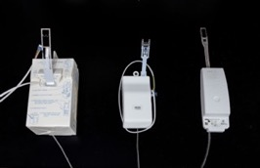
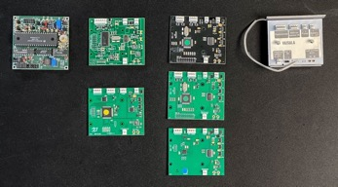
Radiosonde (RS) and Data Interface Board (DIB) (Section 2.4 of GAW No. 268)
Radiosondes can measure:
P (Pressure)
T (Temperature)
U (Rel. Humidity)
Wind (Direction and horizontal Velocity)
GPS-Latitude
GPS-Longitude
GPS-Metric Altitude
Geopotential Altitude derived from PTU
Data Interface Board can measure:
Electrical current of ECC-sensor (I_{M})
Pump temperature (TP)
Optional in addition:
  Applied voltage of pump motor
  Electrical current of pump motor
  Temperature cathode cell solution
  Rotation speed pump motor
Notes:
Time: 0.75 min
Briefly to mention here the Radiosonde and the Data Interface Board.
The radiosonde measuring meteorological parameters plus in-situ GPS-flight coordinates and transmitting all data to the ground station
The Data Interface Boards links the ozonesonde data to the radiosonde
Optionally, nowadays digital electronics enables to record additional housekeeping data.
However, in this webinar we will further focus on the ECC-ozone sonde.

Slide 9
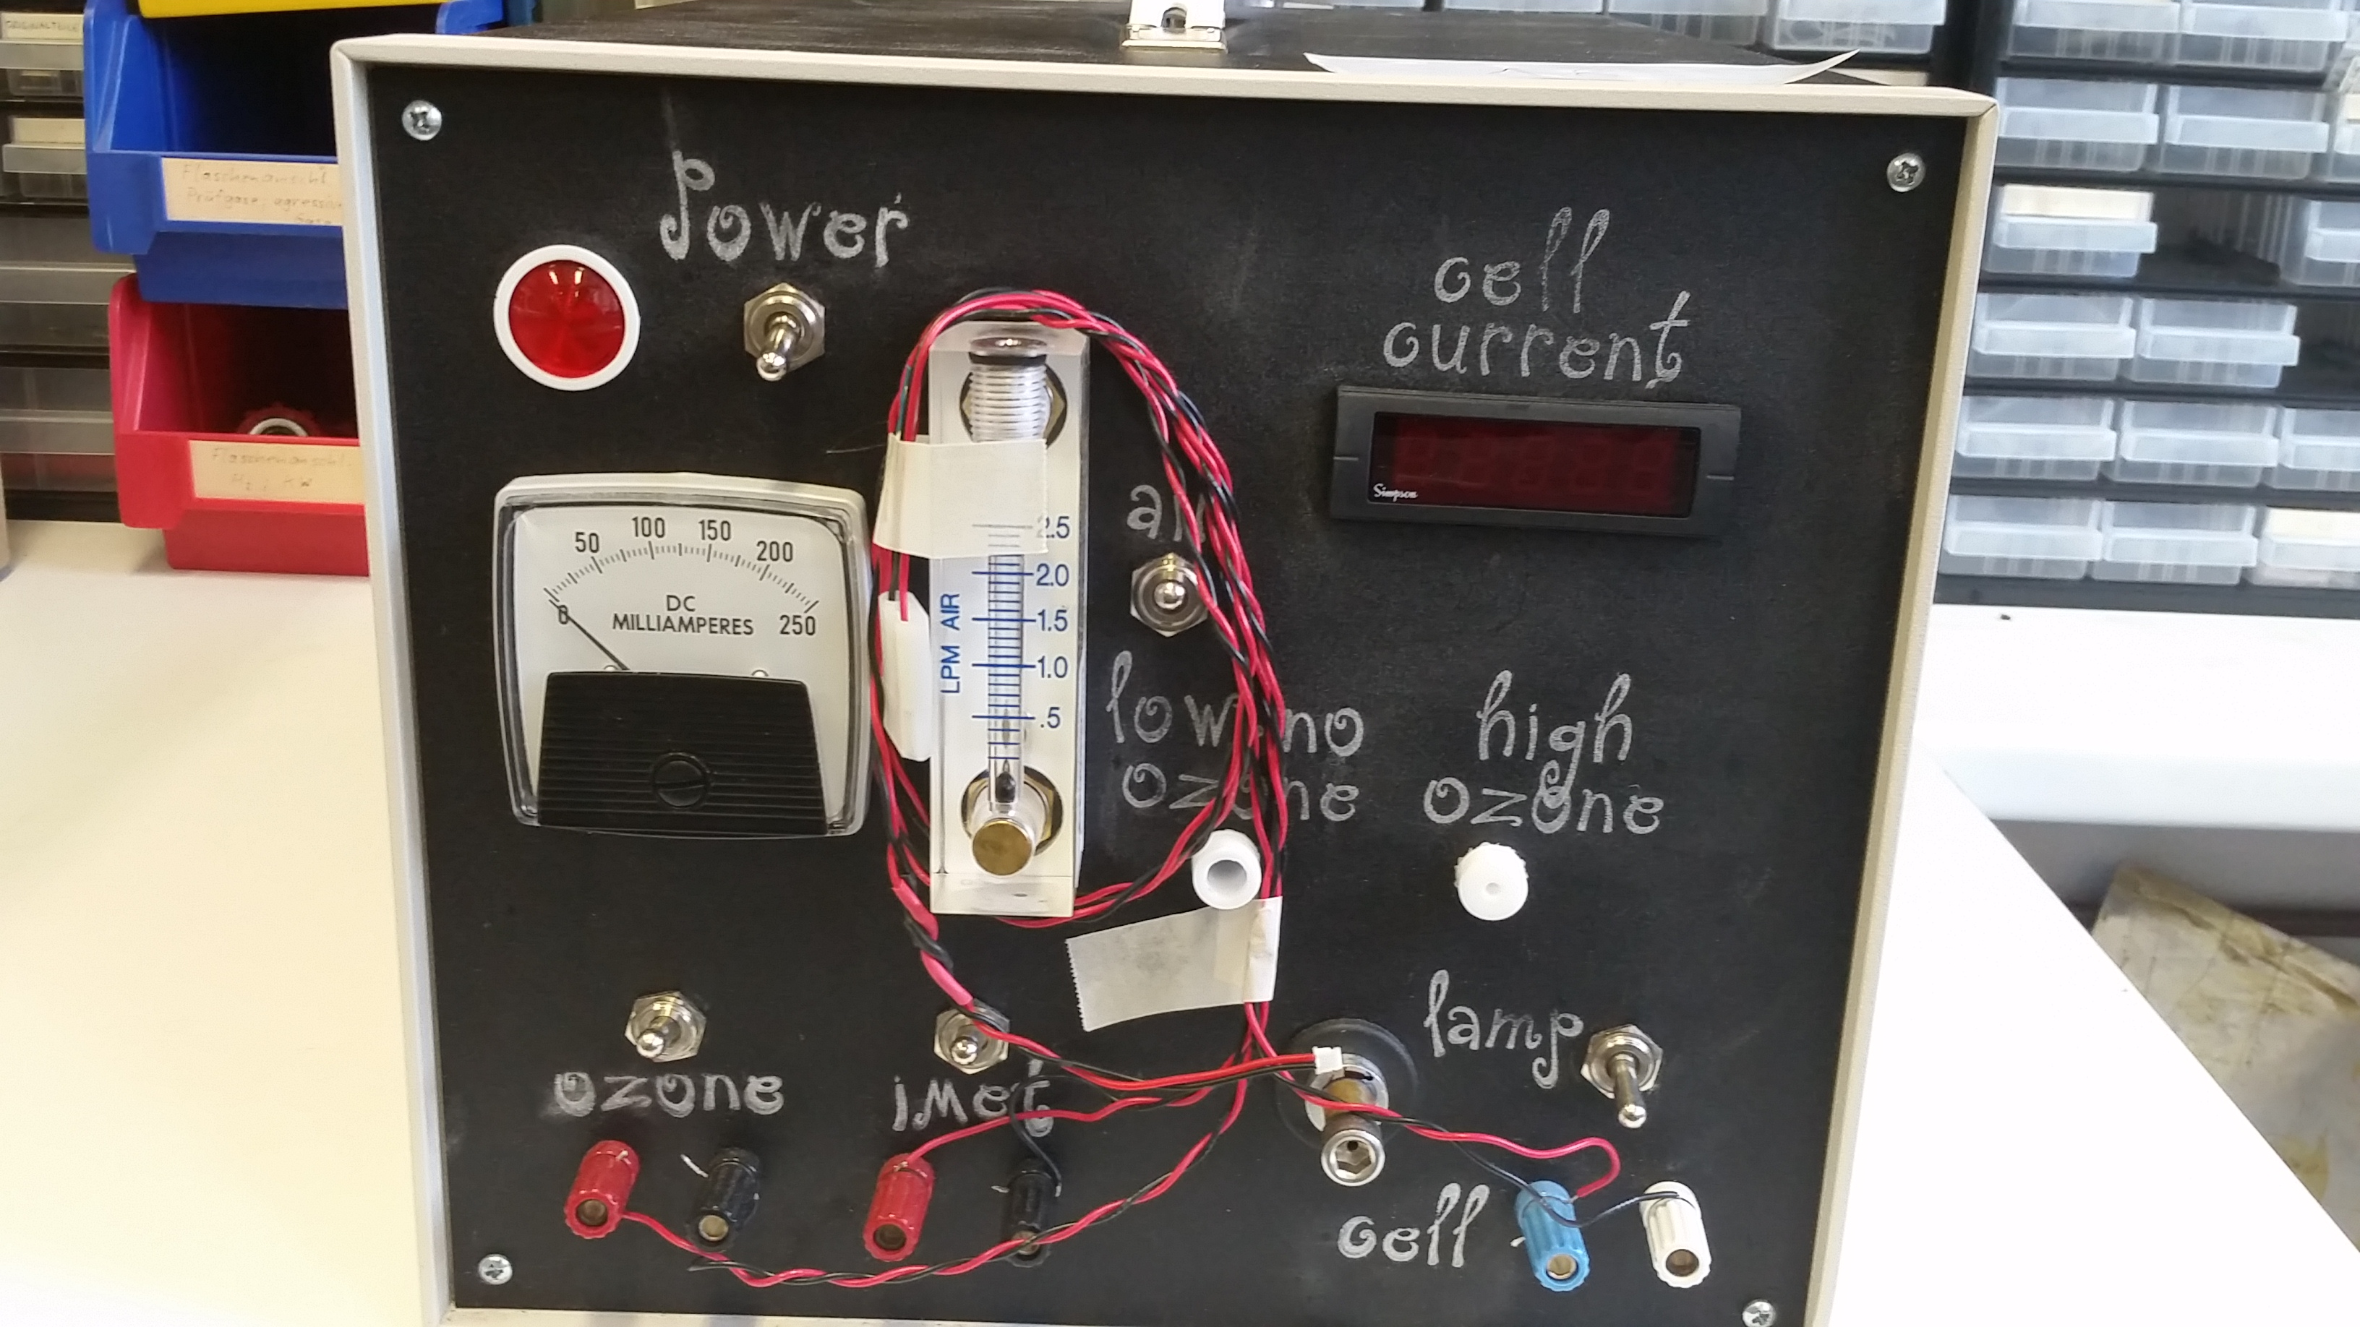
Preparation Check Unit (PCU): Key Requirements (Section 4.2.5 of GAW No. 268)
Provision for the flow of purified and ozone-free air (500–1000 ml/min) through the use of appropriate gas filter techniques
High ozone source for conditioning (cleaning) of the inlet tube, pump, and when dry, also the cathode cell.
Low ozone source (variable) that supplies 0–250 ppbv ozone at 500–1000 ml/min
12 V power to operate the pump motor.
Measurement of applied voltage pump motor (0–20 V, uncertainty 0.05 V or better) and its current (0–250 mA, uncertainty 5 mA or better)
Measurement of ECC cell current I_{M} (Incl. I_{B0} and I_{B1}) (Range: 0–10 µA; Resolution: 0.005 µA: Uncertainty: 0.01 µA or better at I_{M} < 1 µA and 1% of I_{M} or better at I_{M} > 1.00 µA).
Home Made
ENSCI-KTU-3
Home Made
Notes:
Time: 1 min.
A key component in the ground equipment is the preparation check unit to test and check the ozonesonde before launch.
Here we listed the key-requirements or specifications that such a check unit has to fullfill.
Briefly mention the 6 bullits
Provision of a flow of purified and ozone free air
A high ozone source for conditiong (cleaning) the Teflon parts of the ECC-sonde
A low variable ozone source that can supplies ozone volume mixing rations up to 250 ppbv
A 12 V power supply for the pump motor
That it can measure the voltage and current of the pump motor
Accurate measurement of the cell current up to 10 µA

Slide 10
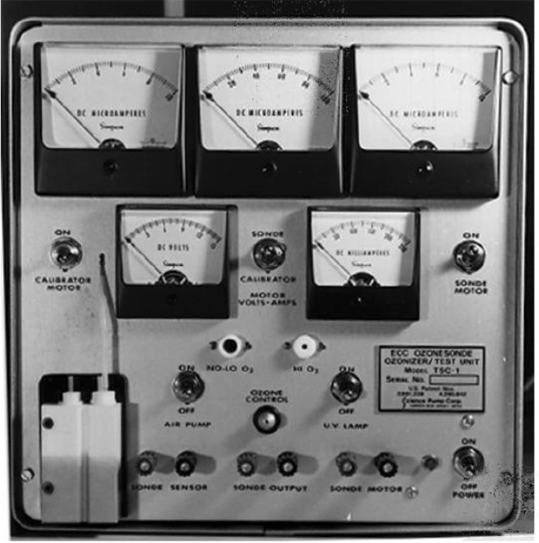
Preparation Check Unit (PCU): Some Critical Remarks
It is strongly recommended that stations check their preparation unit to make sure that it has not been deteriorated over time: Regular Maintenance is Important!
The ASOPOS Panel strongly recommend NOT to use the so-called calibrator cell with which some of the preparation units (e.g. TSC-1 Unit) are equipped.
A number of preparation units are commercially available (e.g. Ensci’s KTU-3 or SPC’s TSC-1).
BUT: SPC TSC-1 Unit is out of time and needs an upgrade: Contact ASOPOS-Panel
Obsolete:
Need UpGrade !
SPC: TSC-1 Unit
Placeholder Gasflow diagramm (To be Done)
Notes:
Time 0.75 min
Here some critical remarks on the preparation check units that are in operation in the global network.
Not all check units fullfill the specifications mentioned in the previous slide. A critical review of the check units used in the network is important to do in the next future.
Above all REGULAR Maintenance of the unit is important, but on that later more in this webinar.
Strong critics here on the TSC-1 Unit of Science Pump Corporation which is a design from the early 1980’s and is definitely obsolete regarding nowadays requirements. This check unit needs to be replaced by a more up to date one!!!

Slide 11
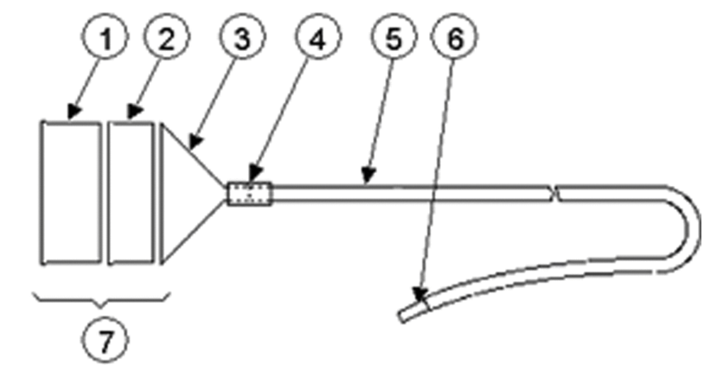
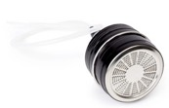
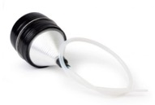

Purified & Zero Air Supply: Proper Gas Filters (1)
Examples of filters that only destroy ozone but NOT purify the air:
Extreme important is to have accurate background current measurements (See Table 5-1 of Chapter 5 of GAW No. 268) of:
  I_{B0}: Before exposure with ozone
  I_{B1}: After exposure with ozone
Too high Background currents I_{B0} and I_{B1} will deteriorate the quality (e.g. uncertainty) of the ozone measurement
Unfortunately the relative simple gas filters (See left some different Ozone Destruction Filters) used by many stations (now and in the past) are only removing ozone but NOT purifying the air from impurities
Therefore it is important to have ozone free air of high purity
This can be achieved only by the use of an appropiate gas filter
1: Catalyst
2: Ultra fiber
Notes:
Time: 1 min
In this slide we will address the use of proper gas filters to provide for an ozone free air supply for the ground check unit
These gas filters are extreme important to obtain proper and accurate background currents measured before and after exposure with ozone during the sonde preparation.
Unfortunately, nowadays many ozone sounding data are still suffering too large background currents which finally will affect the data quality of the ozonesonde
These high backgrounds are caused by improper gas filters that are used to provide ozone free air supply for the ground check unit.
It has been recognized that beside of removing the ozone, the filter should also purify the air from impurities
We only can overcome this problem when we use better gas filters to get not only ozone free supply for the ground check unit, but also that the air has been purified from impurities.

Slide 12
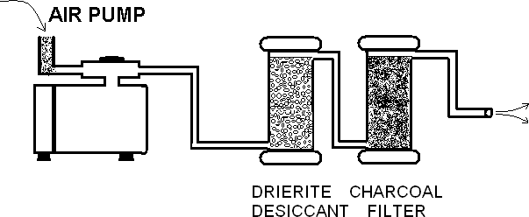
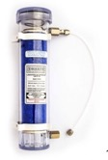

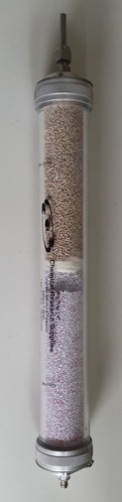
Purified & Zero Air Supply: Proper Gas Filter (2)
Proper gas filter must
  dry the air
  remove the ozone from the air
  purify the air
This can best obtained by (a) filter(s) that contain(s) a cascade of
  drierite desiccant (silicagel) with moist (color) indicator
  active carbon or charcoal
  optional: molecular sieve (4-6 Å)
The filter have to be checked regularly if the silicagel is still dry (moist (color) indicator). All 2 or 3 filter stages can be heated at least at 100-200 ºC for more than 24 hours in order to “clean” and “dry” the absorbers (Regular Maintenance!!).
ASOPOS Panel recommends the station operators to check their filters and consult ASOPOS-Team how to proceed further.
Drierite Desiccant
Two-Stage Gas Filter
Notes:
Time: 0.75 min
How such a proper gas filter could look like.
Now the design is rather simple but essential.
Briefly explain first two bullits.
Important is a regular maintenance of the filter; which we will address later in this webinar.
ASOPOS recommends that the station operators check their filters and eventually consult the ASOPOS-Team how to proceed further.

Slide 13
Sensing Solutions: Requirements (See Annex A of GAW No 268)
Table 2-2 of GAW No. 268
Three different Sensing Solution Types (see left: SST1.0, SST0.5 and SST0.1) are used in the global sonde network
High-purity chemicals (KI, KBr and Na-Phosphate Buffer)
High-purity grade water to prepare aqueous anode and cathode sensing solutions
It is important to follow general rules of cleanliness:
  Clean laboratory tools (e.g. flasks, burettes, syringes etc.)
  Clean handling: Recommended are single-use medical gloves
  Following the practical guidelines of ASOPOS 2.0 as described in Annex A of GAW Report No. 268
Ozonesonde Test Kit
Notes:
Time: 1 min.
A crucial aspect in the preparation of the ozonesonde is the preparation of the sensing solutions for the cathode and anode cell.
Nowadays 3 different sensing solution typers are in use, listed here in Tble2-2 of the GAW 268 report.
Important here is that for the preparation of aquous sensing solutions, only high graded purity of the chemicals and water are used!
Important here to use well cleaned laboratory tools, the use of one way medical handgloves, and in general following the guidelines described in Annex A of GAW No 268.

Slide 14
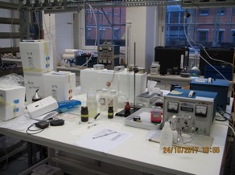
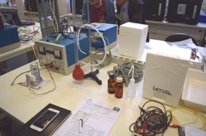
Preparation Laboratory: Requirements (Annex-A of GAW No. 268)
Clean Working Space:
  No Smoking
  No Food
  No Drinks
Clean Working Bench
Ambient Air Detectors to record:
  Pressure (P: +/- 0.5 hPa)
  Temperature (T: +/- 0.2 K)
  Relative Humidity (RH: +/- 5 %)
Notes:
Time: 0.5 min
And when talking about cleanliness, this is of course also the case with regard to the working space and working bench.
Key message here should be, because we are dealing with a chemical ozone sensor, that it is in general exteremely important here to follow steadily the principles of cleaniness.
Further, it should be mentioned that in the preparation laboratory there should be detectors to record air Pressure, Temperature and Relative Humidity. Thes PTU values are necessary finally to calculate the corrected pump flowrate from the bubble flow meter measurements.

Slide 15
Proper In-Flight Pump Temperatures
A proper pump temperature is important so that no freezing or evaporation (by boiling) of the sensing solutions can occur in the course of the sounding.
Important: Note that in the course of the sounding the solution temperature in the cathode cell generally becomes lower than the pump temperature: SPC-6A sondes by up to 5ºC and ENSCI sondes by up 10ºC.
Optimum pump (i.e. cell) temperature should be as low as possible to prevent large losses of sensing solution (evaporation or spraying), particularly when reduced air pressures (< 20-30 hPa) increase the potential for boiling, but not too low to avoid freezing!
Depending on the ECC sonde type the optimum pump temperature for SPC sondes should be 5-10 ºC and for En-Sci sondes 10-15 ºC over the course of the sounding, such that the temperature of the cathode solution is maintained above its freezing point.
A proper in-flight pump temperature can be achieved through the use of :
  Passive heat source: Add an air free water bag/can as heat capacity
  Active (electrically) controlled heat source: only turned on when the pump temperature falls below a certain threshold and turned off when the pump temperature is above the threshold (can be integrated in the interface)
Notes:
Time:1.5 min.
Important on the hardware here is also to mention how to obtain a proper in-flight pump temperature. This is a typical example of a small aspoct of the sonde-hardware but which can become critical on the in-flight perfomance of the sonde in the course of the sounding.
The pump temperature should be namely within a certain range to avoid either freezing of the sensing solution or strong evaporation of the sensing solution.
In both cases namely the ozonesonde will measure too low ozone values.
In addition it has to be noted here that the cathode cell temperatures are usually lower than the pump temperatures: For SPC up to 5 degrees and for En-Sci up to 10 degrees Celsius
Particularly in the upper part of the sounding above 20-25 km altitude the optimum pump temperature should be 5-10 C for SPC sondes and 10-15 C for En-Sci sondes.
However, this is not everywhere easy to achieve. For example in the Tropics or polar regions by adding an extra heat source in the styrofoam box of the sonde.
This extra heat source can be either passive source by adding a heat capacity (200 ml water can) or install a small electrical controlled heat resistance.
However, it is finally a certain trial and error and therefore it is recommended for the individual station operatores when facing pump temeprature problems to consult the ASOPOS team how to proceed…..

Slide 16
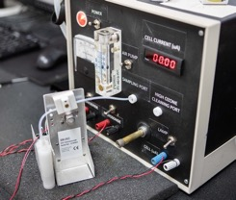
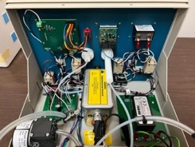
Maintenance: Preparation Check Unit (PCU)
  Check the UV-Lamp (UV of 185 nm)
    Is there a change in the position of the “movable UV-light shielding tube” that is used to test the 5 µA cell current (more than 20% change in the full length of the shielding tube)?
    If yes, then install a new lamp.
  Check the UV-Quartz glass cuvette cleanliness:
    Even if the UV-Lamp is okay, there can still be more than an apparent 20% change in full length of the shielding tube due to a degraded transparency from a dirty cuvette
    In case the gas filter is okay, but the background currents I_{B0} and I_{B1} are systematically too high and NOT within the recommended values.
    If the cuvette is not clean, then replace it with a new one.
Entry UV-Lamp
Housing UV-Cuvette
Notes:
Time 0.75 min
Coming now to our last topic of this webinar: The Maintenance of the ground equipment.
In general it is important to regularly check the functionality of the ground equipment and particularly do regular maintenance on the different components.
This concerns first of all the Preparation Check Unit: Here are to mention two critical aspects dealing with the UV lamp together with the UV-quartz cuvette, both key components in the provision of ozone
Mention the two bullits
First of all is the UV lamp that produces the high and low ozone still providing enough ozone still sufficient or not. This can be seen on a change of the position of the shielding tube to adjust the 5µA ozone current of the ECC
If the lamp is okay but still the position of the shielding tube as for the UV-lamp is not adequate or that the background currents IB0 and IB1 are too large. In both cases it could be that the inside of the cuvette has got polluted.

Slide 17

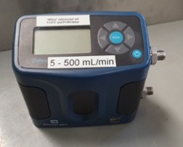
Maintenance: Zero Ozone Air Supply and Automatic Flowmeter
Zero Ozone-Purified Air Supply:
  Check Zero Ozone -Purified Air Filter (moist indicator), especially when background currents are NOT within recommended I_{B0} and I_{B1} values.
    If the filter has degraded, replace with a new (or regenerated) Zero Ozone-Purified Air Filter
    The filter can be regenerated by removing moisture in the absorbent. Heated at 100-200ºC for at least 24 hours
2. Automatic flowmeter:
  If an automated flowmeter is used, compare and record the readings with a calibrated bubble flow meter about every month.
    If agreement not within 0.5-1%: the automatic flowmeter needs to be repaired/recalibrated by its manufacturer
Notes:
Time: 0.75 min
Further important maintenance is to do a regular check of the zero-purified air supply:
Is the moisture indicator in the first trap of the gas filter not anymore indicating low moisture then the filter has to be replaced by a new one.
Further, in case the backgrounds currents IB0 and IB1 are not anymore within the recommended ranges anymore then the filter should be replaced too.
Hereby the old filter usually can be regenerated and then re-used.
Another important aspect on maintenance is when using automatic flowmeters that these electronic devices are regularly (every month) compared with a calibrated bubble flow meter and when they deviate by more than 0.5-1% the automatic flow meter should be reüaired by the manufacturer.

Slide 18
ASOPOS 2.0 Webinar No.2 Hardware: Key Notes
Regular check and maintenance of the ground equipment at the station is important.
It is strongly recommended that stations check their preparation check unit to make sure that it has not been degraded over time.
Unfortunately the relative simple gas filters used by many stations in the network are improper and cause too high background currents I_{B0} and I_{B1}, which deteriorate the quality (e.g. uncertainty) of the measurement.
Proper gas filters must (i) dry the air; (ii) remove the ozone and (iii) purify the air from impurities. Regular maintenance through exchange of gas filter is essential!!
ASOPOS Panel recommends the station operators to check their filters and consult ASOPOS
High graded purity of chemicals (KI, KBr and Na-Phosphate Buffer)
High graded purity of water to prepare aqueous anode and cathode sensing solutions
Important to follow the general rules of cleaniness in the laboratory and during preparation!!
Only then we can achieve the target to get an overall uncertainty of 5% !!!
Notes:
Time 1 min
Now summarizing: In this webinar we only addressed the most critical aspects of the hardware. The entire hardware is described in detail in the GAW No. 268 report.
In this slide we listed some key notes on the most crucial aspects of the hardware used in ozonesoundings.
Briefly mentioning the bullits.
Regular checks and maintenace of the ground equipment is essential.
Use of proper groundcheck unit that fulfill the requirements mentioned in this webinar is
The use of proper gas filters to remove ozone AND impurities of the airflow in order to obtain accurate background currents IB0 and IB1
Use of high graded purity of chemicals and water to prepare the sensing solutions for the electrochemical sensor cells.
And in general the use of clean laboratory tools, a clean working-space and a clean working bench
Only then we can achieve the target to get an overal uncertainty of 5% in our global ozonesonde network.

Slide 19
Closing Remarks
This webinar no. 2 is part of a series of ASOPOS Webinars:
  Introduction to ASOPOS 2.0: An Overview (Anne Thompson & Herman Smit)
  Hardware (Herman Smit & Roeland Van Malderen)
  SOP: Standard Operating Procedures (Roeland Van Malderen, Peter von der Gathen, Gary Morris & Bryan Johnson)
  Data Processing (Herman Smit & David Tarasick)
  Data Quality Indicators (DQI) (Ryan Stauffer & Holger Vömel)
  Meta Data and Software (Ryan Stauffer & Roeland Van Malderen)
The webinars do not replace the Report or associated video clips, but only highlight the most important topics and updates from the previous ASOPOS 1.0 report (WMO/GAW Report No. 201).
Whenever you have questions or need advice, consult the authors of this webinar or any of the ASOPOS Team members listed above !!!
Thank you for your attention. We look forward to future collaborations!!!
Notes:
Time: 0.5 min.
And finally some closing remarks:
This webinar No.2 is part of a series of ASOPOSwebinars for the implementations of the recommendations made by the ASOPOS panel in the GAW Report No.268.
Thank you for your attention and go for good collaborations in the future !!!
Bye Bye.........

