Slide 1

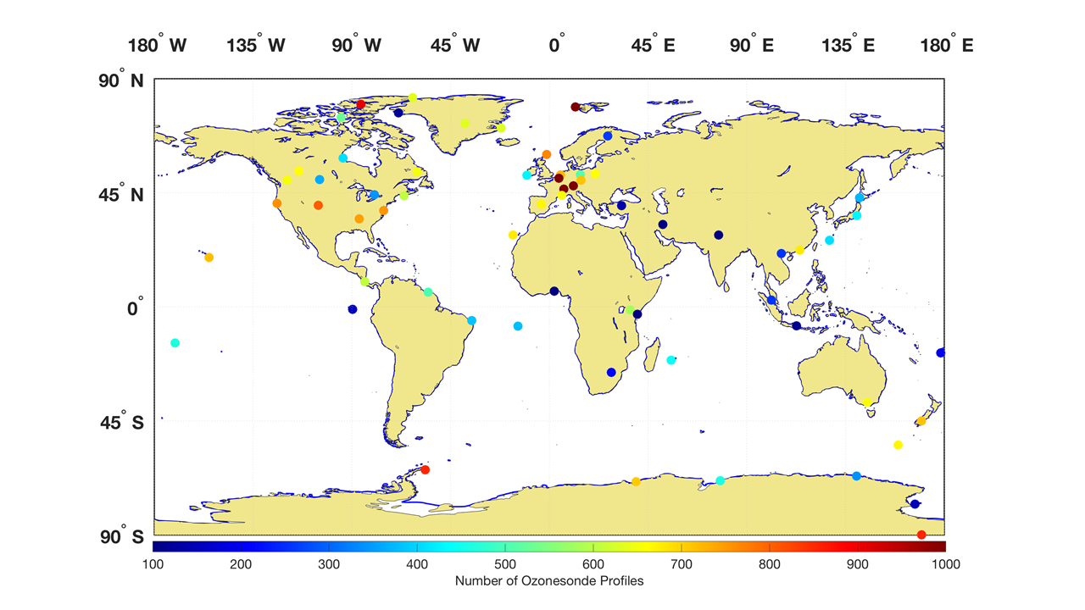









ASOPOS-Webinar Series on the Implementation of the Recommendations Made by the ASOPOS 2.0 Panel
Ozonesonde Measurement Principles and Best Operational Practices
ASOPOS 2.0 (GAW Report No. 268)
(Assessment of Standard Operating Procedures for Ozonesondes)
ASOPOS-Webinar No. 3
Standard Operating Procedures (SOPs) for Ozonesondes
Roeland Van Malderen (*), Peter von der Gathen,
Herman Smit, Gary Morris
(*) Contact: Roeland.VanMalderen@meteo.be
Version Dec 2022

Slide 2

Outline
Introduction
First preparation (3 to 30 days prior to launch)
Second preparation (0 to 1 day prior to launch)
Issues to avoid & potential pitfalls
Take away messages

Slide 3


Introduction
from the JOSIE campaigns: operating and preparation procedures impact accuracy and precision from ozonesonde measurements
Overall recommendation: DO NOT CHANGE! (i.e. don’t switch to a different combination)
  SPC-6A + SST1.0 + PFE: Komhyr 1986
  En-Sci (2)Z + SST0.5 + PFE: Komhyr 1995
  En-Sci (2)Z + SST0.1 + PFE: Johnson et al. 2002/Nakano & Morofuji 2022
SOPs: only small, but important, changes proposed
Reference to WMO GAW 201 (old) and WMO GAW 268 (new)

Slide 4
Introduction
SOPs: only small (but important) changes proposed → WHY CHANGES?
  Keep SOPs as simple as possible.
  Drop manipulations without proven added value (e.g. back pressure of pumps).
  Avoid unnecessary manipulations with cells opened (e.g. refreshing solutions).
  Build in some quality checks/limiting values to avoid launch of bad ozonesondes.
  Get ready for future reprocessing based on current knowledge (Vömel et al., 2020; Tarasick et al., 2021; Smit et al., in preparation): I_{B0}, I_{B1}, sensor response time.
HOW/WHY doing the preparation steps:
  video on Preparation of an ECC-Ozonesonde: https://vimeo.com/niwanz/asoposprep
  GAW Report No. 268, particularly Chapter 4 (WHY) and Annex A (HOW)
➔ Here: key messages + most important changes w.r.t. WMO GAW 201!

Slide 5
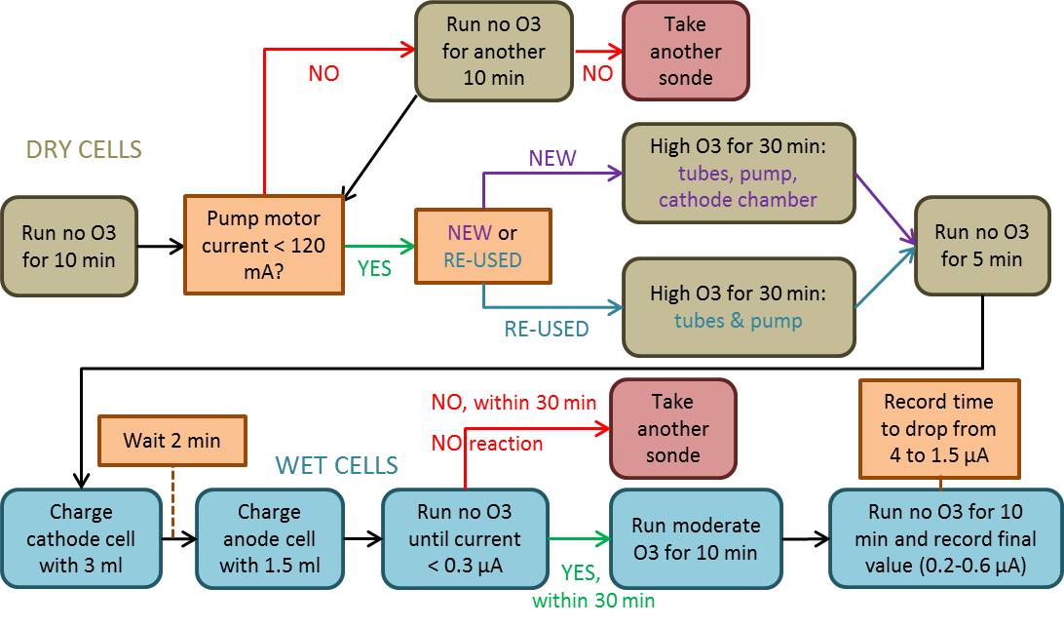
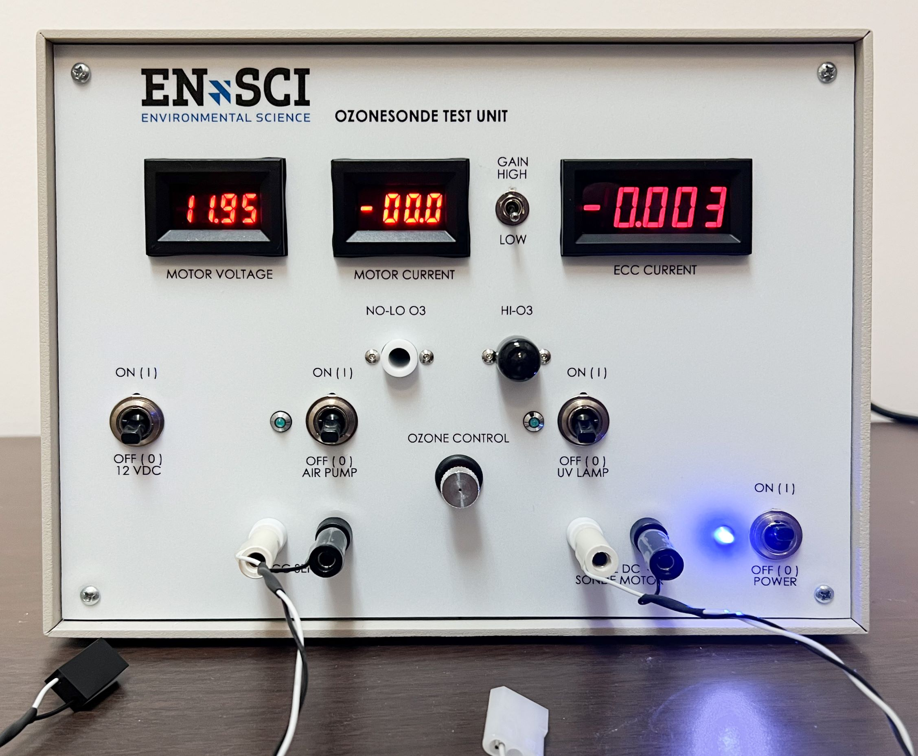
First preparation (3 to 30 days prior to launch)
PURPOSE:
cleaning some parts of the ozonesonde
first pre-check of overall performance of the ozonesonde
charging the ozonesonde with sensing solutions for the first time

Slide 6
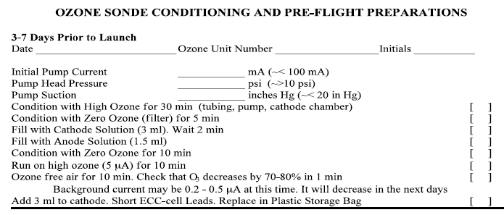
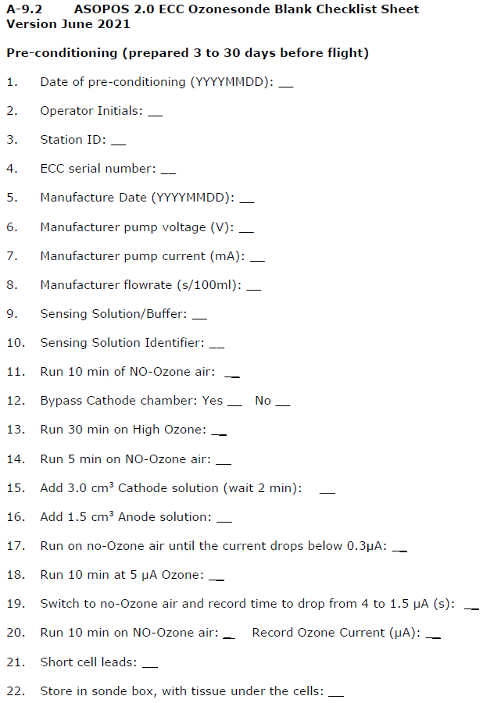
First preparation (3 to 30 days prior to launch)
WMO GAW 201 (old)
WMO GAW 268 (new)

Slide 7
First preparation (3 to 30 days prior to launch)
WMO GAW 201 (old)
WMO GAW 268 (new)
First preparation period extended
➔ no need to refresh solutions after 1 week

Slide 8
First preparation (3 to 30 days prior to launch)
WMO GAW 201 (old)
WMO GAW 268 (new)
There should be also“measured”!
Pump Head Pressure/Suction no longer needed
  note manufacturer measurements
  measured pump current < 120mA!

Slide 9
First preparation (3 to 30 days prior to launch)
WMO GAW 201 (old)
WMO GAW 268 (new)
Pump Head Pressure/Suction no longer needed
  note manufacturer measurements
  measured pump current < 120mA!

Slide 10
First preparation (3 to 30 days prior to launch)
WMO GAW 201 (old)
WMO GAW 268 (new)
Conditioning with high ozone amounts
  NEW sondes: tubing, pump & cathode chamber (i.e. NO BYPASS)
  RE-USED sondes: tubing, pump & only cathode chamber cap (i.e. BYPASS cathode chamber)

Slide 11
First preparation (3 to 30 days prior to launch)
WMO GAW 201 (old)
WMO GAW 268 (new)
Conditioning with high ozone amounts
  NEW sondes: tubing, pump & cathode chamber (i.e. NO BYPASS)
  RE-USED sondes: tubing, pump & only cathode chamber cap (i.e. BYPASS cathode chamber)

Slide 12
First preparation (3 to 30 days prior to launch)
WMO GAW 201 (old)
WMO GAW 268 (new)
When first charged with solutions, run zero ozone air through the cells for a longer time (< 30 min)
  There should be a reaction (high ozone currents) first!
  Ozone current should then drop below
  0.3 µA within 30 min. (longer for En-Sci than SPC)

Slide 13
First preparation (3 to 30 days prior to launch)
WMO GAW 201 (old)
WMO GAW 268 (new)
Store prepared ozonesonde in Styrofoam box, with tissue under the cells
➔ leaking of cells can then be checked after storage ➔ (brown stains from KI)!

Slide 14
Second preparation (0 to 1 day prior to launch) – “day of flight”
PURPOSE:
final check of overall performance of the ozonesonde
measure the variables that enter in the basic equation of the ozonesonde measurement:
measure variables that (might) enter (in the future) in the ozonesonde data processing code (lab conditions at flow rate measurement, background current I_{B0}, fast response time)
pump temperature
measured cell current
[E-2-1]
pump, absorption, and
conversion efficiencies
pump flow rate
background current I_{B1}

Slide 15
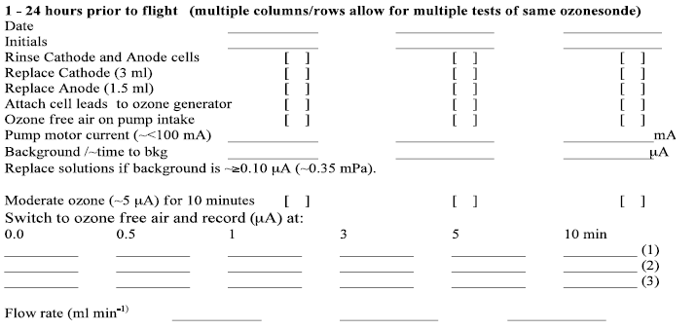
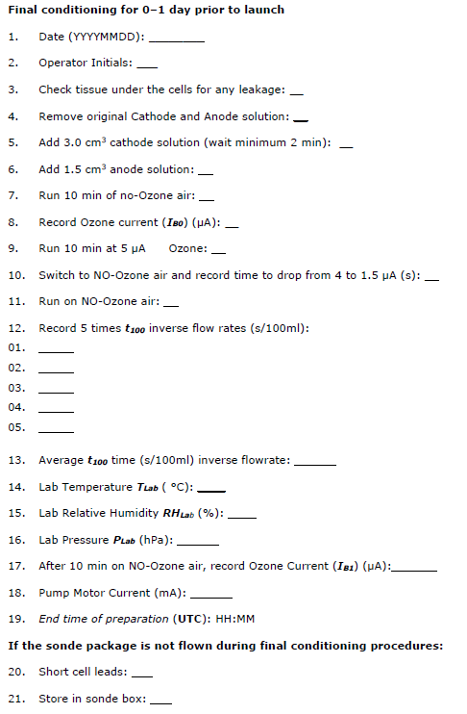
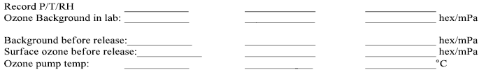
Second preparation (0 to 1 day prior to launch)
WMO GAW 201 (old)
WMO GAW 268 (new)

Slide 16
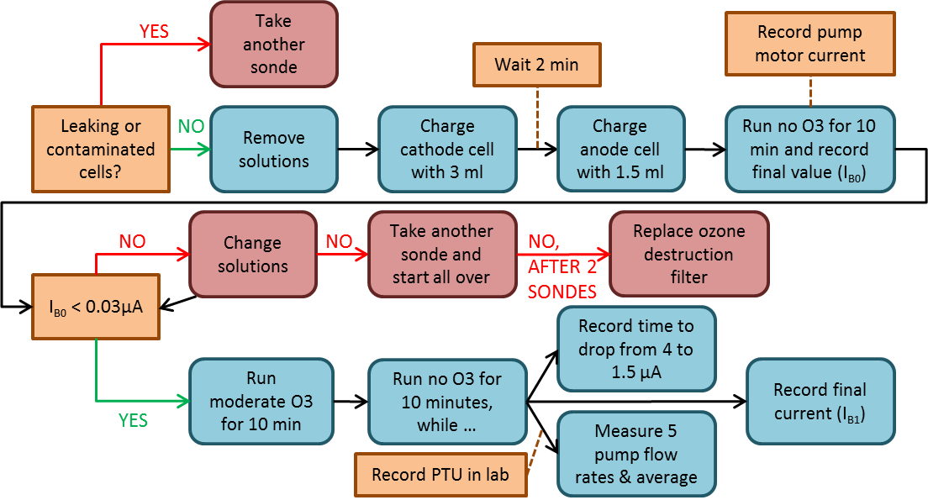
Second preparation (0 to 1 day prior to launch)
WMO GAW 201 (old)
WMO GAW 268 (new)
< 0.03 µA
background current measurements
  I_{B0} < 0.03 µA + actions
  I_{B1} < 0.07 µA + timing
  No I_{B2} (at launch site)!
< 0.07 µA

Slide 17
Second preparation (0 to 1 day prior to launch)
WMO GAW 201 (old)
WMO GAW 268 (new)
sensor (fast) response test ➔ response time of the drop from 4.0 to 1.5 µA to be preferred, as it corresponds to direct measure-ment of the exp. decrease 1/e ≈ 0.368 ≈ 1.5/4.0

Slide 18
Second preparation (0 to 1 day prior to launch)
WMO GAW 201 (old)
WMO GAW 268 (new)
When performing pump flow rate measurements
(→ “Hardware webinar”), accurately record PTU lab conditions for humidification correction (i.e., “dry flow rate” correction)

Slide 19
Issues to avoid & potential pitfalls
We are maintaining a Google Spaces chat/blog group for ozonesonde station operators and technicians. Contact Gary.Morris@noaa.gov to join the space.
Some important pitfalls or guidelines:
  do not spill any of the anode into the cathode!
  check pump temperature (through interface) just before launch
  avoid evaporation (T_{P} >20°C) or freezing (T_{P} < 10°C for En-Sci, < 5°C for SPC) of solutions at lower pressures (P_{Air} < 50 hPa) → “Hardware” Webinar (#2)
  maintain and check the hardware used for the preparation → “Hardware” Webinar (#2)
  carefully archive all the metadata gathered during the preparation → “Metadata” Webinar (#6)
  follow guidelines for data processing → “Processing” Webinar (#4)

Slide 20
Take away messages
NOT treated here: SOPs for cleaning recovered sondes, new data format. Please see the report + more news from data archives in near future.
MOST IMPORTANT TAKE HOME MESSAGE: Do NOT change your SOPs, unless seriously deviating from the SOPs in the report AND after discussing with an ASOPOS member.
Most important proposed changes w.r.t. previous report:
  use I_{B1} for background current subtraction, do not measure I_{B2} anymore
  I_{B0} < 0.03 µA and I_{B1} < 0.07 µA should be feasible with good zero ozone air sources
  (fast) time response measurement between 4 and 1.5 µA drop
  During high ozone conditioning: distinction between new (no bypass) and recovered (bypass) ozonesondes

Slide 21
Closing Remarks
This webinar no. 3 is part of a series of ASOPOS Webinars:
  Introduction to ASOPOS 2.0: An Overview (Anne Thompson & Herman Smit)
  Hardware (Herman Smit & Roeland Van Malderen)
  SOP: Standard Operating Procedures (Roeland Van Malderen, Peter von der Gathen, Gary Morris & Bryan Johnson)
  Data Processing (Herman Smit & David Tarasick)
  Data Quality Indicators (DQI) (Ryan Stauffer & Holger Vömel)
  Meta Data and Software (Ryan Stauffer & Roeland Van Malderen)
The webinars do not replace the Report or associated video clips, but only highlight the most important topics and updates from the previous ASOPOS 1.0 report (WMO/GAW Report No. 201).
Whenever you have questions or need advice, consult the authors of this webinar or any of the ASOPOS Team members listed above !!!
Thank you for your attention. We look forward to future collaborations!!!
Notes:
Time: 0.5 min.
And finally some closing remarks:
This webinar No.2 is part of a series of ASOPOSwebinars for the implementations of the recommendations made by the ASOPOS panel in the GAW Report No.268.
Thank you for your attention and go for good collaborations in the future !!!
Bye Bye.........

