Slide 1

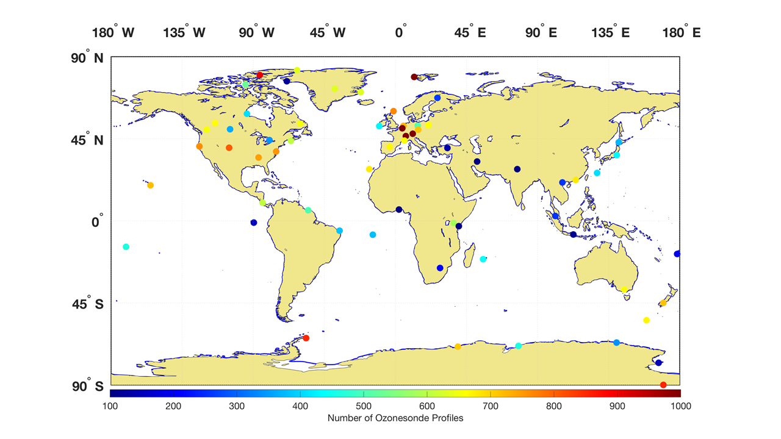
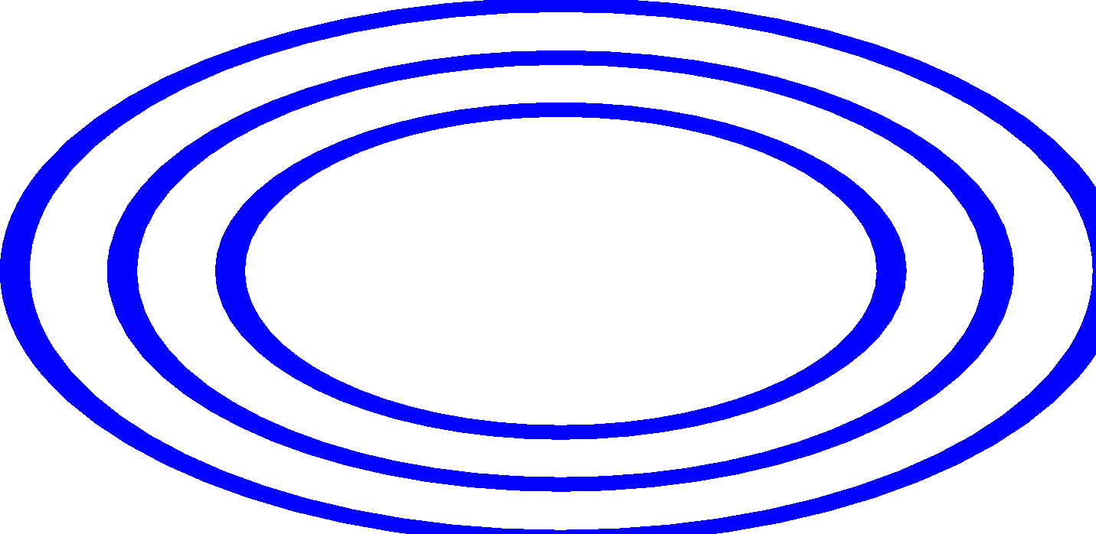









ASOPOS-Webinar Series on the Implementation of the Recommendations Made by the ASOPOS 2.0 Panel
Ozonesonde Measurement Principles and Best Operational Practices
ASOPOS 2.0 (GAW Report No. 268)
(Assessment of Standard Operating Procedures for Ozonesondes)
ASOPOS-Webinar No. 4
Data Processing
Herman Smit ⁽¹⁾, David Tarasick ⁽²⁾
(¹) h.smit@fz-Juelich.de
(²) david.tarasick@ec.gc.ca
Version March 2024
Notes:
Time 1 min:
Welcome to this ASOPOS-Webinar No. 4 on Data Processing of a series of 6 webinars dedicated to the implementation of the recommendations made by the ASOPOS 2.0 panel and published in the GAW report No.268 with the title “Ozonesonde Measurement Principles and Best Operational Practices”.
ASOPOS stands for Assessment of Standard Operating Procedures for Ozone Sondes
My name is Herman Smit and I am from the Research Centre Jülich in Germany and together with my colleague David Tarasick of Environmental Canada Climate Change in Canada we will guide you through this webinar.

Slide 2

Preamble
The focus in this webinar will be not only on the basics of the data processing to derive the ozone partial pressure from the ozonesonde (incl. radiosonde) measurements, but also on new aspects of this ASOPOS 2.0 report, specifically the individual uncertainties of different instrumental parameters that contribute to the overall estimated uncertainty of the ozonesonde data
The scientific and technical basics of the data processing of ozonesonde data and their uncertainty budget are described in Chapter 3 of the ASOPOS 2.0 Report (WMO/GAW No. 268)
The ozonesonde data processing in practice is described in detail in Annex-C (WMO/GAW No. 268) : “Practical Guidelines to Determine Ozone Partial Pressure by ECC Sonde, and its associated uncertainty”
Available at https://library.wmo.int
GAW-Report No. 268
Notes:
Time: 1.0 min
But before we start with this webinar first a few remarks to avoid any misunderstandings.
First of all, this new ASOPOS report builds on the earlier ASOPOS-GAW Report No. 201 from 2014.
Secondly, in this webinar we will highlight the data processing and the ozonesonde uncertainty budget
Hereby, particularly the composition of the uncertainty budget and the overall uncertainty are new important contributions of this new ASOPOS 2.0
Actually, this goes hand in hand with the new sections on the description of meta data which will be treated further in Webinar No. 6
Details of the data processing, the uncertainty budget and their practical guidelines are described in the GAW Report No. 268.

Slide 3

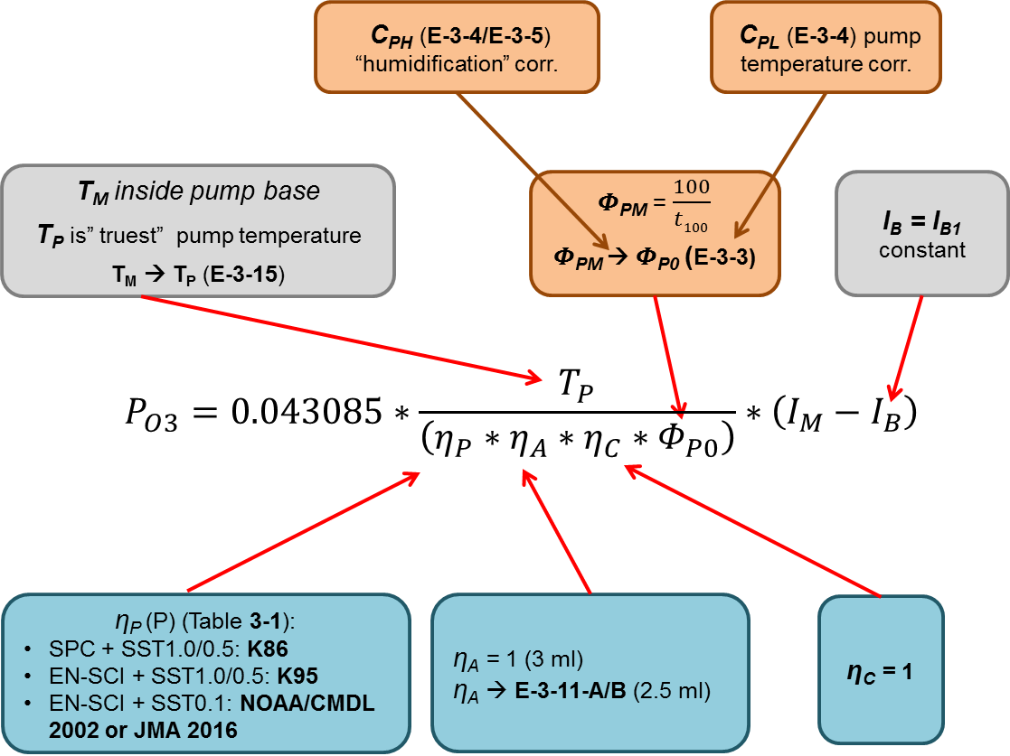
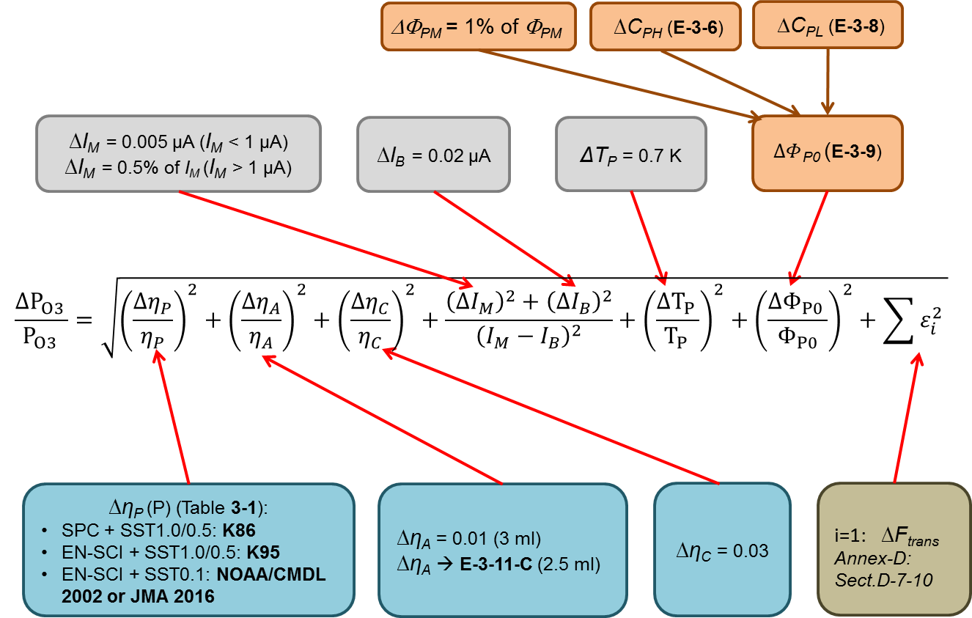
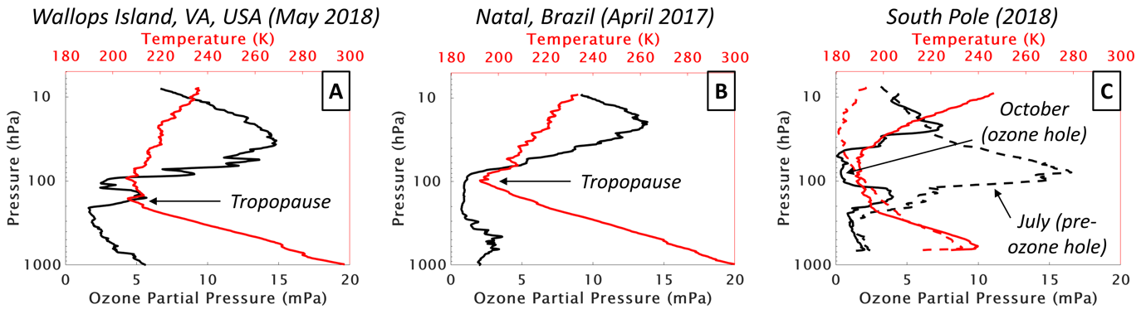
Outline
Basic Formula
Uncertainty Budget
Ozonesonde Parameters
Flight Time
Uncertainty Budget
Individual O₃S-Parameters
Key Notes
Flight Time
Notes:
Time:1.0 min
But before going into any details here first a short outline of this webinar.
We will start giving a short overview of the parameters from which the vertical profiles are derived
Then some words on the flight time as the independent flight variable
Followed by the composition of the uncertainty budget
The focus of this webinars will be on the individual ozonesonde parameters and their contributions to the uncertainty budget.
After this we will give two examples of uncertainty budgets once for a mid-latitude and once for a tropical vertical ozonesonde profile, respectively.
And finally, some key notes from this webinar as take away messages.

Slide 4
Data Processing: Overview (Section C-3 GAW No.268)
The partial pressure of ozone P_{O3} is derived from the ozonesonde (incl. radiosonde) measurements (See Left):
Cell Current (in-flight): I_{M}
Background Current (preparation): I_{B}
Pump temperature (in-flight): from measured T_{PM} toT_{P}
Pump flowrate at ground (preparation): 𝚽_{P0}
Absorption Efficiency (empirical): 𝛈_{A}(P)
Pump Efficiency (empirical): 𝛈_{P}(P)
Conversion Efficiency (empirical): 𝛈_{C}(P)
Radiosonde (in-flight):
  Pressure: P_{Air} ;Temperature: T_{Air} ; Rel. Humidity: U_{Air}
  GPS: Lat, Long, Wind (Velocity & Direction)
  Altitude (calculated): Z or H
The focus here will be on the most critical parameters and their contributions to the overall uncertainty of the ozonesonde measurement
Basic ECC-Ozonesonde Equation: E-2-1
Figure C-3 (Annex-C of WMO/GAW No. 268)
Notes:
Time 1:30
But let us start by giving an overview of all the parameters determining the ozone partial pressure PO3.
This is expressed in the basic ECC ozonesonde equation shown here as E-2-1.
Whereby the measured sonde parameters are: the Cell Current, the Background Current, the Pump Temperature and the Pump Flowrate and in addition the empirically derived sonde parameters of absorption, pump and conversion efficiency, respectively.
Each of the parameters shown in this equation we will now present here in more detail.
However, the radiosonde-parameters mentioned here are beyond the scope of this webinar and are described in more detail in Section 2.4.3 of the GAW Report No. 268.
Here, the focus in this webinar will be on the most critical sonde parameters and their contributions to the overall uncertainty of the ozonesonde measurement PO3.

Slide 5
Flight Time (t_{F}) as Independent Profile Variable (Section C-4 GAW No.268)
Important time markers (See also Section C-4 of WMO/GAW Report No. 268) are:
Time stamp (t_{UTC, IB1}) in UTC of the measurement of I_{B1} (background current after ozone exposure) during preparation. During pre-launch the Flight Time t_{F, Pre-launch} < 0 seconds
Time stamp of the launch (t_{UTC, Launch}) in UTC; here the flight time t_{F,Launch} = 0 seconds
Time stamp of the balloon burst (t_{UTC, Burst}) in UTC
UTC = Coordinated Universal Time = GMT = Greenwich Mean Time
Notes:
Time 1 min
Concerning the flight time which is actually the independent profile variable of the ozonesounding, some remarks are to make here.
Its horizontal timeline shown here, has been splitted into different phases before and after the launch of the balloon sonde.
At the time of the launch the flight time is assumed to be zero, such that the pre-launch period towards the preparation period the flight time can be assumed to evolve with negative values relative to the Launch time
While after launch the flight time, in the course of the sounding, evolves with positive values.
Three important time stamps are here to mention:
UTC-time of the recording of the IB1 background current after exposure with ozone as part of the sonde preparation before launch.
UTC-time of the launch as the start of measuring the vertical ozonesonde profile
UTC-time of the burst of the balloon as the top of the measured vertical ozonesonde profile.

Slide 6
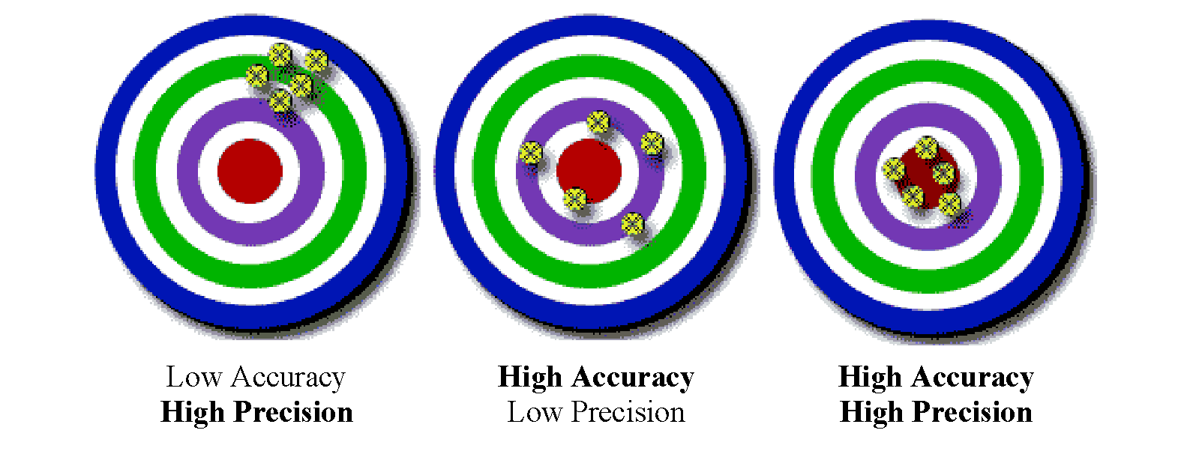
Precison, Accuracy, Bias and Uncertainty Budget (Section C-2 GAW No.268)
Precision and Accuracy
Uncertainty Budget Ozonesonde Equation: E-3-1
Bias and Uncertainty
Figure C-4 of Annex-C of GAW No.268
-Uncertainty
See Also Section 3.3.1 of GAW Report No. 268
Notes:
Time: 1:30
Talking about the uncertainty budget and the contributions of the individual parameters first a few words on precision, accuracy, bias and uncertainty.
In the upper left cartoon the difference between high and low accuracy and precision is demonstrated
While in the lower left figure is expressed what uncertainty is as a statistical number of the measured values which often also can be seen as precision of the measurement.
Bias is thereby the systematic difference between the measured and the true value. The combination of bias and uncertainty is often expressed in qualitative terms as the accuracy of the measurement.
Now coming to the uncertainty budget of the ozonesonde which is expressed in Equation E-3-1 which is derived from the basic ozonesonde equation E-2-1 and this has been described in detail in section 3.3.1 of the GAW No. 268 Report.
In the following slides the different parameters and their uncertainty contributions to the overall uncertainty of the ozonesonde PO3 measurement will be presented.

Slide 7
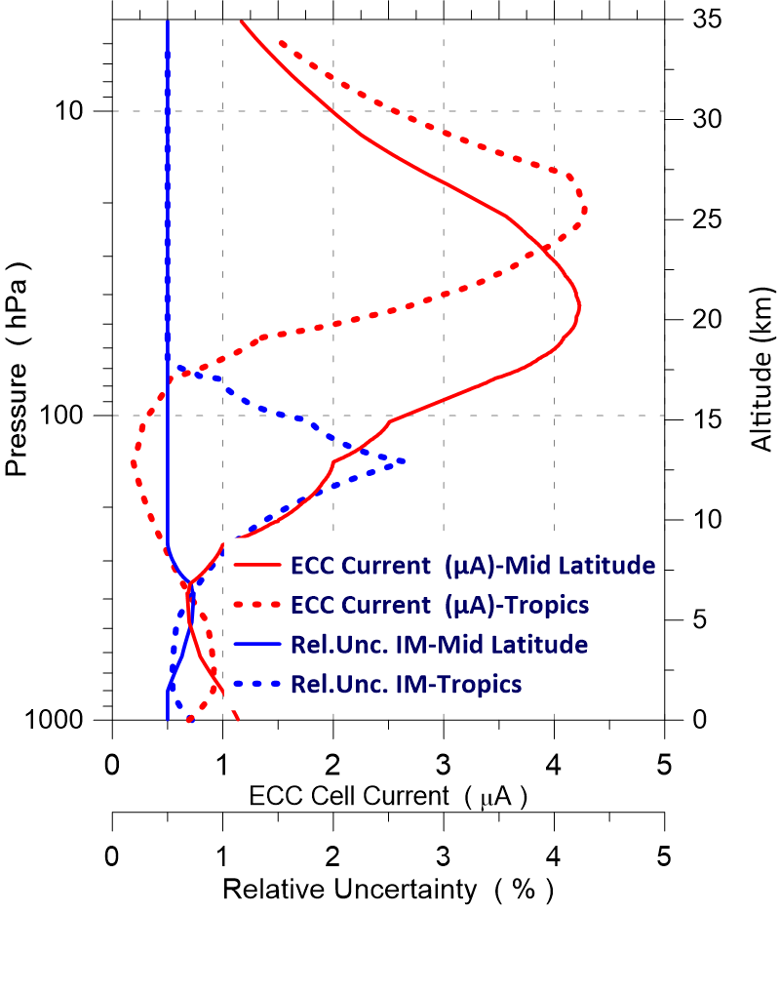
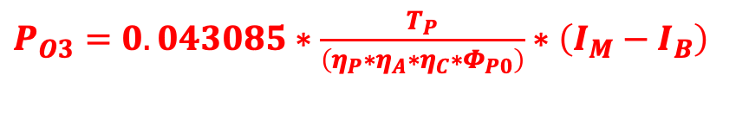
Measured Cell Current: I_{M} & its Uncertainty Δ I_{M} (Section C-6.2)
$P_{O3}=0.043085∗\frac{T_{P}}{\left(η_{P}∗η_{A}∗η_{C}∗Φ_{P0}\right)}∗\left(I_{M}−I_{B}\right)$
The uncertainty of the measured sensor current (I_{M}) is mainly determined by the uncertainty of the current measurement made by the electronics (current to voltage converter) of the sonde data interface board, which is for modern interfaces:
(Section 3.3.6 of WMO/GAW No. 268)
ΔI_{M} = ± 0.005 µA at I_{M} < 1.00µA
ΔI_{M} = ± 0.5% of I_{M} at I_{M} > 1.00µA
Notes:
Time 1:00
But now going to the individual parameters that determine the ozone partial pressure and their individual contributions to the uncertainty budget.
The first parameter to deal with is the measured cell current and its uncertainty. The cell current is measured by a current to a voltage converter as part of the data interface board and the uncertainty of the measured cell current is mainly determinded by this converter. The uncertainty values given here are conservative estimated values
In the graph is shown the relative uncertainty contribution in blue as a function of the altitude or log pressure for a typical mid-latitude and a typical tropical vertical ozone profile, here shown as the equivalent of the measured cell current.
For a mid-latitude profile the relative contribution is less than 1%.
However, for a tropical ozone profile in the upper troposphere with relative low ozone values the relative uncertainty can increase to values of 2 to 3%
In the stratosphere the relative uncertainty of the measured cell current is about 0.5% and thus rather small.

Slide 8
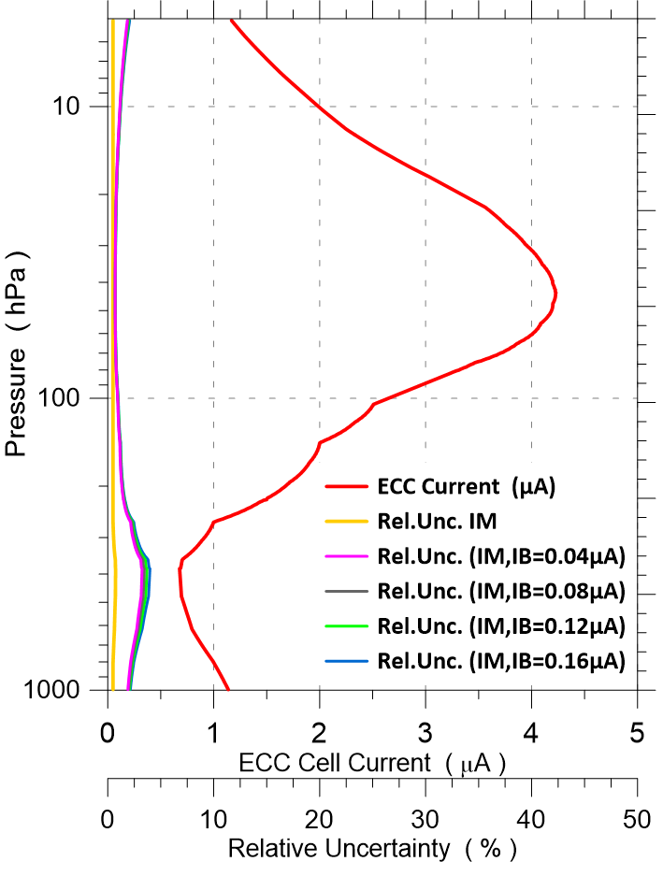
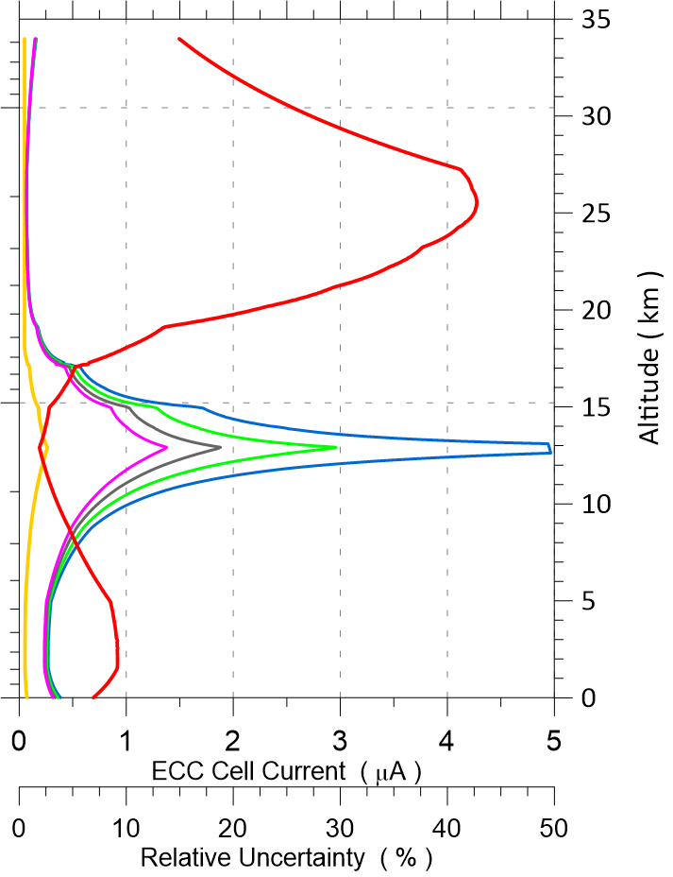
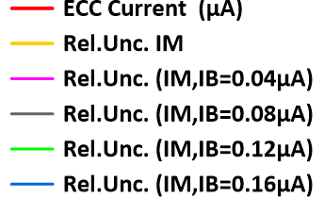

Background Current: I_{B} & its Uncertainty Δ I_{B} (Section C-6.3)
$P_{O3}=0.043085∗\frac{T_{P}}{\left(η_{P}∗η_{A}∗η_{C}∗Φ_{P0}\right)}∗\left(I_{M}−I_{B}\right)$
Following the recommendations in Section 3.3.6 of GAW No. 268, the following background current correction is to be applied:
I. I_{B} = I_{B1}, i.e. the background current measured 10 min. after the ECC sonde has been exposed to a dose of ozone at a cell current of about 5 µA for 10 min.
II. Constant through the entire sounding profile (i.e. independent of air pressure)
III. ΔI_{B1}= ± 0.02 µA in case of a proper background measurement (I_{B1} < 0.07 µA)
Mid Latitude
Tropics
The ASOPOS panel has abandoned the further recording and processing of I_{B2} (after exposure of ozone, just prior to launch) as described in Section 3.3.6 of WMO/GAW No. 268.
Therefore, the panel recommends the use of I_{B1} in formula E-2-1 (See ASOPOS-Webinar No. 3 on SOP’s)
Notes:
Time 2:00
As second parameter in the basic ECC equation is the background current measured as part of the pre-flight preparation.
It is recommended to use a constant background current IB, namely the IB1-value, which is the background current measured after exposure of ozone with an uncertainty of about 0.02 µA.
It is to mention here that in the previous ASOPOS, in GAW Report No 201 it was recommended to use IB2 measured just before the launch. This has been rejected now.
The two graphs show for mid-latitudes and tropics as a function of air pressure the contributions of the relative uncertainty of the difference of the measured cell current and background current IB1
Hereby IB1 is varying between moderate values of 0.04 to 0.08 µA and enhanced values of 0.08 to 0.16 µA.
From the graph it can be seen that for large IB1 values the contribution of the relative uncertainty can become significantly large in the middle upper troposphere when the ozone concentrations are low, which can be particularly the case in the Tropics.
It is obvious that a proper measurement of the background current IB1 with values below 0.07µA is essential.
This can only be achieved during the pre-flight preparation by the use of a good gas filter to achieve zero air.
This means that the gas filter should remove the air flow not only from ozone but also purify it from other contaminants that can cause artifacts and enhance the recorded background current IB1.
The proper use of a good gas filter is presented in more detail in ASOPOS Webinar No. 2 on the Hardware.
Finally, ASOPOS recommend that IB1 should not be larger than 0.07 µA whereby the uncertainty of IB1 is estimated to be 0.02 µA.

Slide 9
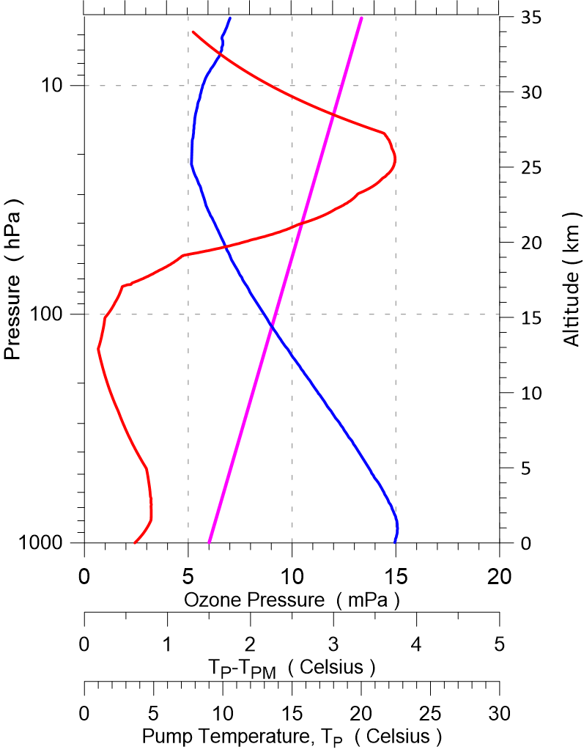
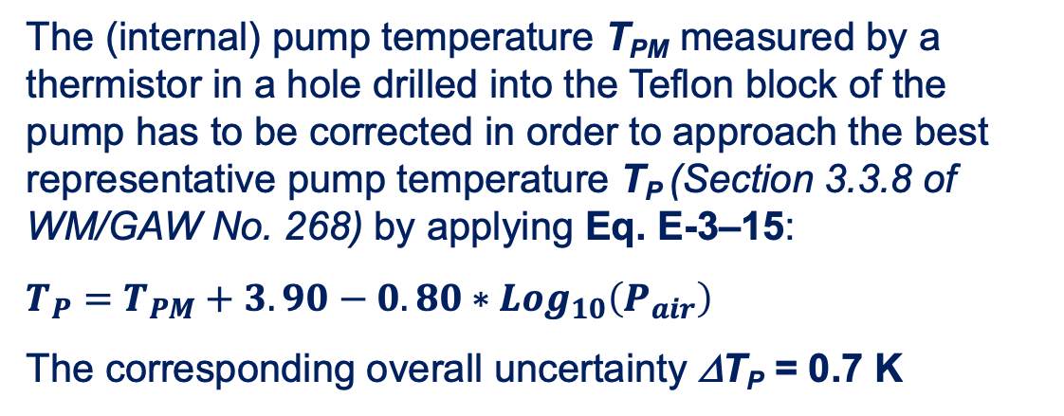
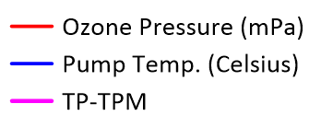

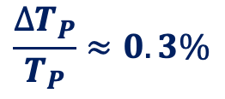
Pump temperature (in-flight): T_{P} & its Uncertainty Δ T_{P} (Section C-6-4)
$P_{O3}=0.043085∗\frac{T_{P}}{\left(η_{P}∗η_{A}∗η_{C}∗Φ_{P0}\right)}∗\left(I_{M}−I_{B}\right)$
T_{P}⁻T_{PM}
P_{O3}
T_{PM}
$$\frac{∆T_{P}}{T_{P}}≈0.3\%$$
Note:
Before 1996 the pump temperature was measured externally (box, taped at inlet or outlet of the pump tubes, or on the metal frame of the ECC-sensor).
These measured temperatures could be 1-8 ºC lower than the internal pump temperature.
Pressure dependent correction formulas have been developed to correct for these artefacts (See Annex D of the WMO/GAW No.268 Report)
Notes:
Time1:00
In-flight the pump temperature is measured with a thermistor in a hole drilled in the Teflon base of the pump. The measured pump temperature TPM has to be corrected in order to approach the best representative pump temperature TP inside the pump-piston volume
Therefore, the empirical correction formula as expressed in Equation E-3-15 has to be applied. It is a small but systematic log pressure dependent correction of 1-3 K as shown in the graph
The uncertainty that can be approximated by 0.7 K, such that the relative uncertainty contribution is about 0.3% and thus rather small.
It is to be noted that even when these corrections are small, they are needed to avoid any systematic bias effects in the long term ozonesonde records.

Slide 10
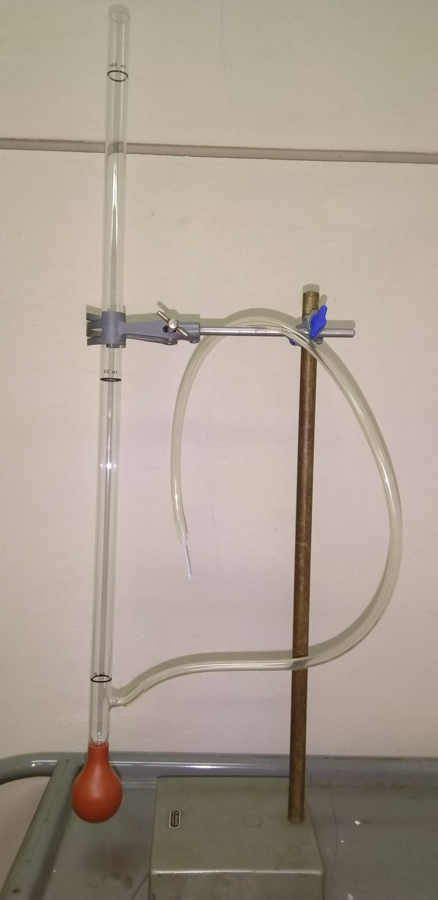
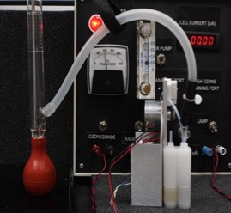
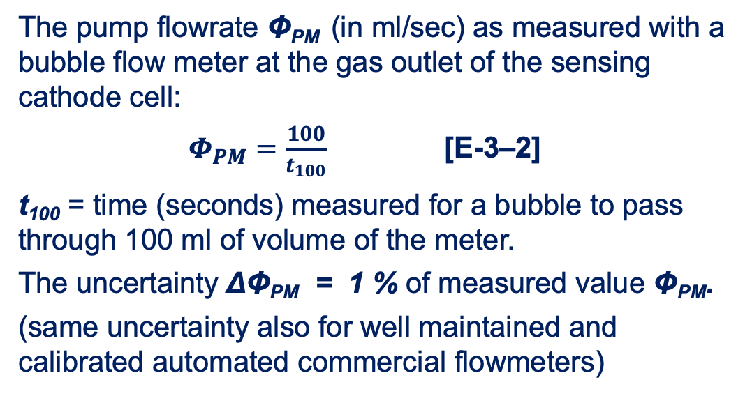
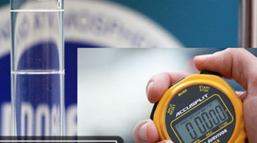

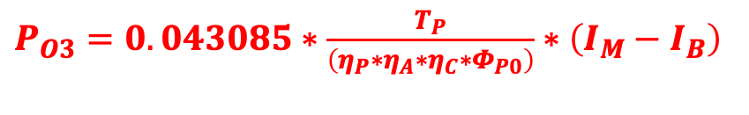
Pump flowrate at ground (preparation): 𝚽_{PM} & uncertainty Δ 𝚽_{PM} (Section C-6.1)
$P_{O3}=0.043085∗\frac{T_{P}}{\left(η_{P}∗η_{A}∗η_{C}∗Φ_{P0}\right)}∗\left(I_{M}−I_{B}\right)$
The measured flowrate Φ_{PM} has to be corrected for:
Temperature effect: small decrease in flowrate by factor C_{PL} through the slightly enhanced pump temperature T_{P} inside the Teflon pump base of about 2 K compared to laboratory temperature T_{Lab}
Humidification effect : increase of flowrate by factor C_{PH} due to evaporation of liquid in the cathode cell and bubble flowmeter
Notes:
Time 1:30
An important parameter to measure carefully is the flowrate of the air sampling pump.
Hereby, the pump flowrate Phi-PM is measured with an accurate bubble flow meter.
This means one measures the time t _100 needed for a bubble to pass a 100 ml of volume of the meter. This can be done with an uncertainty of about 1 % of the measured value of the pump flowrate.
For automated, but well calibrated and well maintained, flowmeter a similar uncertainty can be assumed.
The measured flowrate has to be corrected for two effects:
1.) Small decrease in the flowrate through the slightly enhanced pump temperature inside the Teflon pump base compared to the laboratory temperature
2.) Increase of flowrate due to evaporation in the cathode cell and bubble flowmeter.
Both effects have also to be corrected for when using an automated flowmeter
In the next slide we will explain this in more detail.

Slide 11
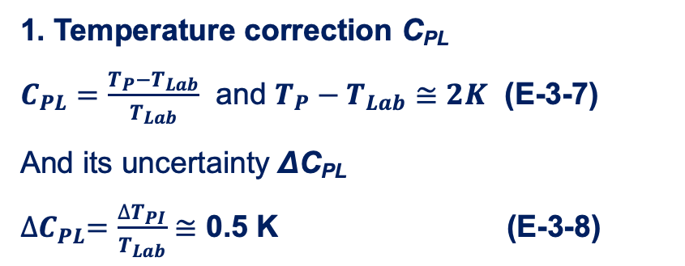
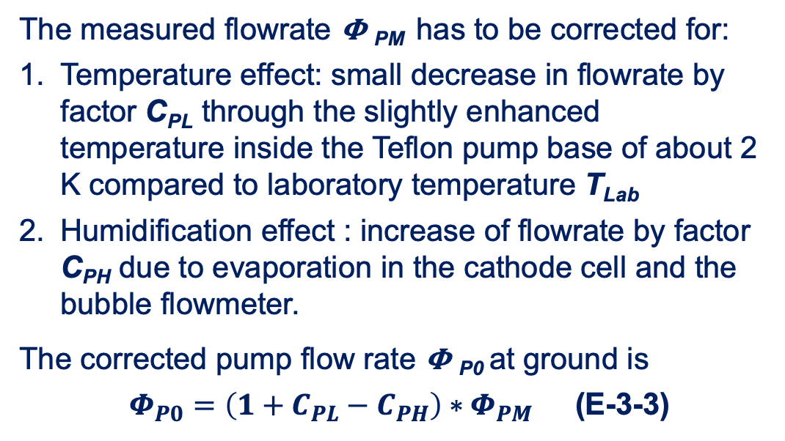
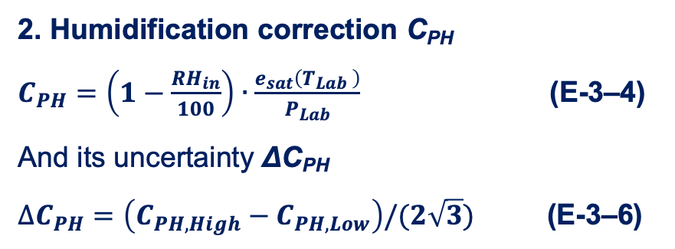

Corrected Pump flowrate at ground: 𝚽_{P0} & its Uncertainty Δ 𝚽_{P0} (Section C-6.1)
$P_{O3}=0.043085∗\frac{T_{P}}{\left(η_{P}∗η_{A}∗η_{C}∗Φ_{P0}\right)}∗\left(I_{M}−I_{B}\right)$
0.007
0.5
0.007
Typical C_{PH} and ∆C_{PH} values are:
T_{Lab} = 20 ºC: C_{PH} ≈ 0.01-0.02 and ∆C_{PH} ≈ 0.003
T_{Lab} = 30 ºC: C_{PH} ≈ 0.02-0.04 and ∆C_{PH} ≈ 0.005
Notes:
Time 0:45
In this slide both, the pump temperature and humidification corrections are explained and expressed in more detail.
Hereby applying the necessary formulas to calculate the correction factors and their uncertainties.
The formulas are explained in detail in section 3.3.2 and annex-C of the GAW No.268 report.
The applied corrections C_PL and C_PH can range between 0.01 and 0.04 with an uncertainties between 0.003 to 0.007

Slide 12
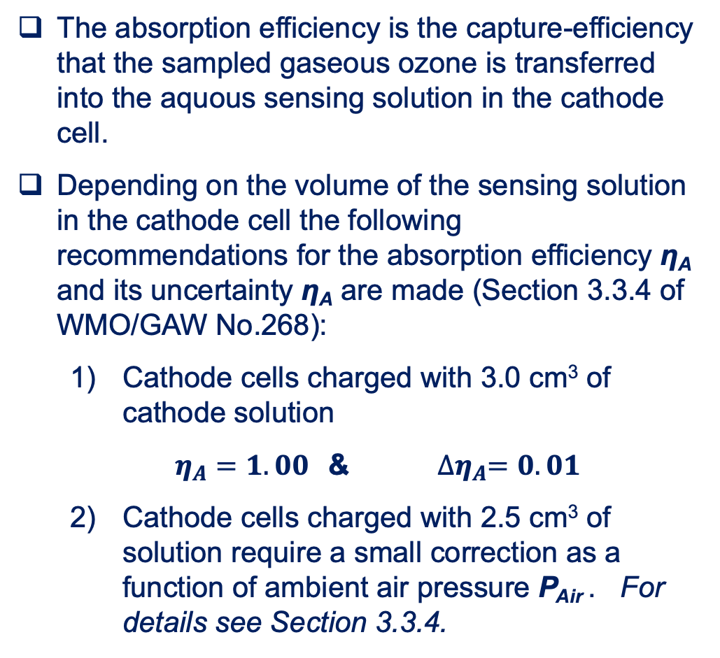

Absorption Efficiency (empirical): 𝛈_{A}(P) & its Uncertainty Δ 𝛈_{A}(P) (Section C-6.5)
$P_{O3}=0.043085∗\frac{T_{P}}{\left(η_{P}∗η_{A}∗η_{C}∗Φ_{P0}\right)}∗\left(I_{M}−I_{B}\right)$
𝛈_{A}(P) for cathode Cell charged with 2.5 cm3 solution
Δ 𝛈_{A}(P) = 0.01
Notes:
Time 0:45
As next the three efficiencies in the basic ECC Equation will be presented.
Here, the first one is the absorption efficiency, which is the efficiency that the gaseous ozone molecules bubbling through the cathode cell solution are absorbed, captured, by the sensing solution-
Or in other words that the ozone molecules are transferred from the gaseous into the liquid phase.
Only after this the ozone can first react with the potassium iodide.
Usually when using 3 ml of cathode solution the absorption efficiency is 1.00 for the entire sounding with an uncertainty of 0.01.
However, stations who use 2.5 ml cathode solution a small pressure dependent correction of about 0 to 4 % in the first 10 km of the profile as shown in the graph.
The pressure dependent correction formula is given in section 3.3.4 of the GAW Report No.268.

Slide 13

Pump Efficiency: 𝛈_{P}(P) & its Uncertainty Δ 𝛈_{P}(P) (Section C-6.6 of GAW No.268)
$P_{O3}=0.043085∗\frac{T_{P}}{\left(η_{P}∗η_{A}∗η_{C}∗Φ_{P0}\right)}∗\left(I_{M}−I_{B}\right)$
At ambient air pressures lower than 100 hPa the efficiency of the gas sampling pump degrades as a function of ambient pressure. Depending on the sonde and sensing solution type, these recommended efficiency tables should be used (Section 3.3.3 of WMO/GAW No.268):
Komhyr-1986 (K86-Efficiency) for SPC-6A sondes with SST1.0 or SST0.5;
Komhyr-1995 (K95-Efficiency) for ENSCI sondes with SST1.0 or SST0.5;
Johnson-2002 (CMDL-Efficiency) or Nakano- 2019/2022 (JMA-Efficiency) for ENSCI sondes with SST0.1.
Notes:
The corresponding pressure dependent pump efficiencies η_{P} and their uncertainties Δη_{P} as a function of ambient air pressure P_{Air} are listed in Table 3–1 (Section 3.3.3).
Between 100 and 10 hPa Johnson-2002, Nakano-2019 and Nakano-2022 (AMT, 2022) agree within better than 1% deviation
Notes:
Time 1:30
The next efficiency term in the basic ECC equation is that of the pump efficiency.
It is well known that the pump efficiency declines at lower pressures below 100 hPa which can become significant in the upper part of the profile.
The pressure dependent efficiency tables used are empirically derived and shown in the graph on this slide.
Using SST1.0 or SST0.5 ASOPOS recommend to use the Komhyr 1986 tables for the SPC sonde type and the Komhyr 1995 table for the En-Sci.
These recommendations are the same as in the previous ASOPOS 1.0 in GAW Report No. 201 from 2014.
New here is that for En-Sci sondes using the low buffered SST0.1 , which means 1%KI but only with a tenth of a buffer, it is recommended to use the efficiencies measured by CMDL or JMA. These efficiency tables all agree within 1 %.

Slide 14
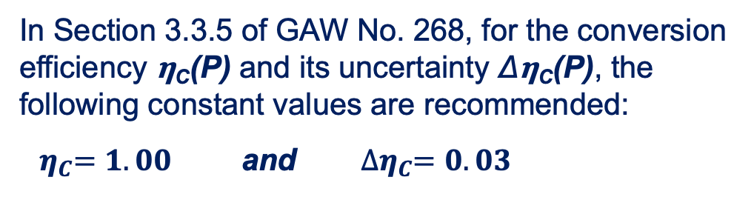
Conversion Efficiency (empirical): 𝛈_{C}(P) & its Uncertainty Δ 𝛈_{C}(P) (Section C-6.7)
$P_{O3}=0.043085∗\frac{T_{P}}{\left(η_{P}∗η_{A}∗η_{C}∗Φ_{P0}\right)}∗\left(I_{M}−I_{B}\right)$
Notes:
Time 0:45
The third efficiency term in the basic ECC equation is the conversion efficiency which indicates the efficiency conversion of the absorbed ozone in the sensing solution into the measured electrical cell current.
The conversion includes the chemical reaction and the following electrochemical processes
In the new ASOPOS Report in Chapter 3 of the GAW Report No.268 the underlying processes, which are not fully understood, have been discussed in detail.
However, the same as for ASOPOS 1.0 still a good approach is to use the recommended value of 1.00 for the conversion efficiency with an uncertainty of 0.03.

Slide 15
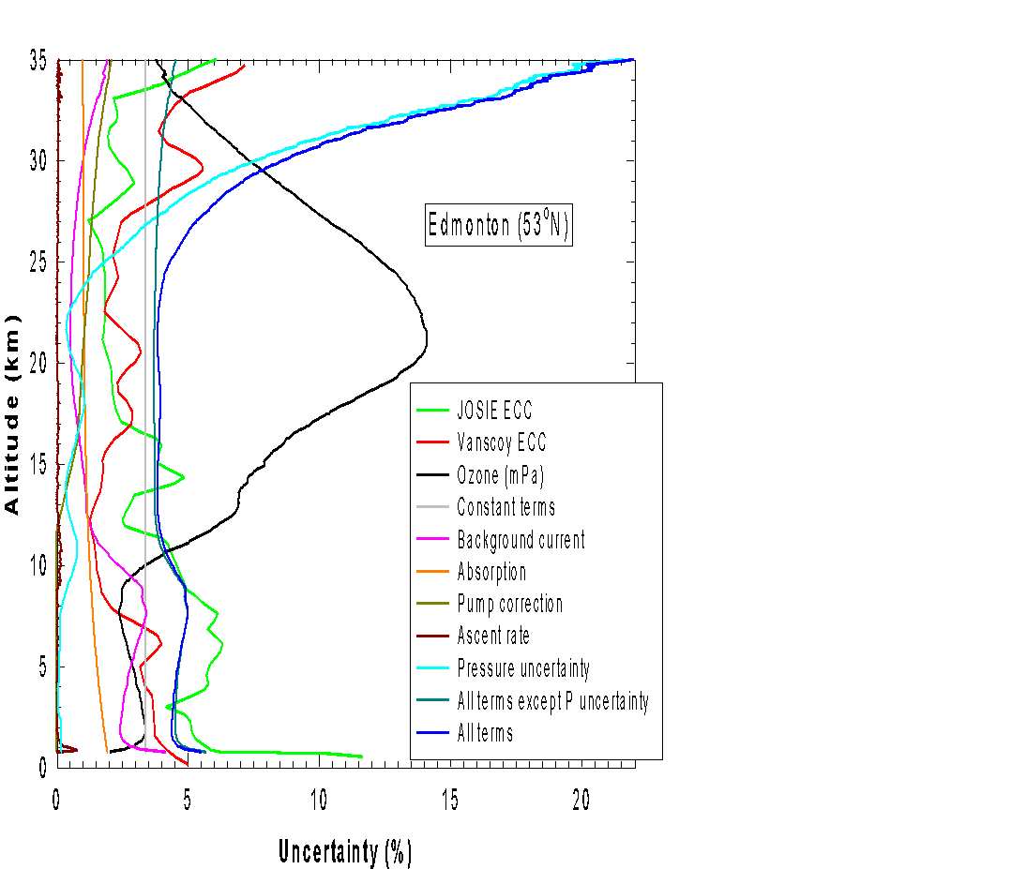
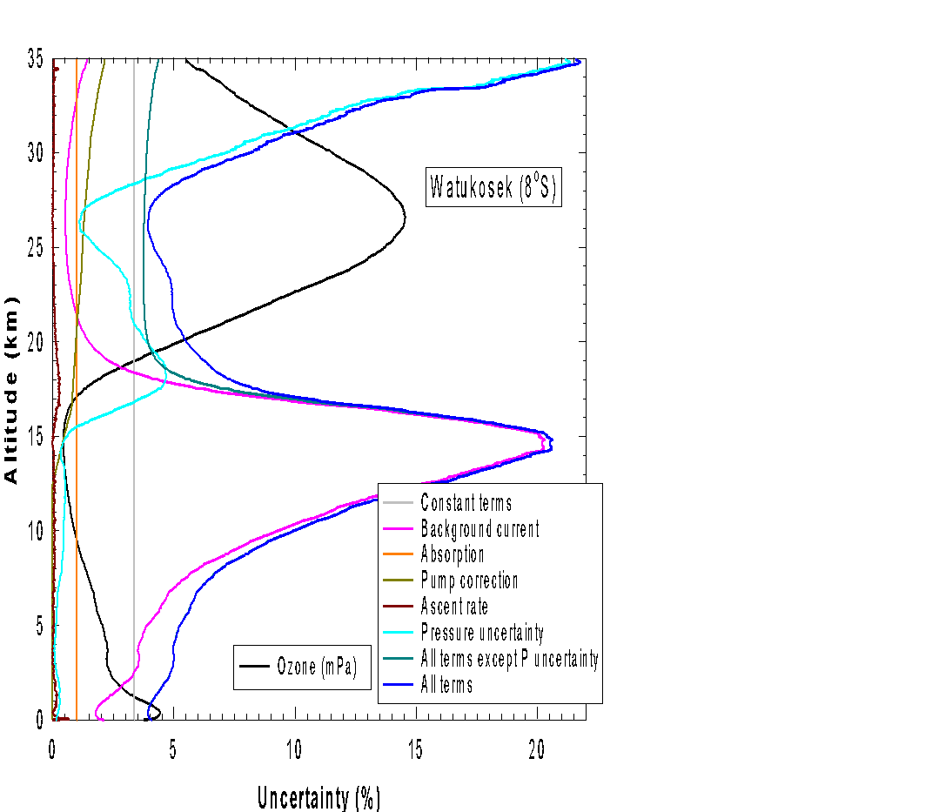
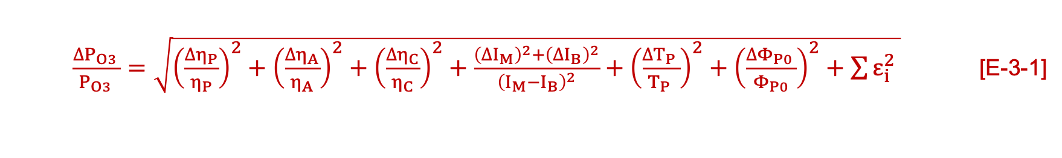
Overall Uncertainty and its Uncertainty Budget (Section 3.3.12 of GAW No.268)
$\frac{∆P_{O3 }}{P_{O3 }}=\sqrt{{\left(\frac{∆η_{P}}{η_{P}}\right)}^{2}+{\left(\frac{∆η_{A}}{η_{A}}\right)}^{2}+{\left(\frac{∆η_{C}}{η_{C}}\right)}^{2}+\frac{{\left({∆I}_{M}\right)}^{2}+{\left({∆I}_{B}\right)}^{2}}{{\left(I_{M}−I_{B}\right)}^{2}}+{\left(\frac{∆T_{P }}{T_{P }}\right)}^{2}+{\left(\frac{∆Φ_{P0 }}{Φ_{P0}}\right)}^{2}+\sum{ε_{i}^{2}} }$ [E-3-1]
Mid-Latitude
Tropical
Blue: Overall Uncertainty
Pink: Background Current
Figure 3-9 (Page 52 of GAW No. 268)
Figure 3-10 (Page 52 of GAW No. 268)
For details: Tarasick et al., 2021, https://doi.org/10.1029/2019EA000914
Notes:
Time: 2:00
Now in the previous slides we have described and discussed the individual parameters and their uncertainty contributions
In this slide the individual contributions and the overall uncertainty are displayed here in two graphs as a function of altitude once for a typical mid-latitude and once for a typical tropical ozone profile
The graphs are based on a study done by Tarasick et al in 2021.
Both graphs demonstrate clearly the different contributions and that they can vary significantly with altitude mostly due to their pressure dependence.
In the Troposhere the dominating contribution is from the background current
While in the Stratosphere the pump flow efficiency is the dominating factor.
In addition, the impact of the pressure uncertainty of the radiosonde is shown, which can be significantly above 28 km.
The last is particularly the case in the era before 2000 by not having GPS included in the radiosondes for accurate altitude measurements.

Slide 16
Data Processing: Key Points
In ASOPOS 2.0 the data processing methodology to follow has remained the same as that formulated in ASOPOS 1.0 (GAW Report No. 201, 2014), with some important exceptions :
  Background current I_{B} = I_{B1} and NOT I_{B2} as previously recommended.
  Corrections to the pump flowrate determined at the ground now include the pump temperature correction and the humidification correction.
  Recommendation that for low buffered sensing solution (En-Sci SST0.1) the pressure dependent CMDL/JMA pumpflow efficiencies should be used.
New in ASOPOS 2.0 are the practical guidelines to derive the different contributions to the instrumental uncertainty, to estimate the overall measurement uncertainty budget; these values are stored in the sonde data files.
All the supporting data necessary to derive the ozone partial pressure and its uncertainties must be included in the metadata as essential information for data processing, as well as for possible future re-processing.
ASOPOS 2.0 has established the scientific basis for future resolution of the slow and fast time response of the ECC ozone sensor.
ASOPOS 2.0 also includes practical guidelines for the homogenisation of historical long term ozone records.
Notes:
Time 1:00

Slide 17
Closing Remarks
This webinar no.4 is part of a series of six ASOPOS Webinars:
  Introduction to ASOPOS 2.0: An Overview (Anne Thompson & Herman Smit)
  Hardware (Herman Smit & Roeland VanMalderen)
  SOP: Standard Operating Procedures (Roeland VanMalderen & Peter van der Gathen & Gary Morris & Bryan Johnson)
  Data Processing (Herman Smit & David Tarasick)
  Data Quality Indicators (DQI) (Ryan Staufer & Holger Voemel)
  Meta Data and Software (Ryan Staufer & Roeland VanMalderen)
The webinars do not replace the report or associated video clips, but only highlight the most important topics and changes with respect to the previous ASOPOS 1.0 report (GAW Report No. 201, 2014).
For questions, clarification or general advice, the authors of this webinar and the ASOPOS Team are more than happy to assist!!!
Thank you for your attention and for good collaboration in the future !!!
Notes:
Time: 0.5 min.
And finally, some closing remarks:
This webinar No.4 is part of a series of 6 ASOPOS webinars aiming the implementation of the recommendations made by the ASOPOS panel in the GAW Report No.268.
Bullit 2 and 3 to mention
Thank you for your attention and let us go for good collaborations in the future !!!
Bye Bye.........

Slide 18
Back Up Slides

Slide 19
Pump Efficiency (PFE): 𝛈_{P}(P) & its Uncertainty Δ 𝛈_{P}(P) (2)
Addendum Nov.2022: New PFE-Publication by Nakano and Morofuji in AMTD giving new PFE values and their uncertainties, obtained over all 1387 PFE Samples they obtained in period 2009-2022. https://doi.org/10.5194/egusphere-2022-565
Between 100 and 10 hPa Nakano-2019 and Nakano-2022 agree within better than 1% deviation
Expanded Table 3-1 (Section 3.3.3) of pressure dependent pump efficiencies η_{P} and their uncertainties Δη_{P} as a function of ambient air pressure P_{Air}
Pressure [hPa] | ECC (SPC-6a) Komhyr,1986 K86-Efficiency | ECC (ENSCI) Komhyr et al., 1995 K95-Efficiency | ECC (CMDL) Johnson et al., 2002 | ECC (UWYO) Johnson et al., 2002 | ECC (JMA) Nakano, 2019 | ECC (JMA*) Nakano et al., 2022
1000 | 1 | 1 | 1 | 1 | 1 | 1
100 | 0.989 ± 0.005 | 0.993 ± 0.005 | 0.968 ± 0.009 | 0.978 ± 0.011 | 0.976 ± 0.008 | 0.978 ± 0.009
50 | 0.985 ± 0.006 | 0.982 ± 0.005 | 0.951 ± 0.011 | 0.964 ± 0.012 | 0.962 ± 0.009 | 0.964 ± 0.011
30 | 0.978 ± 0.008 | 0.972 ± 0.008 | 0.935 ± 0.011 | 0.953 ± 0.015 | 0.948 ± 0.011 | 0.948 ± 0.013
20 | 0.969 ± 0.008 | 0.961 ± 0.011 | 0.918 ± 0.012 | 0.938 ± 0.018 | 0.932 ± 0.011 | 0.929± 0.014
10 | 0.948 ± 0.009 | 0.938 ± 0.021 | 0.873 ± 0.015 | 0.893 ± 0.026 | 0.891 ± 0.013 | 0.883 ± 0.017
7 | 0.935 ± 0.010 | 0.920 ± 0.022 | 0.837 ± 0.019 | 0.858 ± 0.029 | 0.861 ± 0.014 | 0.848 ± 0.020
5 | 0.916 ± 0.012 | 0.889 ± 0.021 | 0.794 ± 0.023 | 0.817 ± 0.034 | 0.824 ± 0.016 | 0.807 ± 0.023

