Slide 1

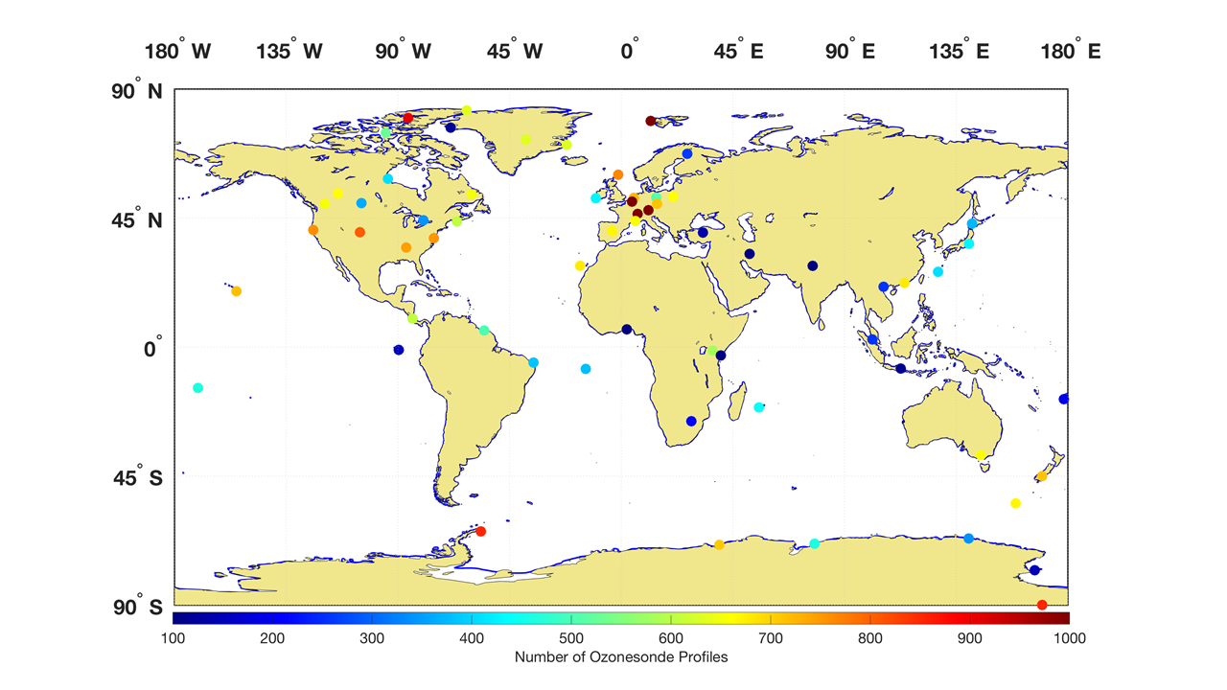









ASOPOS-Webinar Series on the Implementation of the Recommendations Made by the ASOPOS 2.0 Panel
Ozonesonde Measurement Principles and Best Operational Practices
ASOPOS 2.0 (GAW Report No. 268)
(Assessment of Standard Operating Procedures for Ozonesondes)
ASOPOS-Webinar No. 5
Ozonesonde Data Quality Indicators
Ryan Stauffer¹ and Holger Vömel²
¹NASA Goddard Space Flight Center; ryan.m.stauffer@nasa.gov
²National Center for Atmospheric Research; voemel@ucar.edu
Version March 2024

Slide 2

Outline
What are examples of ozonesonde Data Quality Indicators (DQI)?
Screening individual ozonesonde profiles to assess reliability and measurement uncertainty
Monitor for changes to metadata and measurements in long-term records (Note: Metadata are covered extensively in Webinar #6)
Assist in performing and evaluating the homogenization of long-term records or records from multiple stations

Slide 3
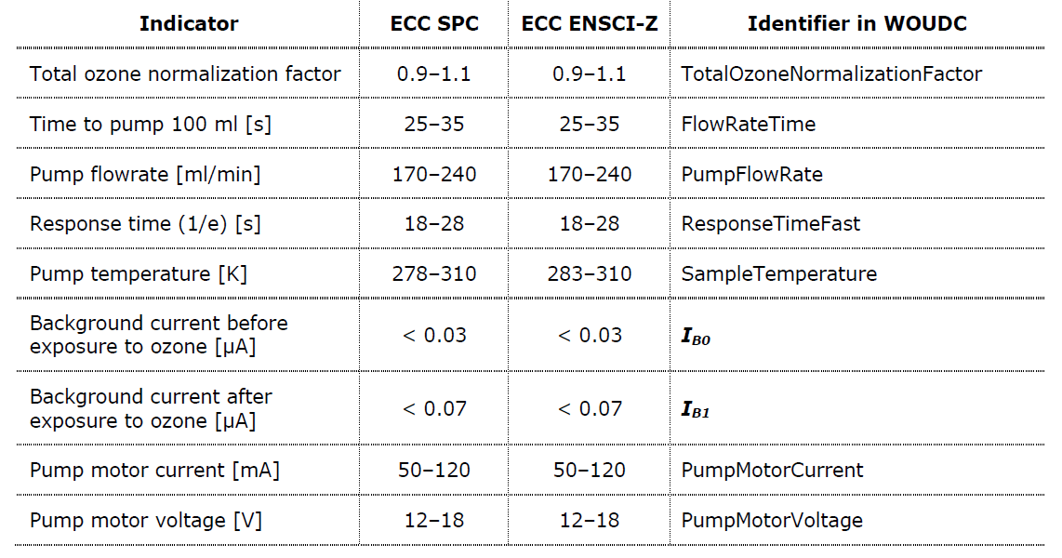
Examples of Ozonesonde DQI
Issues with some DQI are more common than others
Note the difference in acceptable Pump Temperature values between the two ozonesonde types. This is due to the different construction of the ECC frame for SPC vs. ENSCI
We will show examples of two DQI from an individual profile: Pump Temperature and Total Ozone Normalization Factor
Table of common ozonesonde DQI, acceptable ranges for SPC and ENSCI ECC types, and the identifier name used in WOUDC archived data files

Slide 4
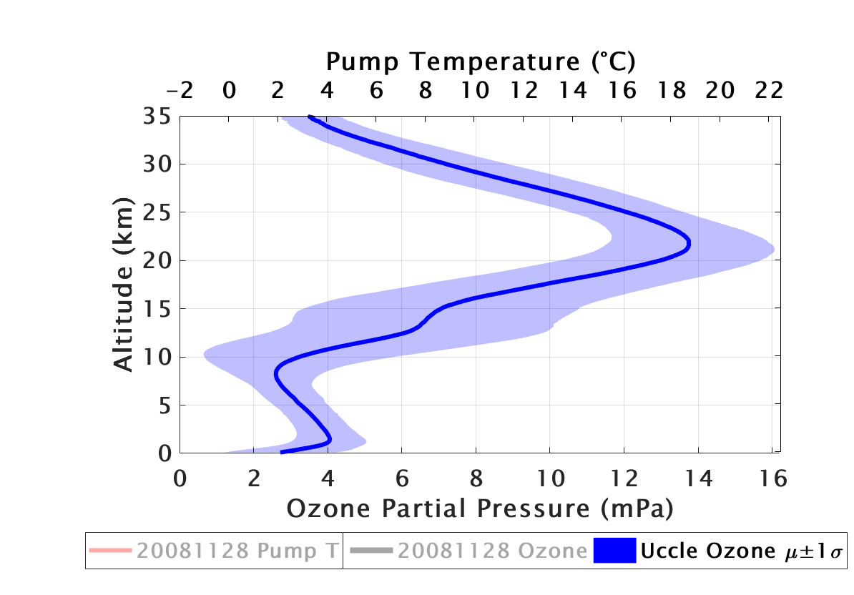
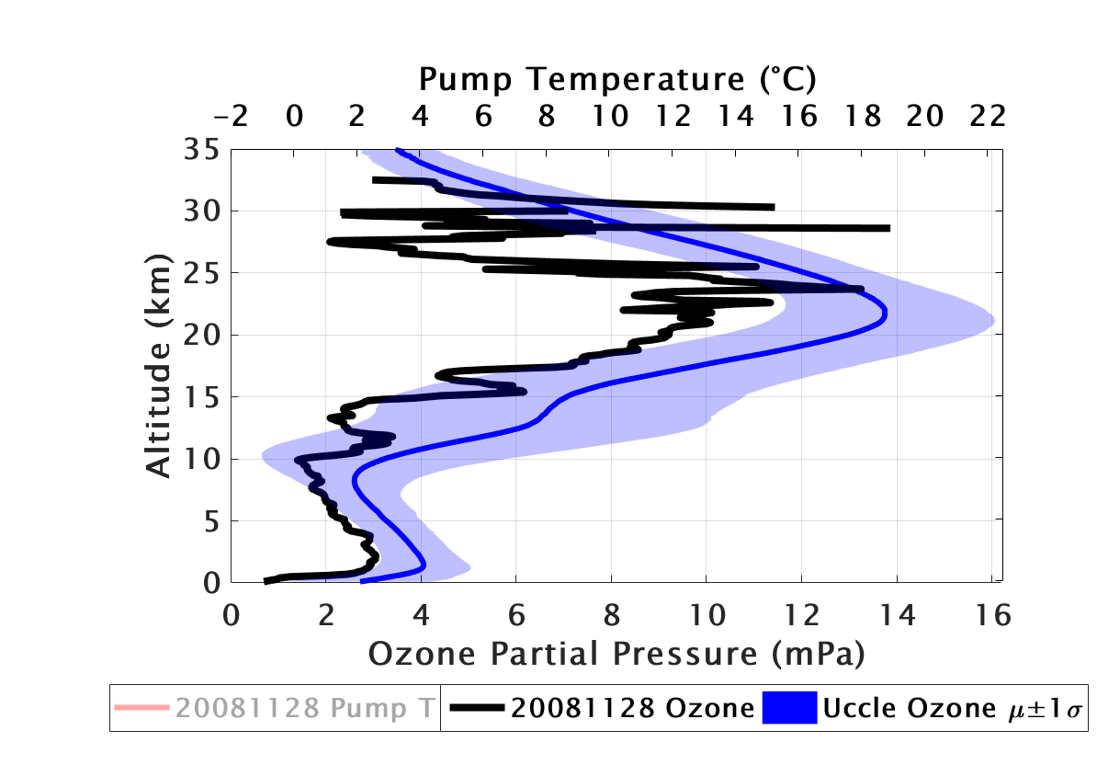
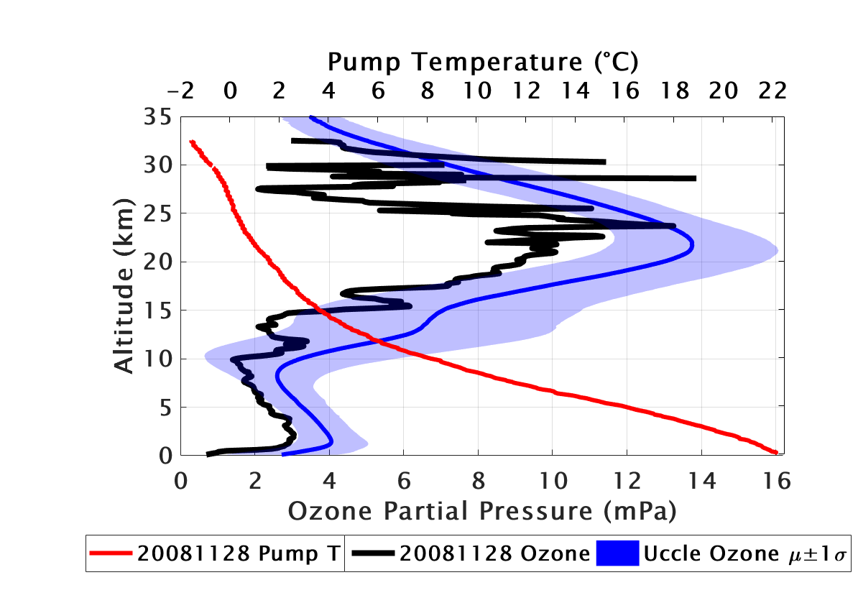
Using DQI to Identify Problems in Profile Data
This shows an example from Uccle, Belgium
The profile on 20081128 measures ozone that is erratic and generally much lower in the stratosphere than is typical for Uccle
Using the pump temperature DQI, we see that the pump is far too cold in the stratosphere, and the ECC sensing solutions are likely freezing, leading to the strange ozone measurements
Total ozone normalization factor (OMI/ECC) is 1.157 (> 1.1). This is an additional indicator that this profile is of lower quality
Average ± 1 standard deviation of the ozone partial pressure from all Uccle ozonesondes (blue). Ozone partial pressure from the 20081128 profile (black). Pump temperature from the 20081128 profile (red).
4

Slide 5
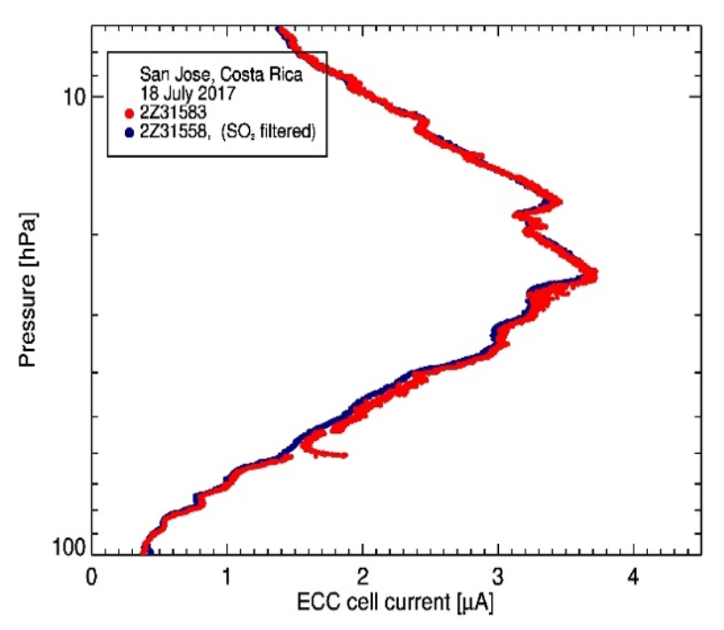
Other Potential Artefacts: “Ozone Spikes”
Profile data should be examined to identify artefacts not covered by standard DQI
This example shows an “ozone spike” at 60 hPa from one of two ozonesondes flown in dual-flight configuration at San José, Costa Rica
These occasional artefacts are not well understood, but the affected ozone data should be removed if possible prior to final archival
Dual ozonesonde flight from San José, Costa Rica showing an “ozone spike” in the red ozonesonde profile that does not appear in the blue ozonesonde profile

Slide 6
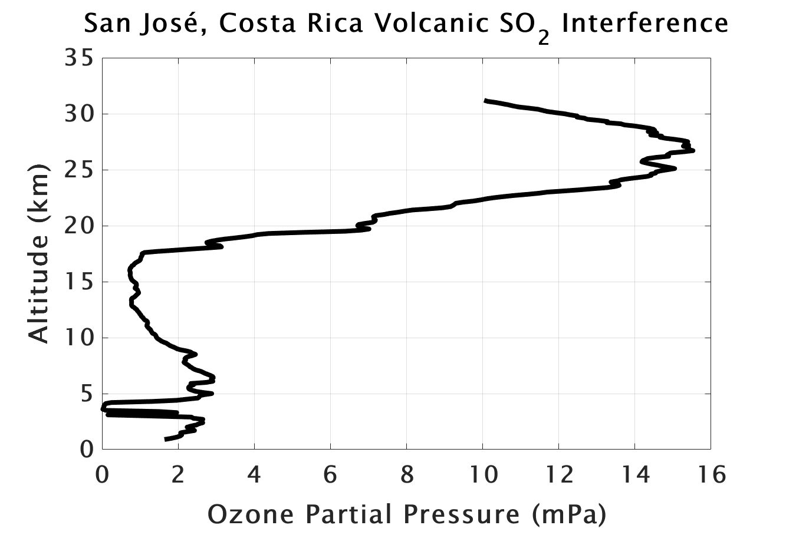
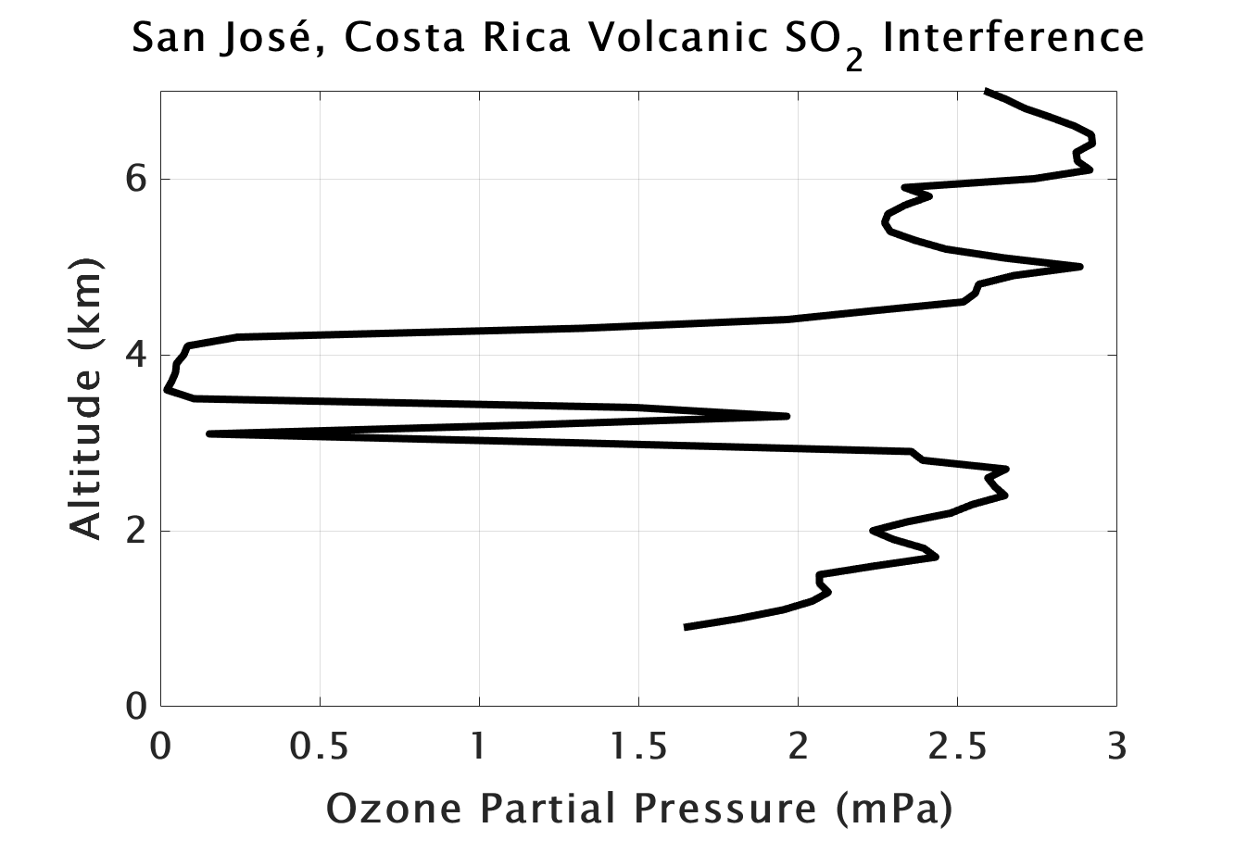
Other Potential Artefacts: SO₂ Interference
A second example from San José, Costa Rica shows the effect of SO₂ interference from a nearby volcano, which produces artificially low (sometimes zero) ozone measurements from the ECC
These profiles are common at stations with nearby volcanic activity, and SO₂-polluted stations (less of a concern with modern data)
These measurements should be excluded from typical ozone analyses, but are useful to include in archived data
Ozonesonde partial pressure from a flight from San José, Costa Rica on 20090605 showing volcanic SO₂ interference from 3 to 4 km AMSL

Slide 7
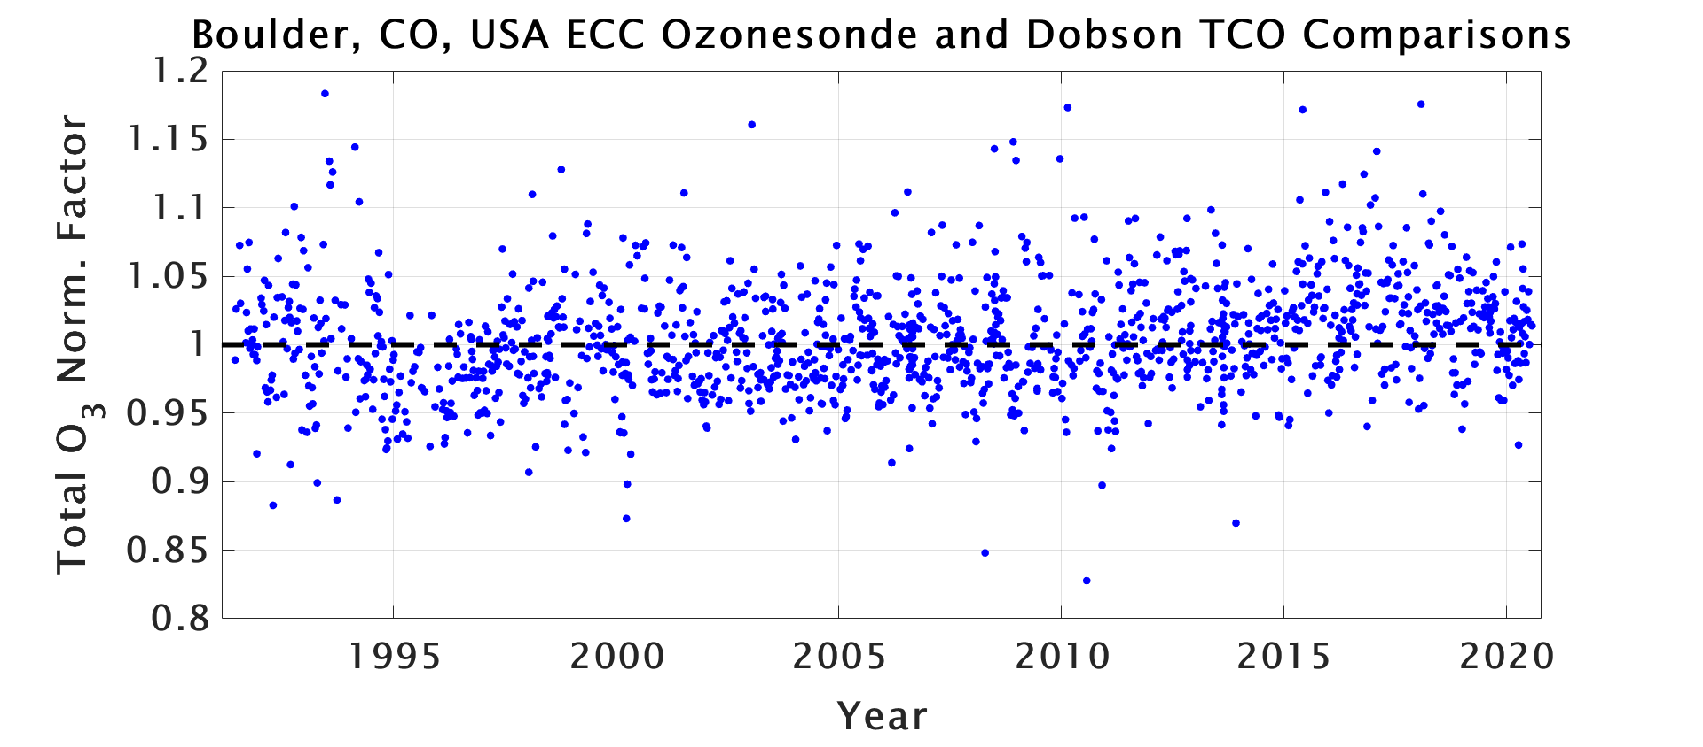
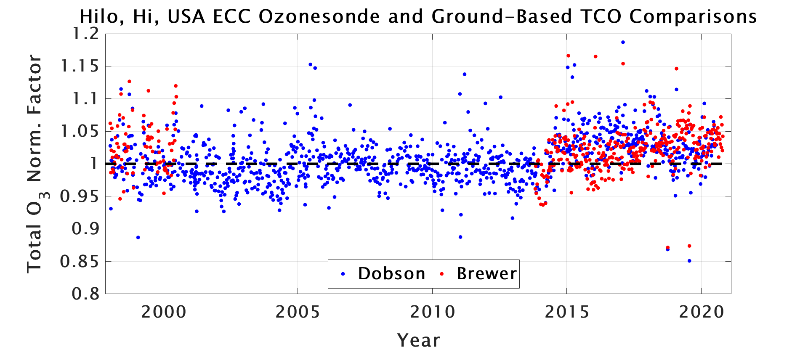
DQI Tracking for Long-Term Records
Time series of total ozone normalization factor from satellite or ground-based total column ozone (TCO; examples at right →) can be used to track long-term data quality changes
Note the long-term stability of normalization factors at Boulder (top), and a step change noticed in 2014 at Hilo (bottom). Changes to DQI should be investigated
*Do not apply normalization factors to ozonesonde profile data! This is an obsolete practice*
Time series of ozonesonde and ground-based TCO comparisons at Boulder (top) and Hilo (bottom)

Slide 8
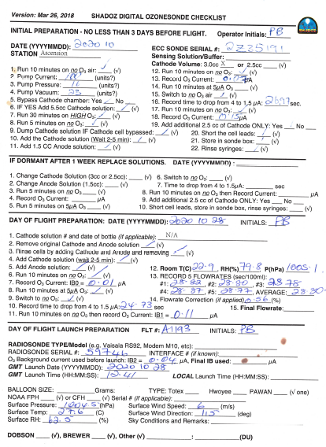
Accurate Metadata Collection and DQI
Accurate metadata is vital to link long-term DQI evaluations with changes to ozonesonde data quality
Metadata are a requirement for reprocessing and homogenizing station data
Example checksheets (on right) should be combined with electronic recordkeeping
More on Metadata in the separate Webinar #6 presentation…

Slide 9
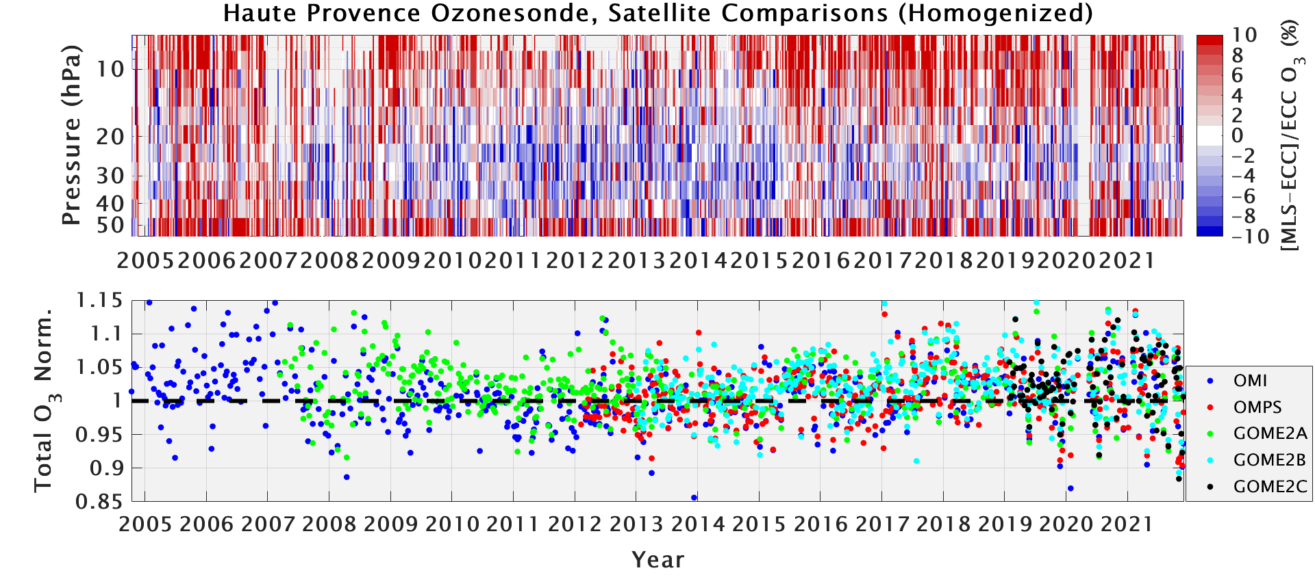
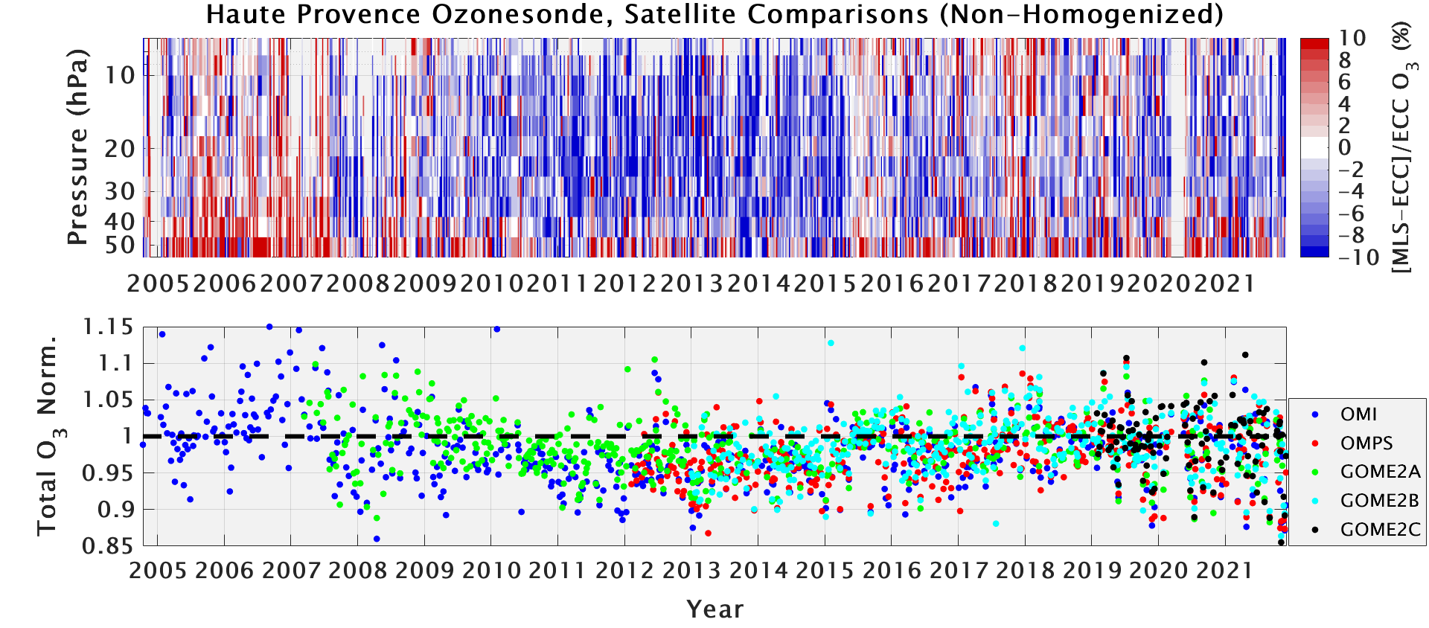
DQI used to Assess Data Homogenization (OHP)
DQI can be used to characterize the changes and quality/accuracy for homogenized ozonesonde time series
The OHP station recently homogenized their data using collected metadata
The non-homogenized data show large biases in the stratosphere (top) and TCO (bottom) compared to satellite instruments. The ozonesondes generally measure too high TCO
Biases in the homogenized data are greatly reduced. This is an example of successful metadata collection and homogenization verified using DQI
Comparisons of OHP ozonesonde data with Aura MLS in the stratosphere (percent difference; top) and TCO from 5 satellite instruments (TCO normalization factor; bottom). See Ancellet et al., (2022; AMT)
9

Slide 10
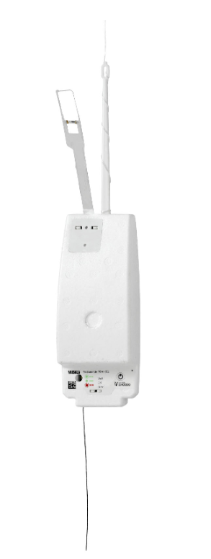
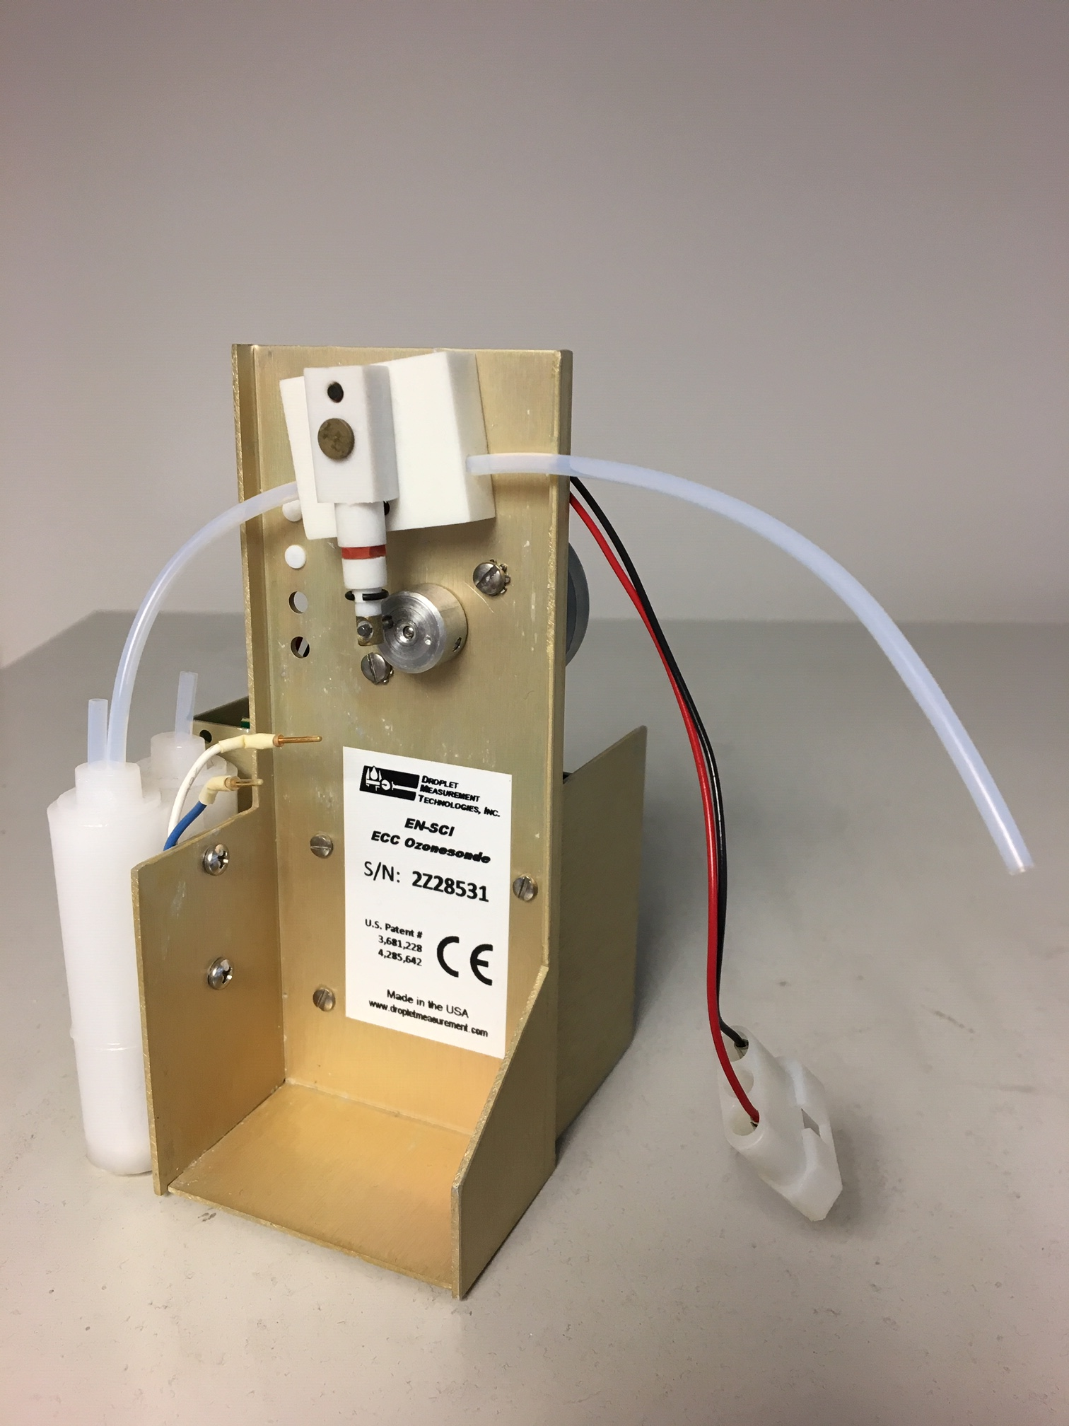
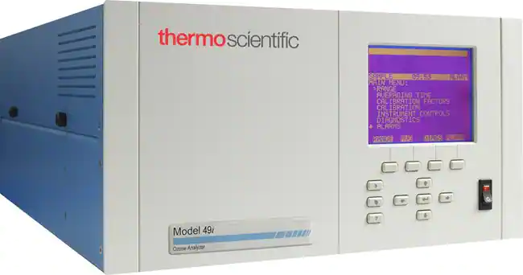
Other Evaluations to Ensure Data Quality
For more information on surface weather station best-practices, see Chapters 2-4 of WMO #8: https://library.wmo.int/doc_num.php?explnum_id=11386
Ozonesonde ground checks against surface ozone instrumentation should be performed where available
Maintained long-term records of the comparisons can also be used as DQI
Do not forget about the radiosonde! Verify surface data against a high-quality surface weather station (p, T, RH, GPS data)
Accurate pressure and altitude registration are crucial for ozonesonde data quality

Slide 11
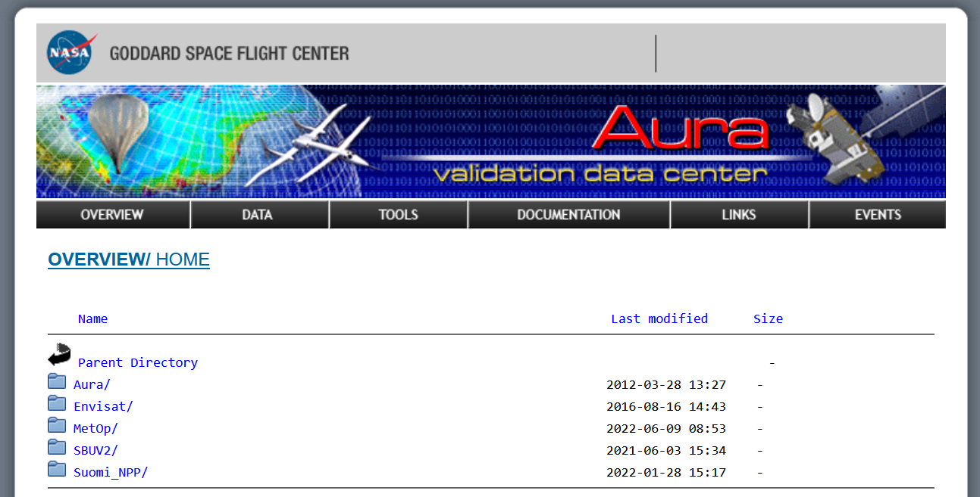
Satellite Data Sources to Evaluate DQI (AVDC)
ASOPOS recommends, in addition to ground-based independent data (if available), to use Level 2 satellite overpass data to evaluate ozonesonde data time series
Level 2 satellite overpass data for hundreds of locations are available at NASA/GSFC’s Aura Validation Data Center (AVDC)
L2 Ozone Overpass Data File Links (used in Stauffer et al., 2020; 2022):
Aura MLS: https://avdc.gsfc.nasa.gov/pub/data/satellite/Aura/MLS/V05/L2GPOVP/O3/
OMI: https://avdc.gsfc.nasa.gov/pub/data/satellite/Aura/OMI/V03/L2OVP/OMTO3/
OMPS: https://avdc.gsfc.nasa.gov/pub/data/satellite/Suomi_NPP/L2OVP/NMTO3-L2/
GOME-2A: https://avdc.gsfc.nasa.gov/pub/data/satellite/MetOp/GOME2/V03/L2OVP/GOME2A/
GOME-2B: https://avdc.gsfc.nasa.gov/pub/data/satellite/MetOp/GOME2/V03/L2OVP/GOME2B/
GOME-2C: https://avdc.gsfc.nasa.gov/pub/data/satellite/MetOp/GOME2/V03/L2OVP/GOME2C/
Example Comparison Time Series: https://tropo.gsfc.nasa.gov/shadoz/SHADOZ_PubsList.html

Slide 12
Key Points/Summary 1
Data Quality Indicators (DQI) include measures of the ozonesonde performance during laboratory preparation, and evaluation of the collected ozonesonde data
DQI can be applied to individual profiles:
  Anomalous ECC cell or ozonesonde pump characteristics
  Freezing or boiling solution leading to erratic ozonesonde measurements
  Identify problems with either the ECC or ground preparation equipment (high background current, slow response time)
  Poor agreement (>10% difference) with independent TCO data
DQI can be applied to track long-term data records:
  Multi-year evaluations against independent TCO from co-located ground-based and satellite overpass data, satellite stratospheric profiles
  Identification of step changes to DQI resulting from intentional or inadvertent changes to station practices, or changes to ECC ozonesonde manufacture/construction

Slide 13
Key Points/Summary 2
Other artefacts that are less common and not covered by standard DQI:
  “Ozone spikes” from cell chemistry that are not well understood
  Interferences such as from SO₂, leading to artificially low ozonesonde ozone
Accurate and complete metadata collection is vital
  Enables, and is a requirement to homogenize and reprocess ozonesonde data
  Combined with DQI, can be used to assess the changes and improvements to ozonesonde station time series after homogenization
Ground checks of the ozonesonde with a surface ozone instrument, if available, and radiosonde should also be performed

Slide 14
Select References
Smit, H. & A. M. Thompson, and the ASOPOS 2.0 Panel, “Ozonesonde Measurement Principles and Best Operational Practices”, GAW Report #268, 2021: https://tinyurl.com/4ysxpk9m
Stauffer, R. M., et al., “An Examination of the Recent Stability of Ozonesonde Global Network Data”, ESS, 2022: https://tinyurl.com/2t8mx4m8
Ancellet, G., et al., “Homogenization of the Observatoire de Haute Provence Electrochemical Concentration Cell (ECC) Ozonesonde Data Record: Comparison with Lidar and Satellite Observations”, Atmos. Meas. Tech., 2022: https://tinyurl.com/2mz3xbpr
Tarasick, D. W., et al., “Improving ECC Ozonesonde Data Quality: Assessment of Current Methods and Outstanding Issues”, Earth Space Sci., 2021: https://tinyurl.com/bdh5ysys
Vömel, H., et al., “A New Method to Correct the Electrochemical Concentration Cell (ECC) Ozonesonde Time Response and its Implications for “Background Current” and Pump Efficiency”, Atmos. Meas. Tech., 2020: https://tinyurl.com/4r2d64vc
Stauffer, R. M., et al., “A Post-2013 Dropoff in Total Ozone at a Third of Global Ozonesonde Stations: Electrochemical Concentration Cell Instrument Artifacts?”, Geophys. Res. Lett., 2020: https://tinyurl.com/yck9drdk
Sterling, C. W., et al., “Homogenizing and Estimating the Uncertainty in NOAA’s Long-Term Vertical Ozone Profile Records Measured with the Electrochemical Concentration Cell Ozonesonde”, Atmos. Meas. Tech., 2018: https://tinyurl.com/mhz6teym
Thompson, A. M., et al., “First Reprocessing of Southern Hemisphere Additional Ozonesondes (SHADOZ) Ozone Profiles (1998–2016): 2. Comparisons With Satellites and Ground-Based Instruments”, J. Geophys. Res., 2017: https://tinyurl.com/msrufuap
Witte, J. C., et al., “First Reprocessing of Southern Hemisphere ADditional OZonesondes (SHADOZ) Profile Records (1998–2015): 1. Methodology and Evaluation”, J. Geophys. Res., 2017: https://tinyurl.com/7ew6zkhz
Tarasick, D. W. et al., “A Re-evaluated Canadian Ozonesonde Record: Measurements of the Vertical Distribution of Ozone over Canada from 1966 to 2013”, Atmos. Meas. Tech., 2016: https://tinyurl.com/map6a8nf
Van Malderen, R., et al., “On Instrumental Errors and Related Correction Strategies of Ozonesondes: Possible Effect on Calculated Ozone Trends for the Nearby Sites Uccle and De Bilt”, Atmos. Meas. Tech., 2016: https://tinyurl.com/37wfpyvt

