Slide 1

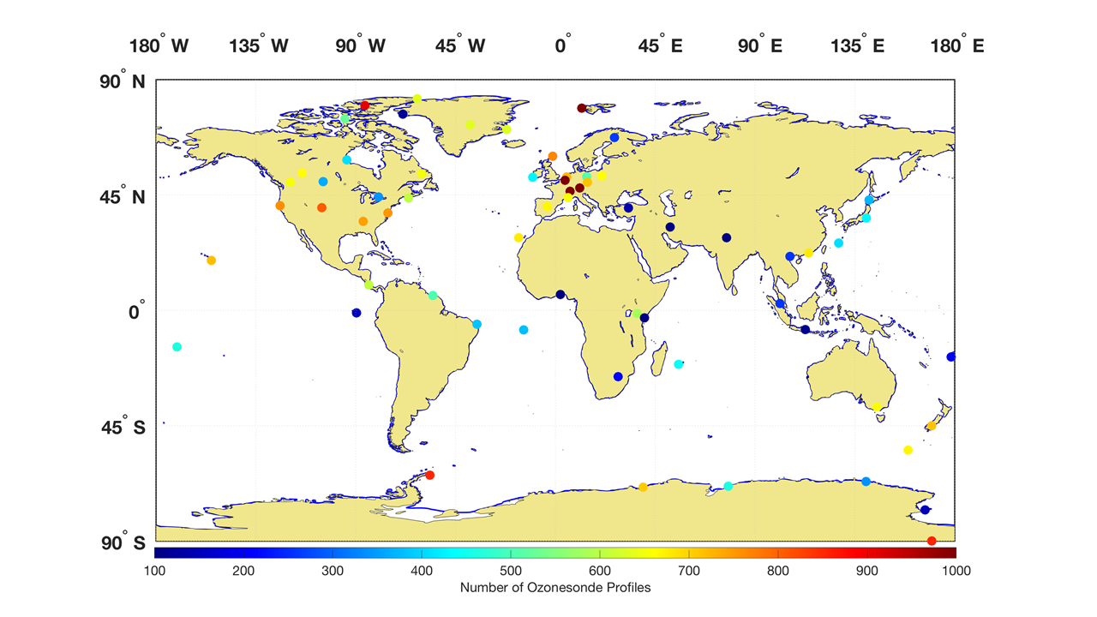









ASOPOS-Webinar Series on the Implementation of the Recommendations Made by the ASOPOS 2.0 Panel
Ozonesonde Measurement Principles and Best Operational Practices
ASOPOS 2.0 (GAW Report No. 268)
(Assessment of Standard Operating Procedures for Ozonesondes)
ASOPOS-Webinar No. 6
Metadata and Software
Roeland Van Malderen⁽¹⁾, and Ryan Stauffer⁽²⁾
(¹) roeland.vanmalderen@meteo.be
(²) ryan.m.stauffer@nasa.gov
Version March 2024

Slide 2

Preamble
This ASOPOS 2.0 Report builds on the earlier ASOPOS 1.0 (GAW Report No. 201, 2014)
However, metadata was only slightly treated in the previous report within the context of the (new) ozonesonde data format.
Metadata has a prominent role in WMO GAW 268, Annex B entirely devoted to it. This Annex lists and defines/describes the ozonesonde metadata.
In this Webinar, we will not go through the list of metadata fields, but focus on the importance of digitally archiving (which) metadata, and how this could be implemented in practice.
Available at https://library.wmo.int
GAW-Report No. 268
Notes:
Time: 1.0 min
But before we start with this webinar first a few remarks to avoid any misunderstandings.
This new ASOPOS report builds on the earlier ASOPOS-GAW Report No. 201 from 2014.
In this webinar we only highlight the most crucial aspects of the hardware and their limitations
Because these have shown that in practice they can have a significant impact on the performance of the ozonesonde
In general the hardware is described in detail in the GAW No. 268 Report .

Slide 3

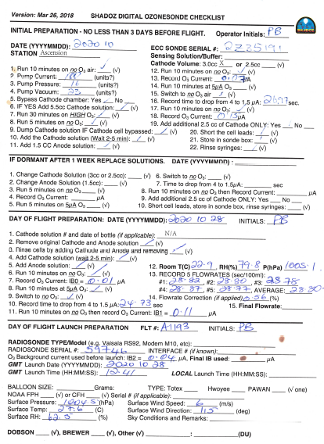
Outline
Introduction
Categories of metadata
Metadata in Practice
Software
Take away messages

Slide 4
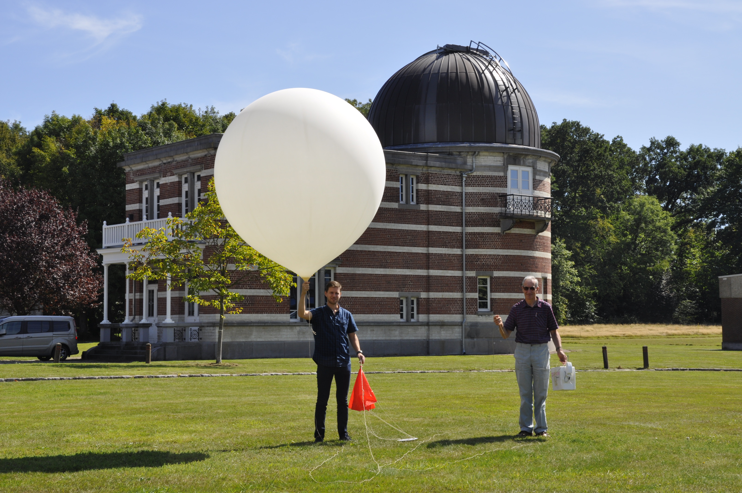
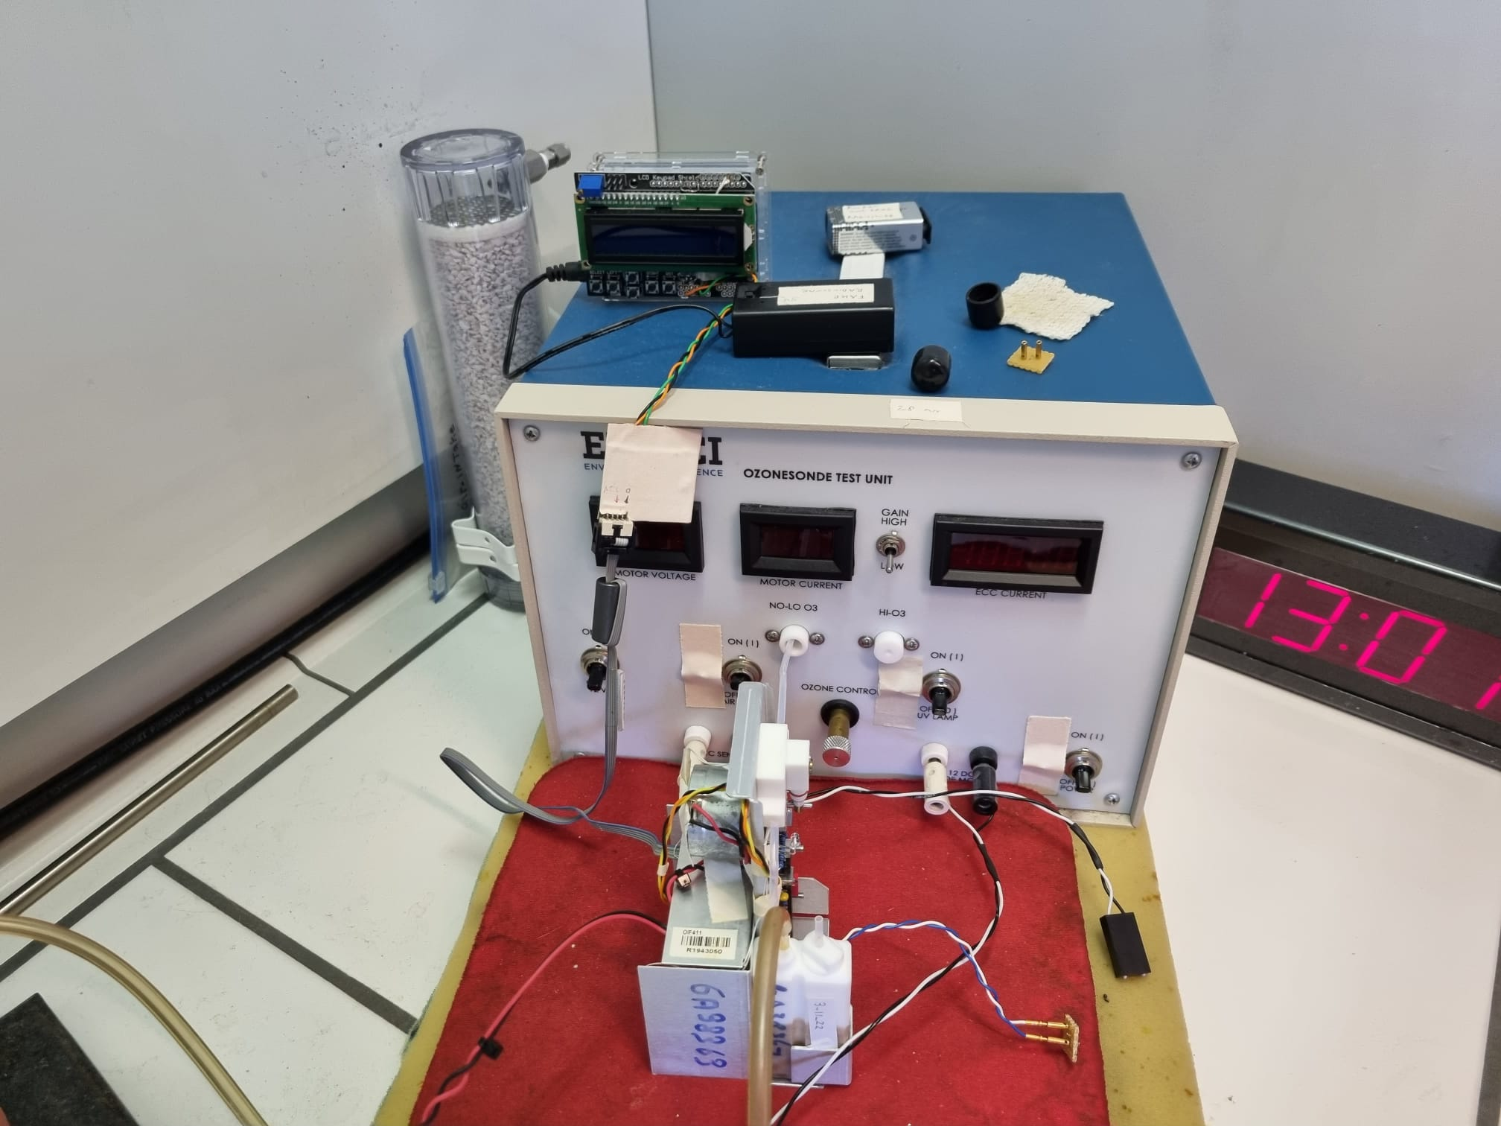
Introduction
What is metadata?
  Wikipedia: “data about data”, “data that provides information about other data”
  WMO WIGOS Metadata Standard document: “data describing the data”, 10 categories: (1) observed variable, (2) purpose of observation, (3) station/platform, (4) environment, (5) instruments and methods of observations, (6) sampling, (7) data processing and reporting, (8) data quality, (9) ownership and data policy, (10) contact
  ASOPOS report: “additional information to calculate ozone concentrations from the raw data and to describe the observations”; metadata characterizes the environment under which ozone measurements were taken, the ozonesonde itself, and how it was used.
balloon
parachute
ozone sonde
ground receiving unit + processing
radiosonde
environment
ozonesonde preparation & characterisation

Slide 5
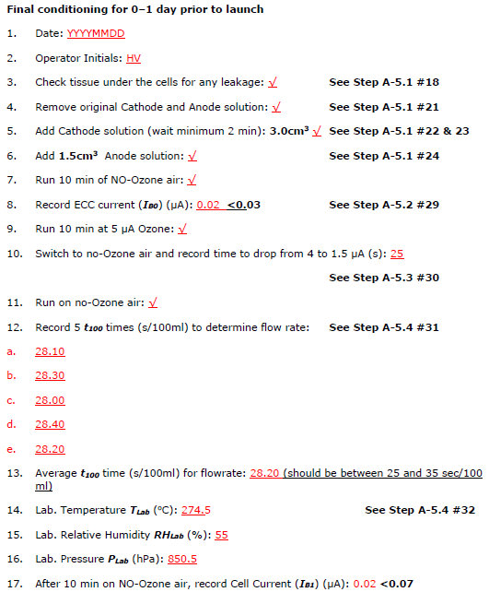
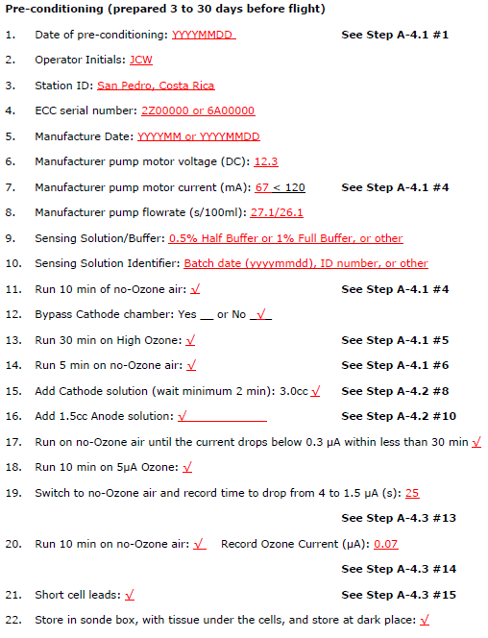

Introduction
What is metadata?
During the ozonesonde preparation, measurements to characterize the ozonesonde and its performance are captured (see Webinar #3: SOPs)
Some of these data, noted on the prepsheets (see Webinar #3: SOPs) should be archived!

Slide 6
Introduction
Why archive metadata?
  Needed for processing the data (ozone partial pressures)
  Metadata are a requirement for reprocessing and homogenizing station data.
  Metadata might be necessary for future reprocessing of the data with new methods.
  Digital archiving of historical metadata for future generations, in international databases (WOUDC, NDACC, SHADOZ, NOAA)
  Metadata helps to ensure the traceability, transparency, and data quality (uncertainties).
  Accurate metadata is vital to link long-term DQI evaluations with changes to ozonesonde data quality (see Webinar #5 “Ozonesonde Data Quality Indicators”)
Which metadata should be archived?

Slide 7
Introduction
NDACC
WOUDC
Which metadata should be archived?
SHADOZ
PTU ozonesonde lab
Reprocessed
NOAA
ALL
Ozonesonde response time
Transfer function
Dry flowrate correction
Burst pressure
Total ozone stop pressure
Payload weight
Ground equipment
Time to pump 100 ml
Background currents IB0, IB1
Balance weight used for inflation
Heating method of box
Type Ozone-free air
Launch date/time
Cathode Soln Volume Correction
Ozonesonde/Radiosonde serial number
Pump Temperature Correction
Vertical averaging/smoothing method
Balloon lift percentage
Lifting gas
Solution type/volume
Balloon material/brand/type/weight/volume/pretreatment
Weather at launch
Unwinder length
Station latitude/longitude/height
Processing software
WMO GAW No. 268, Annex B: guidelines to harmonize the metadata definition and content between the different archives! How much and which data should be archived (min – optimum – max)?
➔ WMO GAW No. 268, Annex B: guidelines for the (radiosonde system) software providers about ➔ incorporating metadata fields

Slide 8

Different categories
In WMO GAW No. 268, different categories of metadata are defined:
Required Metadata
  Without which processing of the raw data is not possible
  Appear in the ECC equation
Essential Metadata
  To understand the performance of the instrumentation
  Describe most aspects of the ozonesonde preparation and its behaviour during preparation (prepsheets!)
Desirable Metadata
  Needed to fully understand all aspects regarding an ECC ozonesonde observation
Obsolete Metadata
  Used/archived in the past, but no added value anymore
[E-2-1]

Slide 9
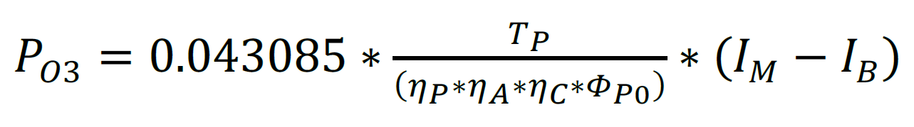
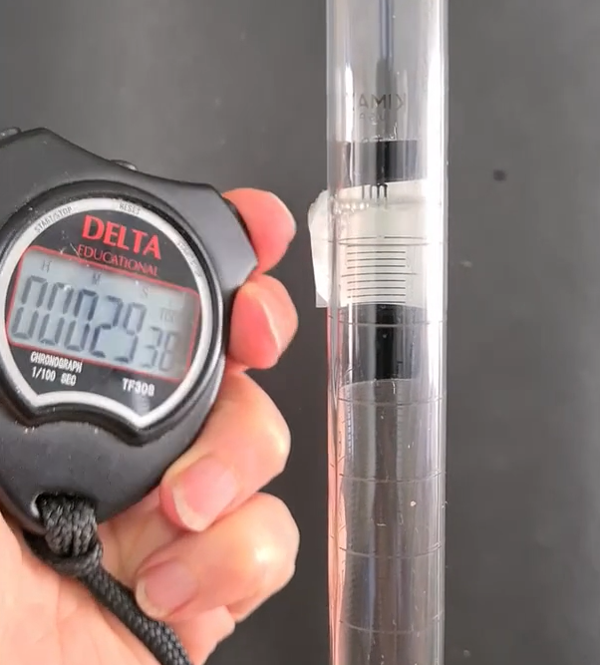
1: Required Metadata I
WMO/GAW #268 E-2-1 →
Pump Flowrate (Φ_{P0}). Ozone data cannot be processed without Φ_{P0}. Day of Flight t100 (Φ_{PM}, sec/100mL) timing shown →
See GAW #268 Table 4-1 and related equations on humidification correction of Φ_{PM} (measured flowrate) to Φ_{P0}
Note: Use a stopwatch with .01s resolution (not a cell phone!)
Φ_{PM} Pump flowrate measurement. See: https://vimeo.com/502869920/2388d5c95a

Slide 10
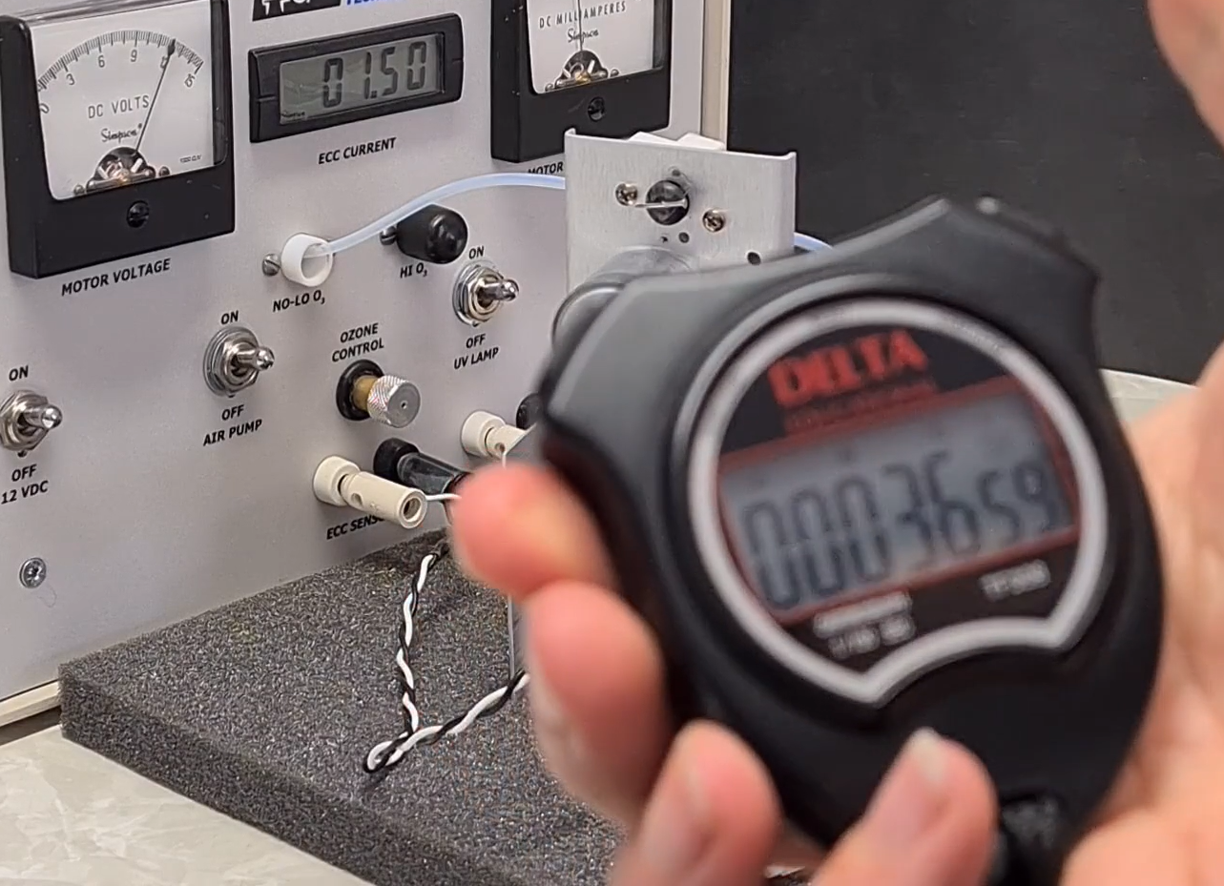
1: Required Metadata II
WMO/GAW #268 E-2-1 →
4 to 1.5 µA response time (sec) on Day of Flight
Does not appear in E-2-1 ozone partial pressure equation, but is a requirement for data processing with the time response correction (Vömel et al., 2020; Tarasick et al., 2021, Smit et al., in prep.)
4 to 1.5 µA response time. See: https://vimeo.com/502869920/2388d5c95a

Slide 11
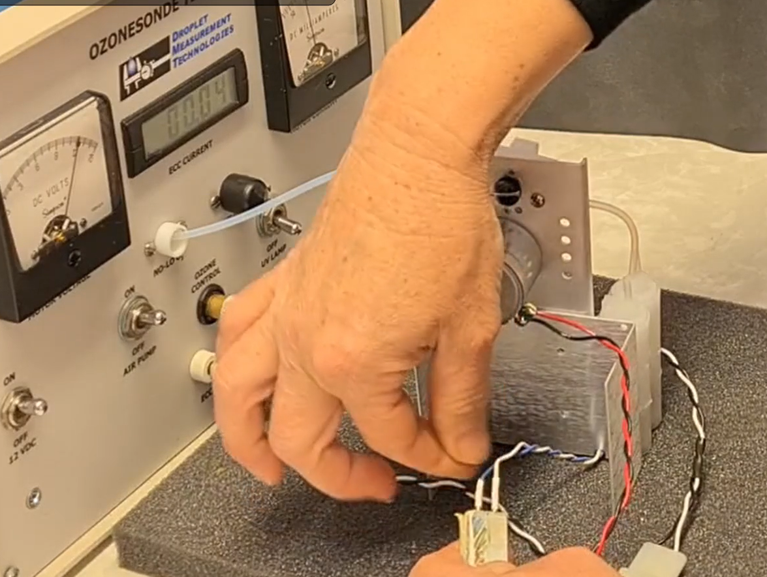
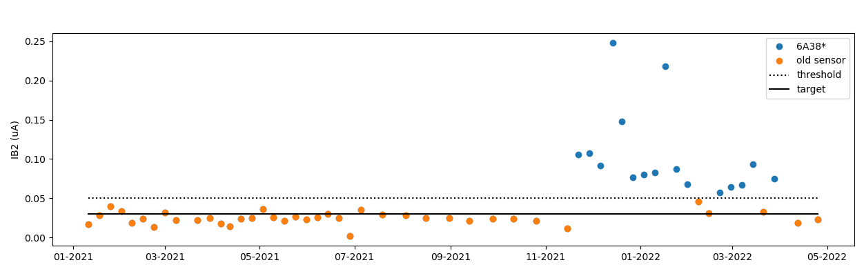
2: Essential Metadata I
Background current (IB0 and IB1). Recall that IB background current used in processing is Required metadata. Use IB1!
IB0 and IB1 characterize the performance of the ECC cell
Background current measurement →
https://vimeo.com/502869920/2388d5c95a
Several stations found high background currents from sets of SPC ECCs in the ~38000 serial number range
Example from Paramaribo shown (blue dots) →
Credit: A. Piters, KNMI

Slide 12
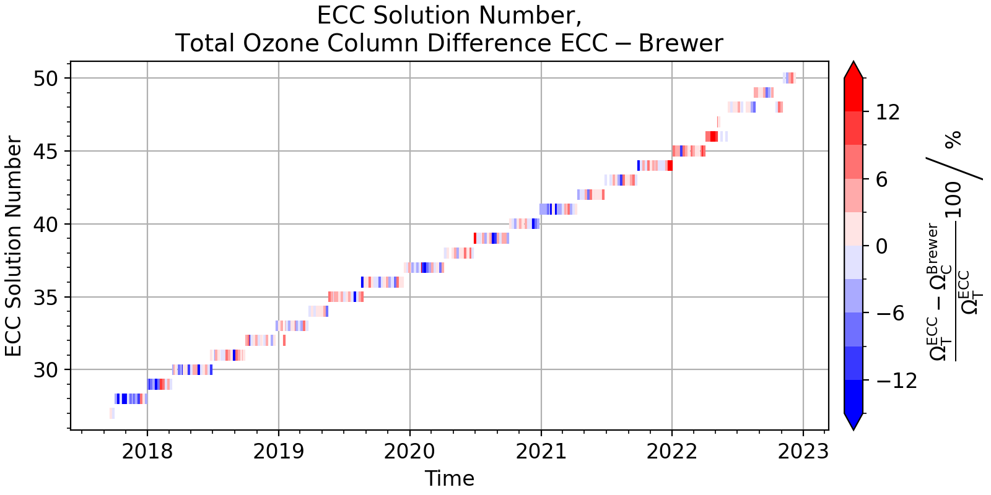
2: Essential Metadata II
Date or # identifier for Sensing Solution Type (SST) is useful for tracking any ECC performance changes related to SST batch
Careful preparation of ECC sensing solutions is critical to ozone data quality. See Webinar #2 Sensing Solutions: Requirements
Credit: P. Oelsner, DWD
Example: Lindenberg use SST identifier to investigate a recent high bias in ECC ozone at their station →

Slide 13
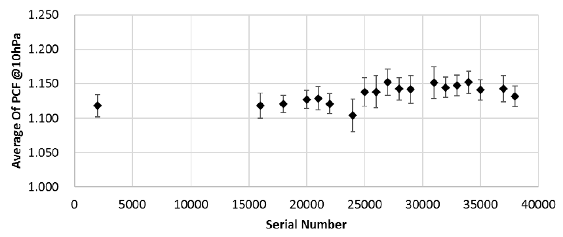
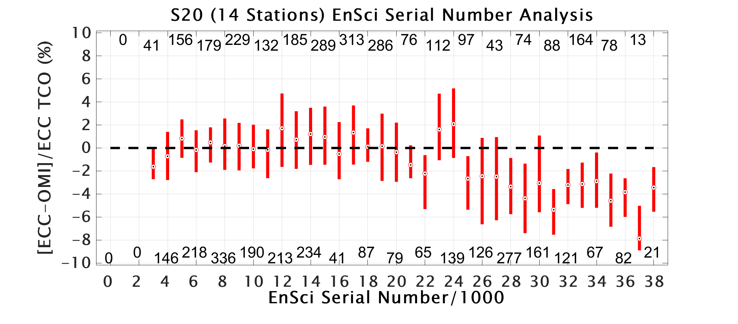
2: Essential Metadata III
ECC Serial Number, either 6AXXXXX for SPC or 1/2ZXXXXX for EN-SCI
*Extremely Important* for assessing ECC production quality and performance
Nakano and Morofuji (2022; EGUsphere) show changes to EN-SCI stratospheric pump efficiencies (top). This effect may contribute to the EN-SCI “Dropoff” low bias (Stauffer et al., 2022; bottom), as the serial numbers are correlated →

Slide 14
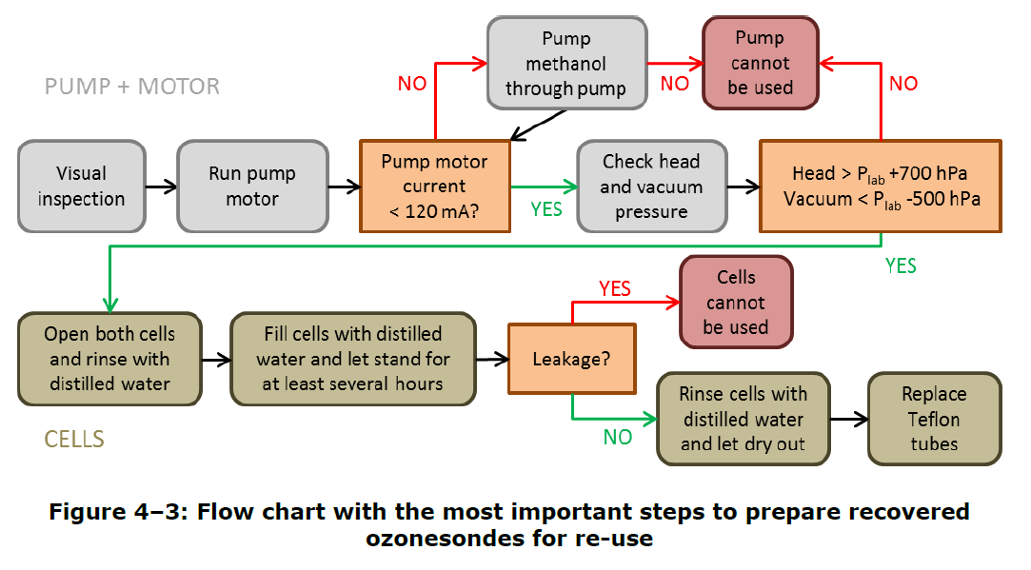
3: Desirable Metadata
For Recovered ECCs: Date of Previous Launch
  Characterize the performance of recovered and refurbished ECCs
  See GAW #268 4.2.3: “SOP for Re-Use of Recovered Sondes” →
Where Applicable: Sonde Heater (Y/N? and Type)
  Used primarily at very cold locations and the tropics (cold upper troposphere) where freezing of ECC solutions are a common concern
  Types: Passive (water can, other thermal materials) and Active (electric and thermostat heaters). See Webinar #2 “Proper In-Flight Pump Temperatures”
  Recall Webinar #5 on importance of Pump Temperature Data Quality Indicator

Slide 15
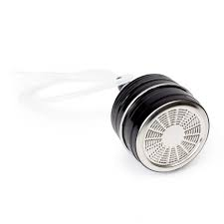
Obsolete Metadata
IB2 is now considered Obsolete Metadata and is replaced by “IB background current used in processing.” Use IB1!
Inconsistencies in timing and the quality of ozone filters at stations led to the elimination of IB2 in ASOPOS 2.0 SOPs
Typical ozone destruction filter used for IB2 just prior to launch. Not recommended for pre-launch! →
Zero ozone air/filtered air should not be given to the ECC after IB1 measurement. See Webinar #3 on SOPs

Slide 16
Metadata in Practice
Table B-3 of metadata fields in Annex B
Radiosonde software should be aligned with this table (see next slides)
Metadata content in the ozonesonde archives (WOUDC, NDACC, SHADOZ, NOAA) should be consistent with this table (more news on this in the coming months)
ASOPOS will provide an updated (meta)data template, with explanatory description, for the missing metadata fields (e.g. total ozone normalization factors), as a supplement to Annex B
Not only uniformity in amount of reported metadata fields, but also in their meaning & format
  meaning: metadata fields are well defined/described, with suggested naming convention
  format: use type, unit and missing value definition of B-3 (pages 129-130 of the report)
GOAL: all Annex B metadata fields for each sounding MINIMUM: “required + essential” metadata fields

Slide 17
Metadata in Practice
Metadata & Processing
Concept of “Configuration File”:
  Contains metadata fields that are invariable over several soundings (e.g. background correction method, sensing solution recipe, source of zero air, ECC sonde/RS manufacturer, processing software and version, sonde heater, etc.)
  Minimizes the typing in of metadata values by the ozonesounding operator
Concept of “Consistent or RS-Supplied Processing”
  Some networks (SHADOZ, NOAA) do a consistent processing across several stations with a common software package (e.g., SkySonde).
  If RS manufacturer software packages align with the metadata implementation and data processing+formatting of WMO GAW No. 268, individual stations might rely on those software for their (meta)data provision
  RS manufacturer-supplied processing might be helpful for near-real time data provision (e.g. upload to (European/AURA) Validation Data Centers, CAMS validation, etc.).

Slide 18
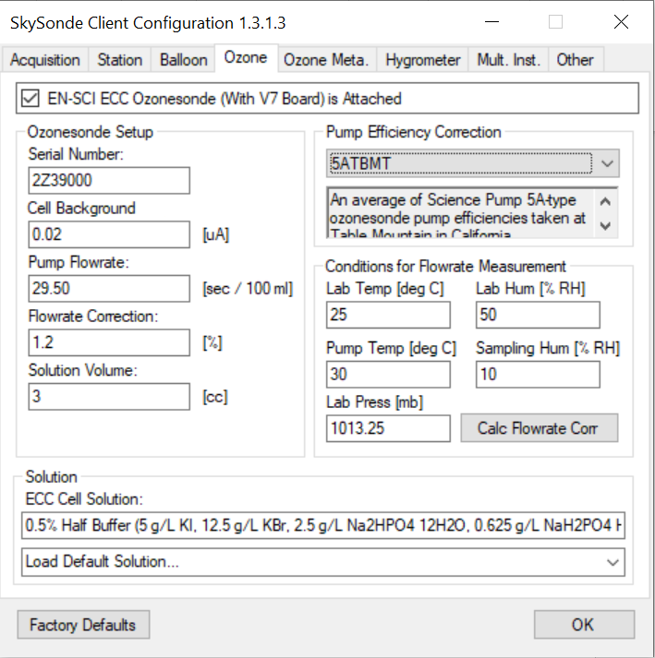
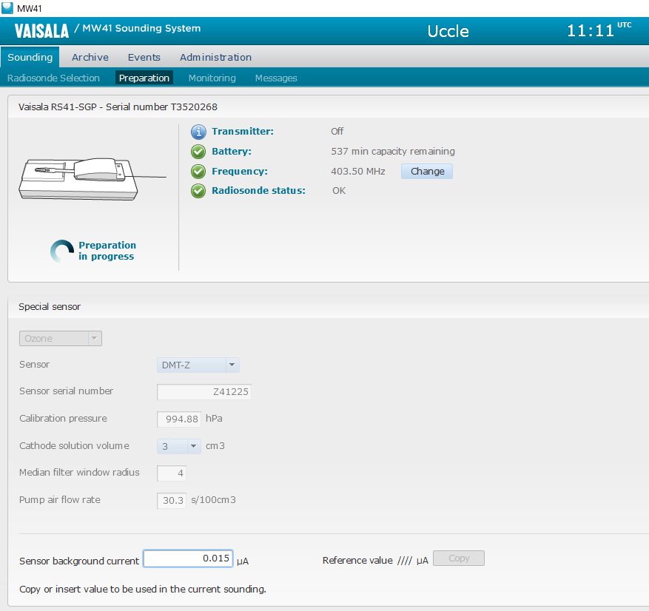
Metadata Entry in Sounding Software
Example screenshots from software provider metadata entry shown below. Current software packages currently do not capture all metadata fields specified in WMO/GAW #268 Annex B
NOAA SkySonde
ASOPOS 2.0 has contacted providers about implementation of GAW #268 metadata recommendations. Stay tuned!
Vaisala MW41

Slide 19
Key Points/Summary 1
Metadata are captured and recorded to calculate ECC ozone measurements, and characterize the performance and attributes of individual ECC sensors
Three Categories defined by ASOPOS 2.0 WMO/GAW #268:
  Required Metadata, without which ozone partial pressure calculation and reprocessing is impossible
  Essential Metadata, used to understand the performance of the ECC and its preparation
  Desirable Metadata, which are useful to understand all aspects of the ECC measurement and conditions
Obsolete Metadata such as IB2 are no longer of use for ECC measurements and data processing

Slide 20
Key Points/Summary 2
Metadata can be used to formulate Data Quality Indicators (see Webinar #5) to track the performance of individual ECCs, and any changes to long-term records
Metadata are captured in RS-provided sounding software and hand-written notes. Electronic records of all metadata must be kept
RS software currently does not capture all Metadata specified in Annex B. Stay tuned for updates from ASOPOS 2.0 and the manufacturers
Stations should strive to archive as much Metadata as feasible from Annex B (minimum: required + essential), so that future reprocessing is enabled and ECC performance is well-quantified
Stay tuned for updates of the (meta)data content and format of the archives (WOUDC, NDACC, etc.)

Slide 21
Select References
Smit, H. & A. M. Thompson, and the ASOPOS 2.0 Panel, “Ozonesonde Measurement Principles and Best Operational Practices”, GAW Report #268, 2021: https://tinyurl.com/4ysxpk9m
Nakano, T., & T. Morofuji, “Development of an automated pump efficiency measuring system for ozonesonde utilizing the airbag type flowmeter”, EGUsphere, 2022 [preprint]: https://tinyurl.com/3h6sznfk
Stauffer, R. M., et al., “An Examination of the Recent Stability of Ozonesonde Global Network Data”, ESS, 2022: https://tinyurl.com/2t8mx4m8
Tarasick, D. W., et al., “Improving ECC Ozonesonde Data Quality: Assessment of Current Methods and Outstanding Issues”, Earth Space Sci., 2021: https://tinyurl.com/bdh5ysys
Vömel, H., et al., “A New Method to Correct the Electrochemical Concentration Cell (ECC) Ozonesonde Time Response and its Implications for “Background Current” and Pump Efficiency”, Atmos. Meas. Tech., 2020: https://tinyurl.com/4r2d64vc
NIWA, “Standard Operating Procedure for Ozonesonde Preparation”, Vimeo Video: https://tinyurl.com/mskyrewe

Slide 22
Closing Remarks
This webinar no. 6 is part of a series of ASOPOS Webinars:
  Introduction to ASOPOS 2.0: An Overview (Anne Thompson & Herman Smit)
  Hardware (Herman Smit & Roeland Van Malderen)
  SOP: Standard Operating Procedures (Roeland Van Malderen, Peter von der Gathen, Gary Morris & Bryan Johnson)
  Data Processing (Herman Smit & David Tarasick)
  Data Quality Indicators (DQI) (Ryan Stauffer & Holger Vömel)
  Meta Data and Software (Roeland Van Malderen & Ryan Stauffer)
The webinars do not replace the Report or associated video clips, but only highlight the most important topics and updates from the previous ASOPOS 1.0 report (WMO/GAW Report No. 201).
Whenever you have questions or need advice, consult the authors of this webinar or any of the ASOPOS Team members listed above !!!
Thank you for your attention. We look forward to future collaborations!!!
Notes:
Time: 0.5 min.
And finally some closing remarks:
This webinar No.2 is part of a series of ASOPOSwebinars for the implementations of the recommendations made by the ASOPOS panel in the GAW Report No.268.
Thank you for your attention and go for good collaborations in the future !!!
Bye Bye.........

